Slide 1
Building an iPad/iPhone Microscope
This is for the science teacher leaders who received their microscope parts in May of 2016.

Slide 2
You should have received:
A plastic grocery bag with materials
Make sure everything listed on the next slide is in your bag.
If you have any questions or concerns let me know

Slide 3
(wrapped in a piece of napkin with scotch tape)

Slide 4
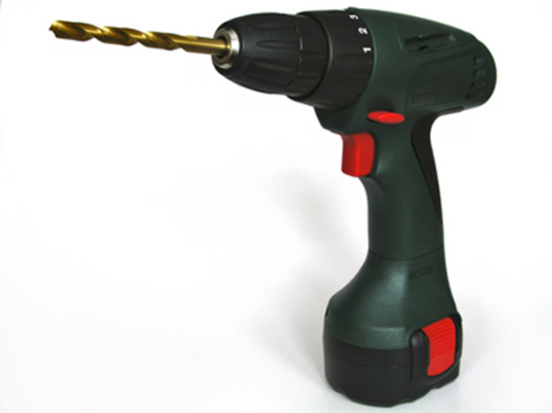

Slide 5
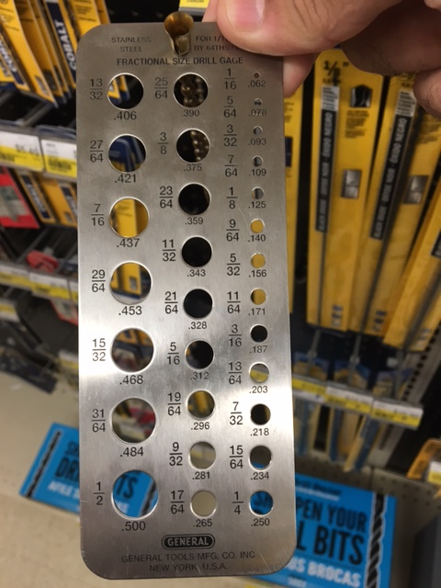
Some microscopes are not fitting together perfectly!
This can be fixed easily but you will need a DRILL and LARGE DRILL BIT (size 7/16 or .437)

Slide 6
7/16 or .437 size drill bit
Drill larger holes in the four corners of the wood and Plexiglas. This will give you more flexibility when putting it together.
There are already holes there. You are just making the holes larger.
Also, drill larger holes on the smaller “platform” piece of Plexiglas (2 x 10 inch). This will make sure your wingnuts will be able to raise and lower the object being magnified easily.

Slide 7
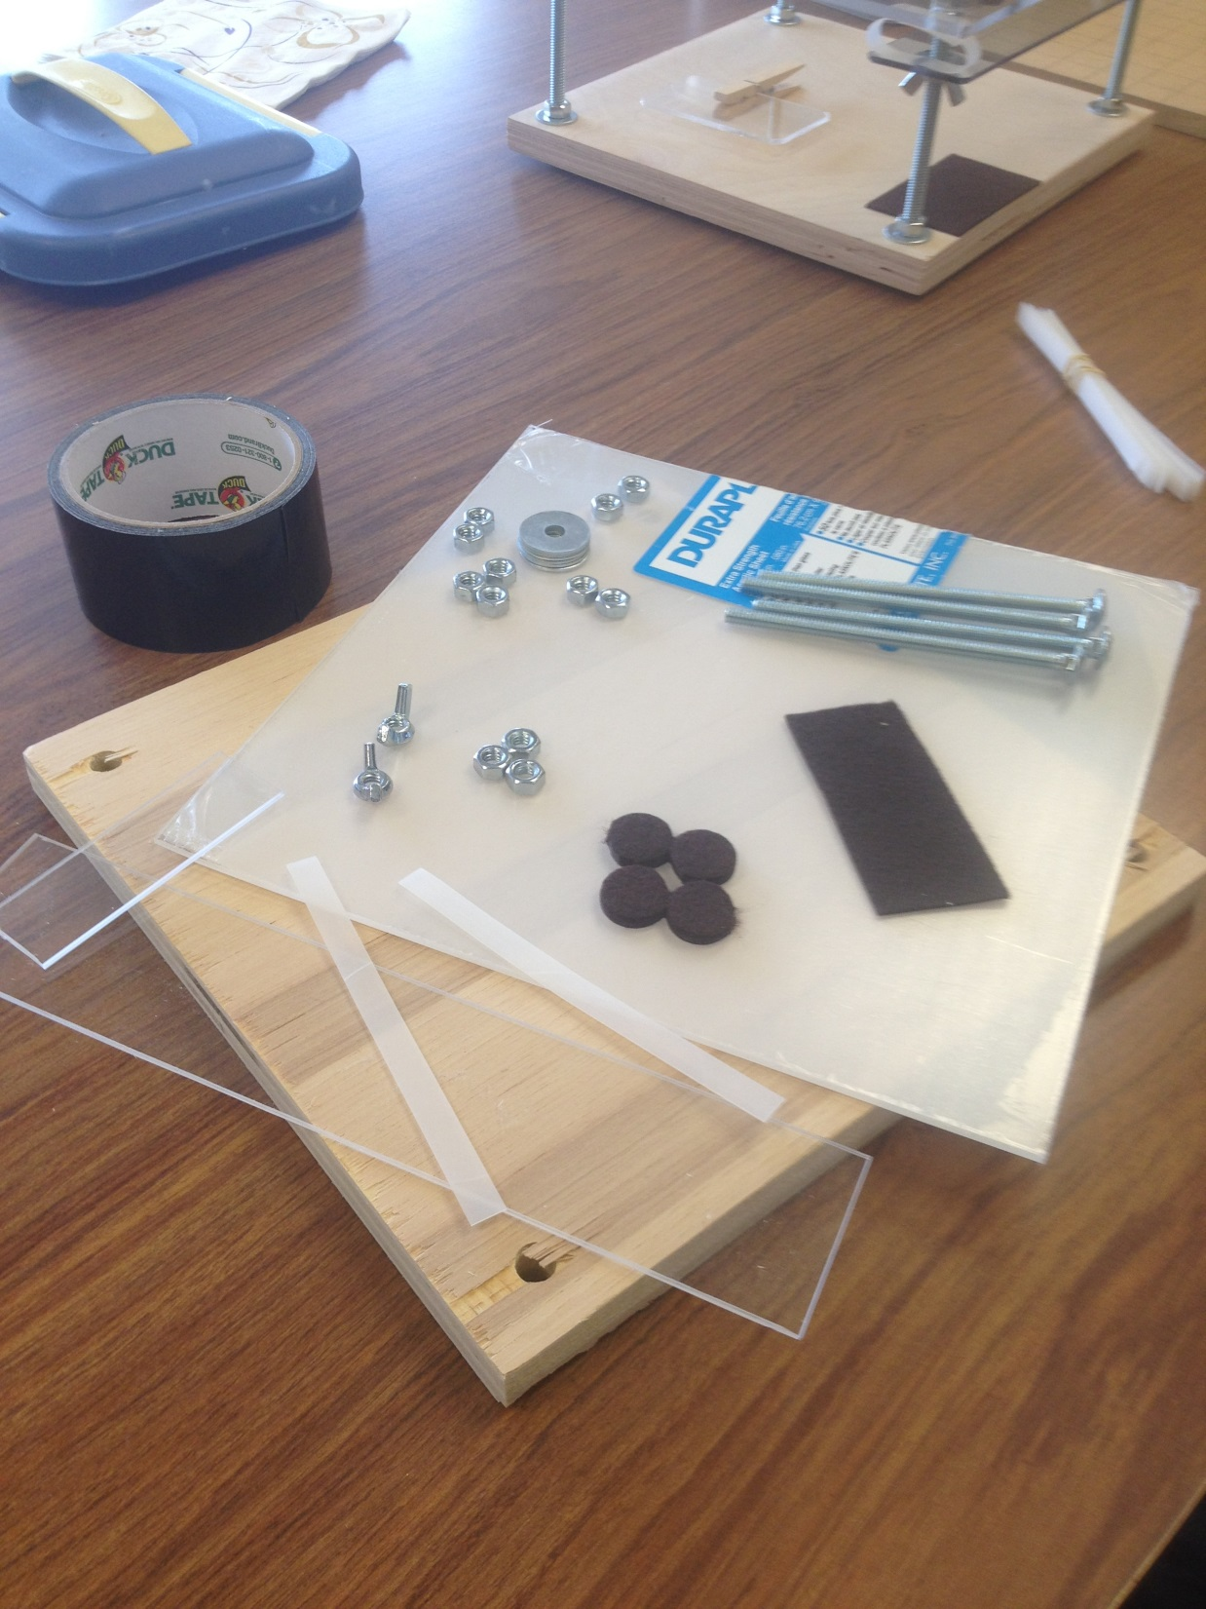

Slide 8
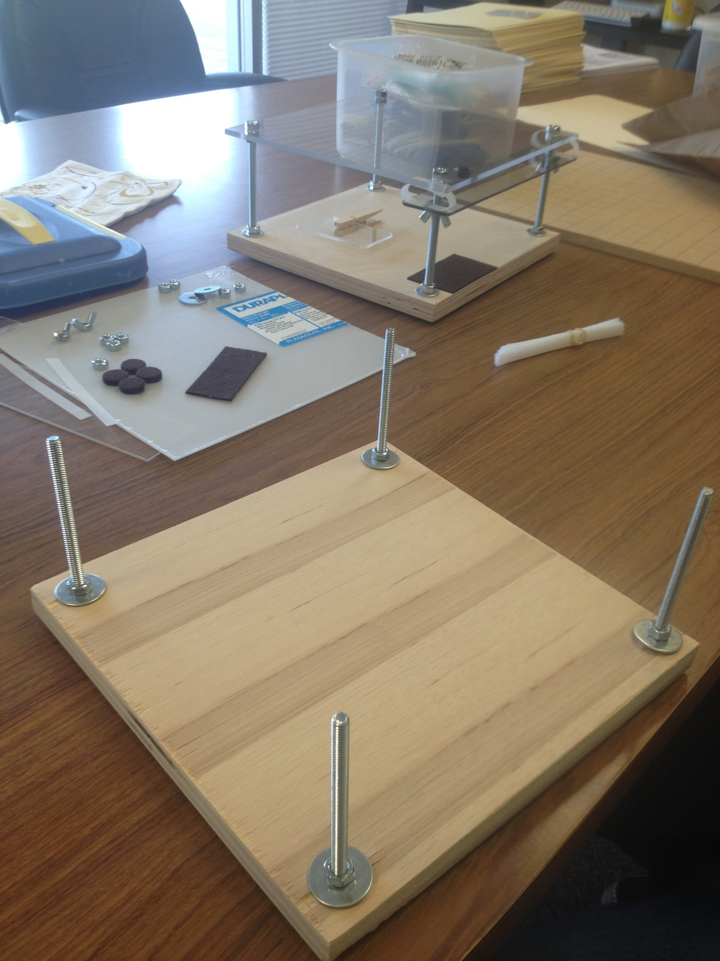

Slide 9
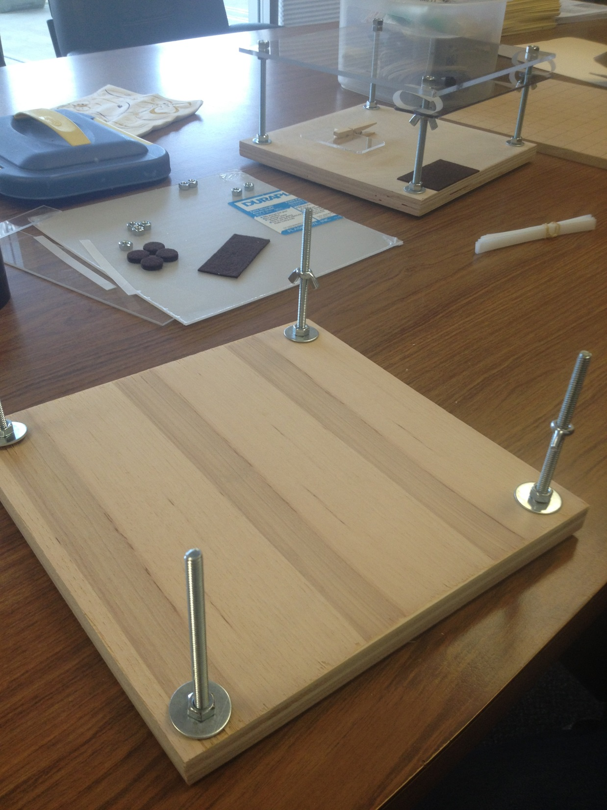

Slide 10
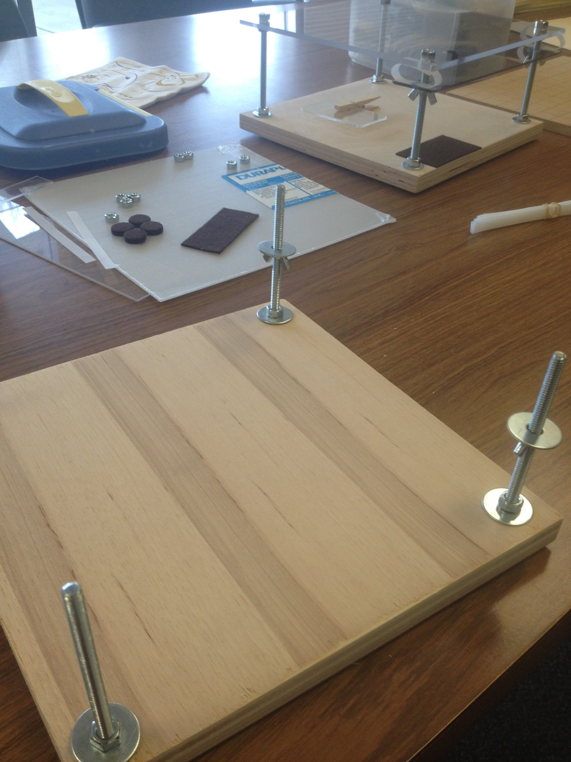

Slide 11
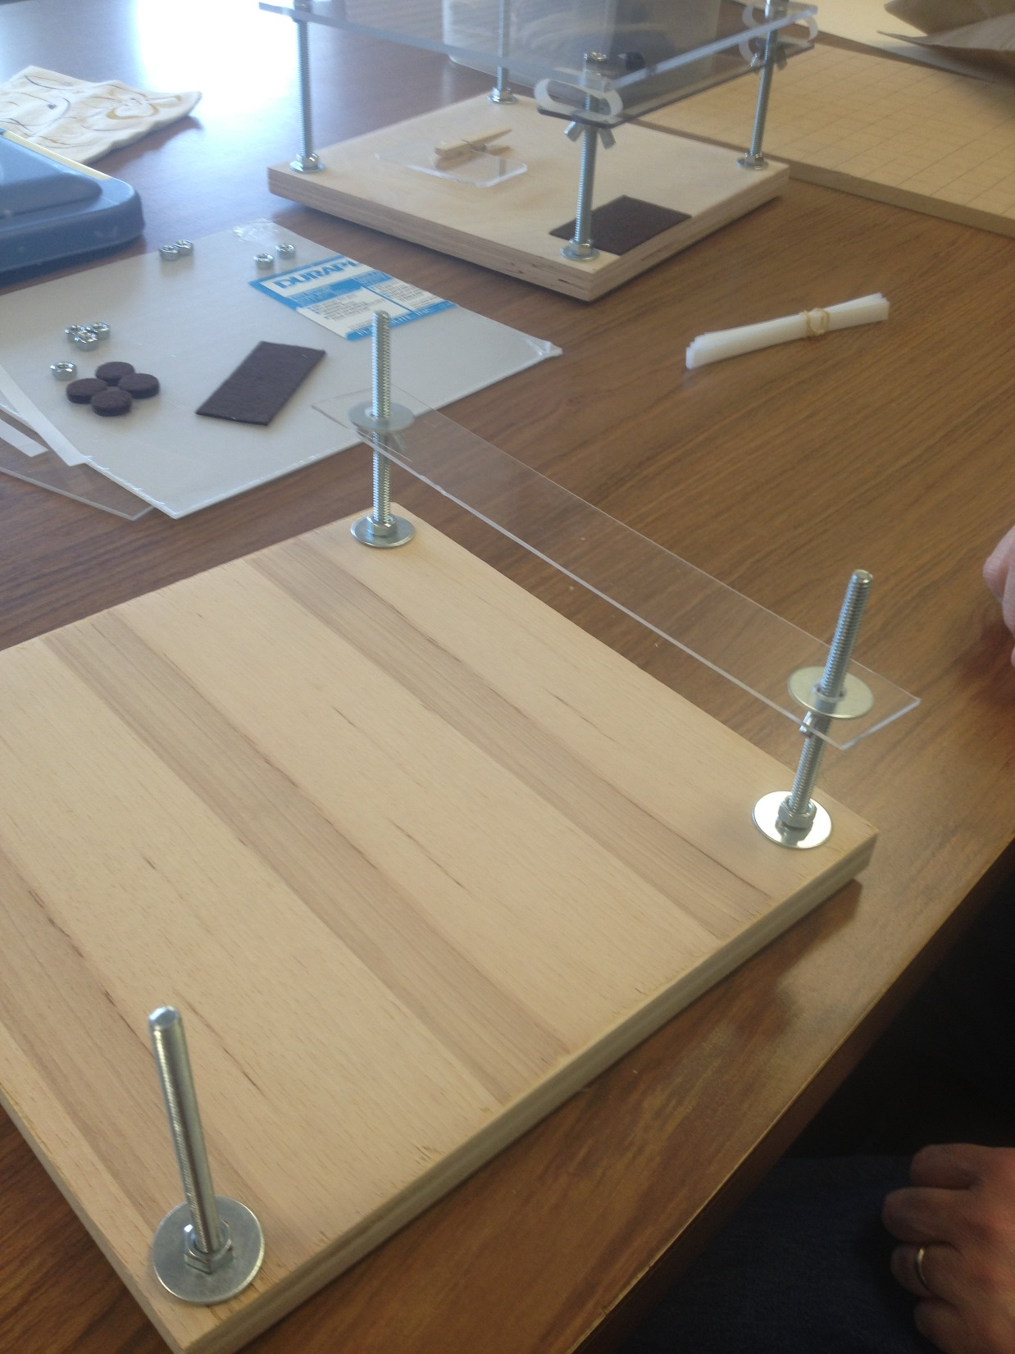

Slide 12
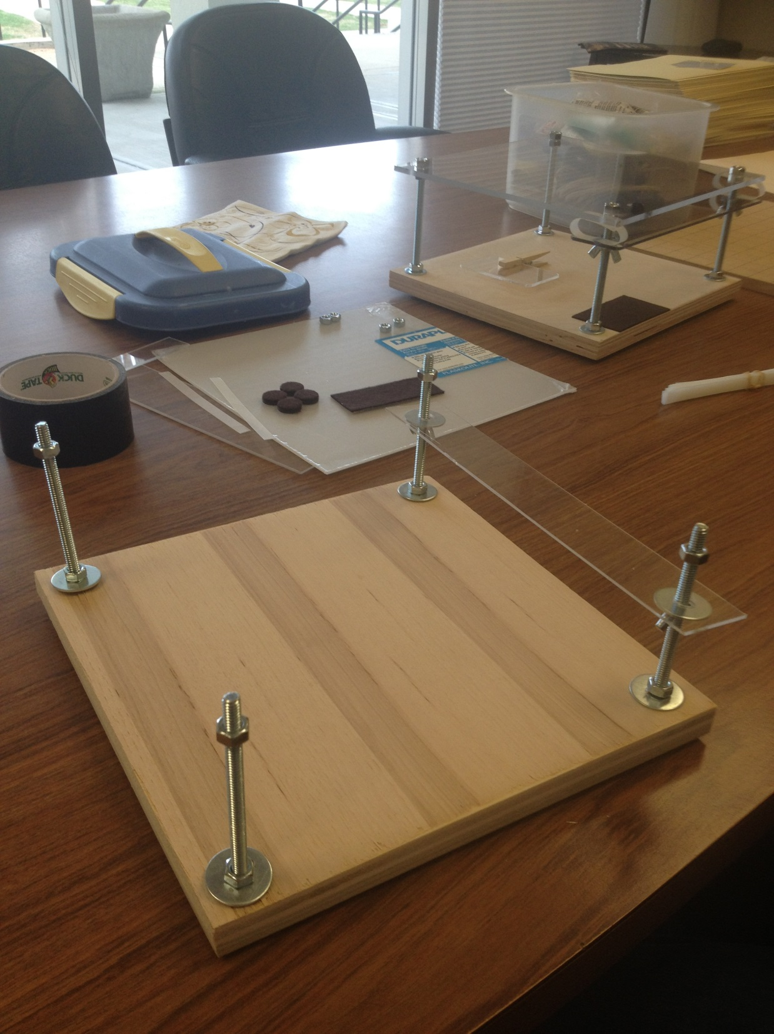

Slide 13
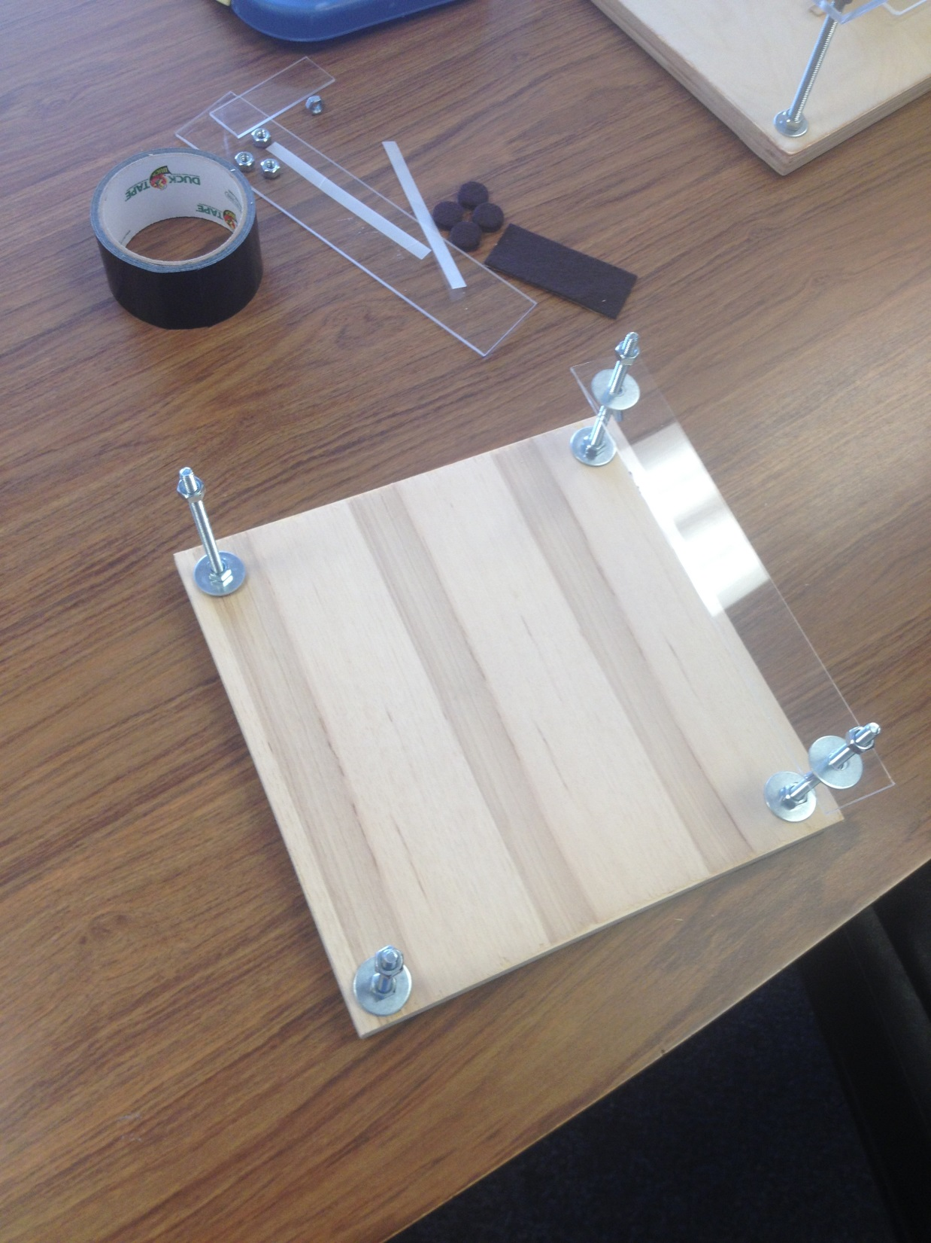

Slide 14
Please locate a drill for the lens
You need to drill the hole for your lens. It is marked with a blue dot on your Plexiglas.
If you drill a hole that is too big you can use poster putty to hold in place. If the hole is a tight fit you can go ahead and use hot glue.

Slide 15
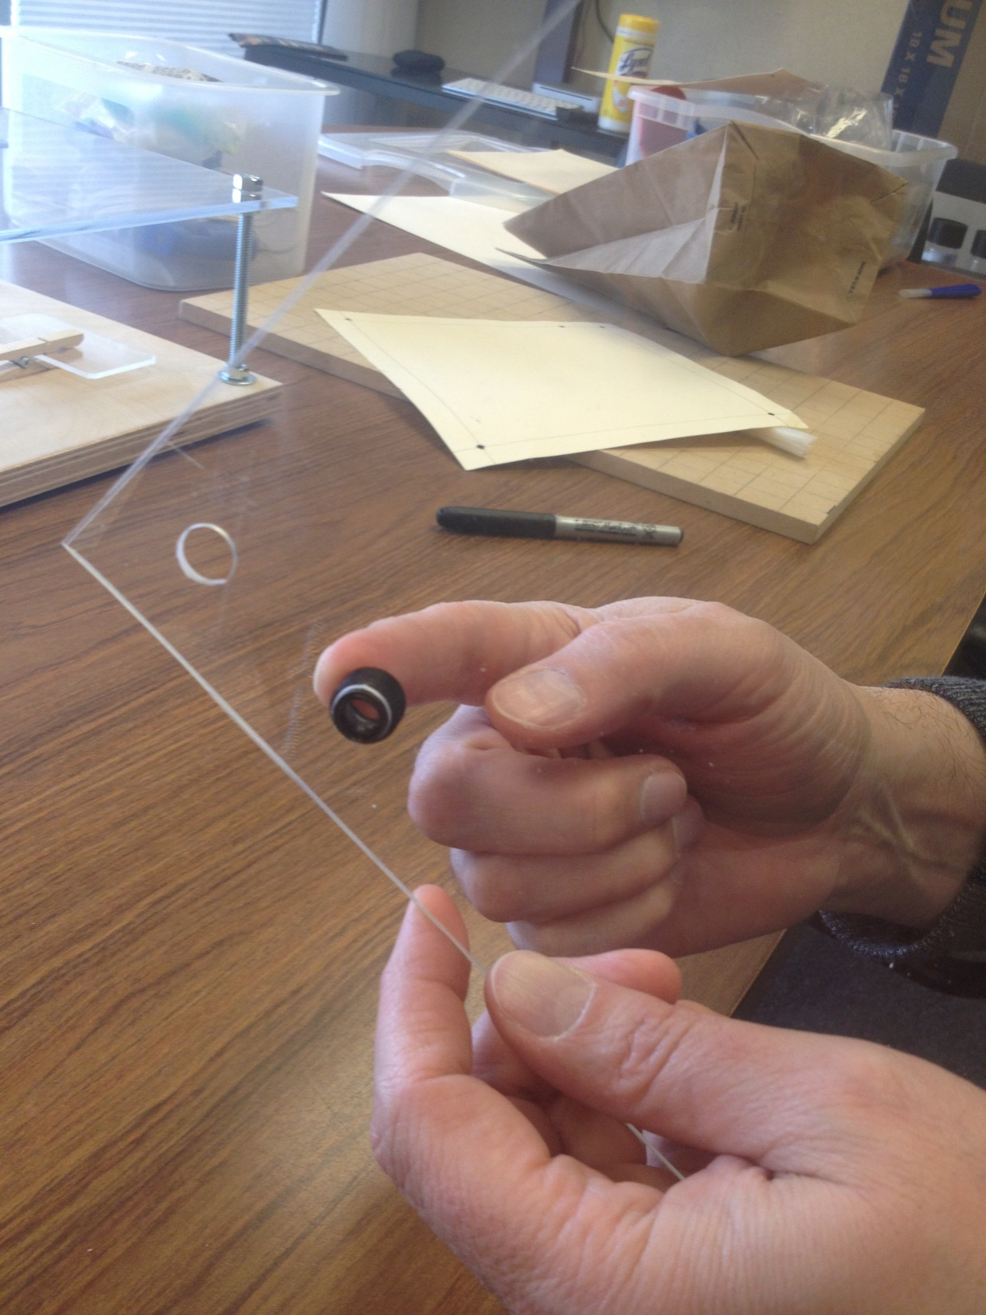

Slide 16
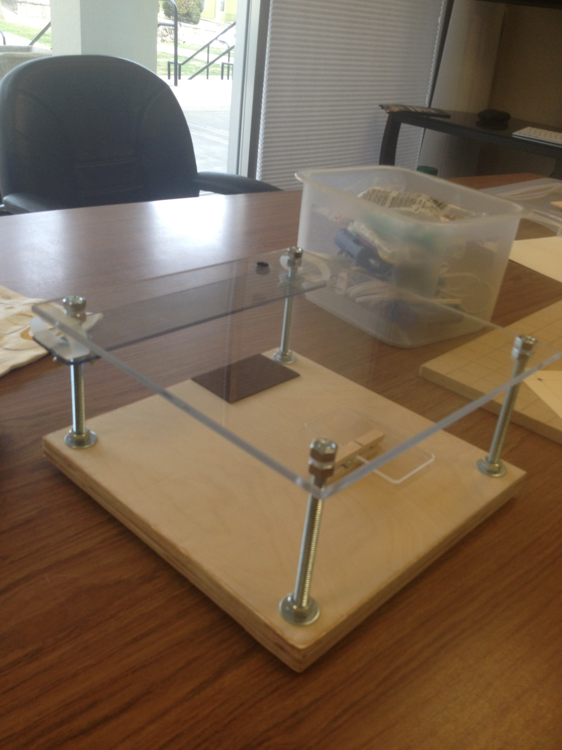

Slide 17
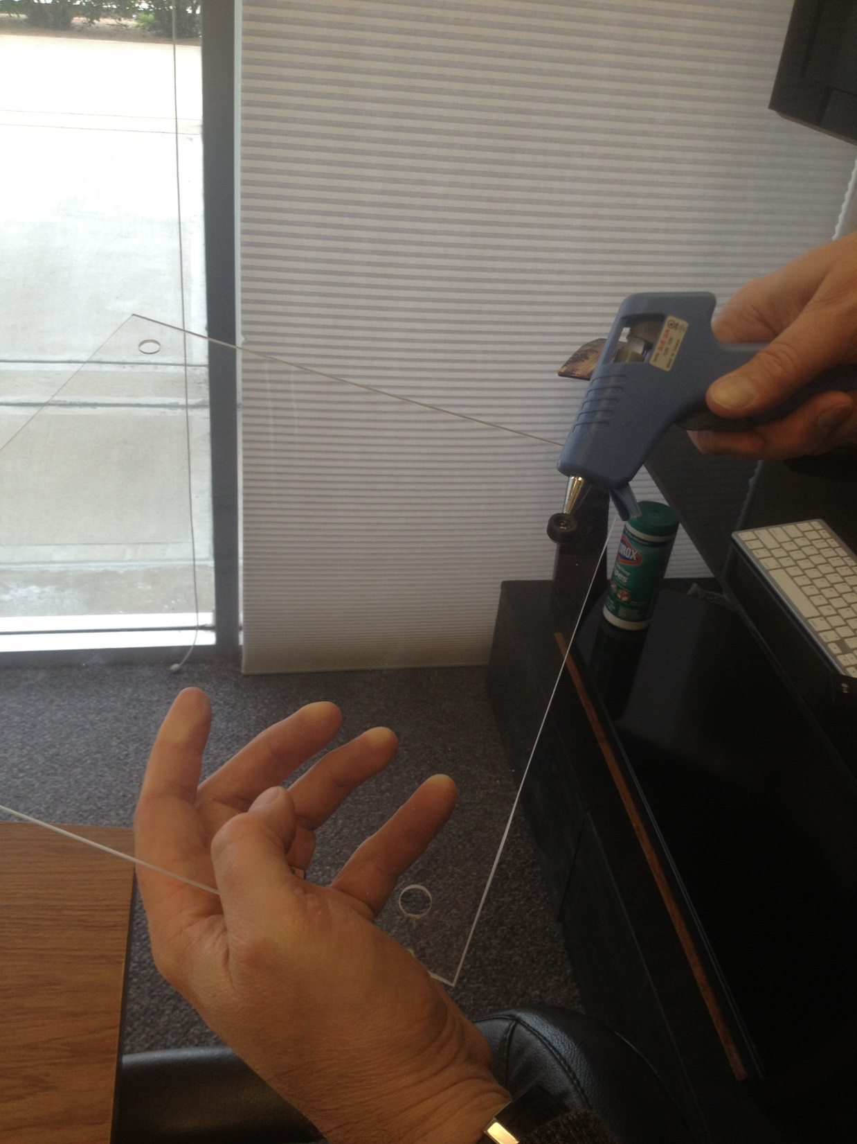

Slide 18
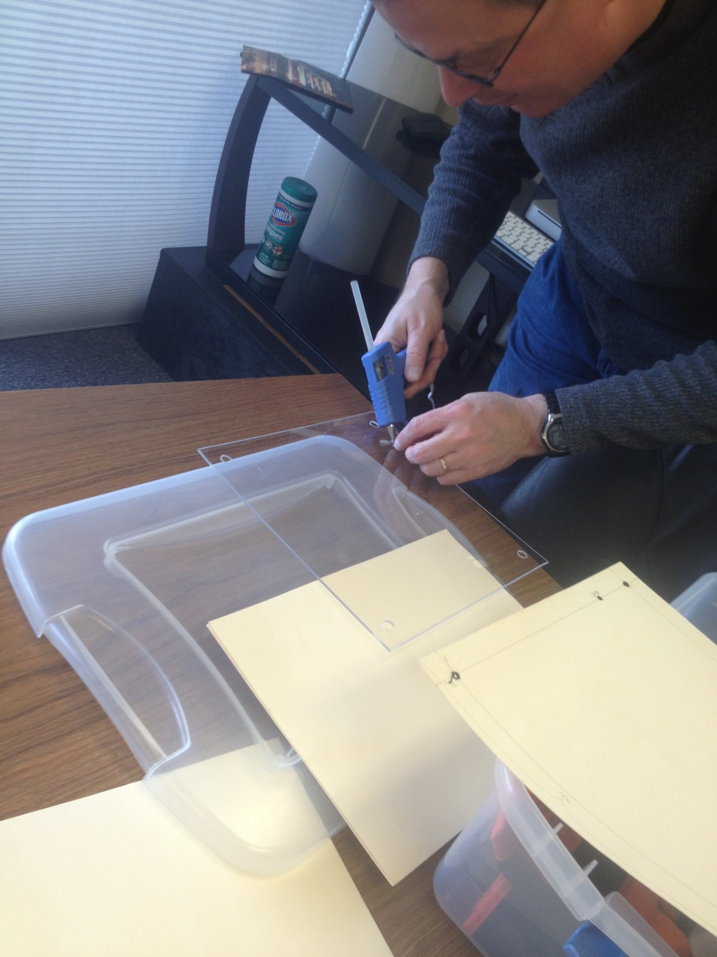

Slide 19
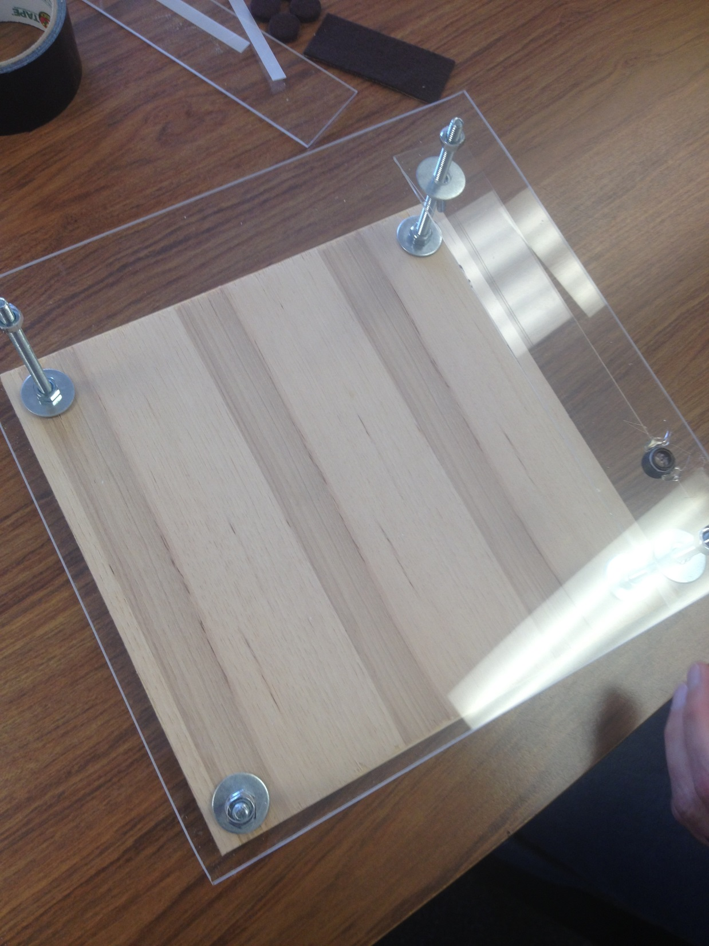

Slide 20
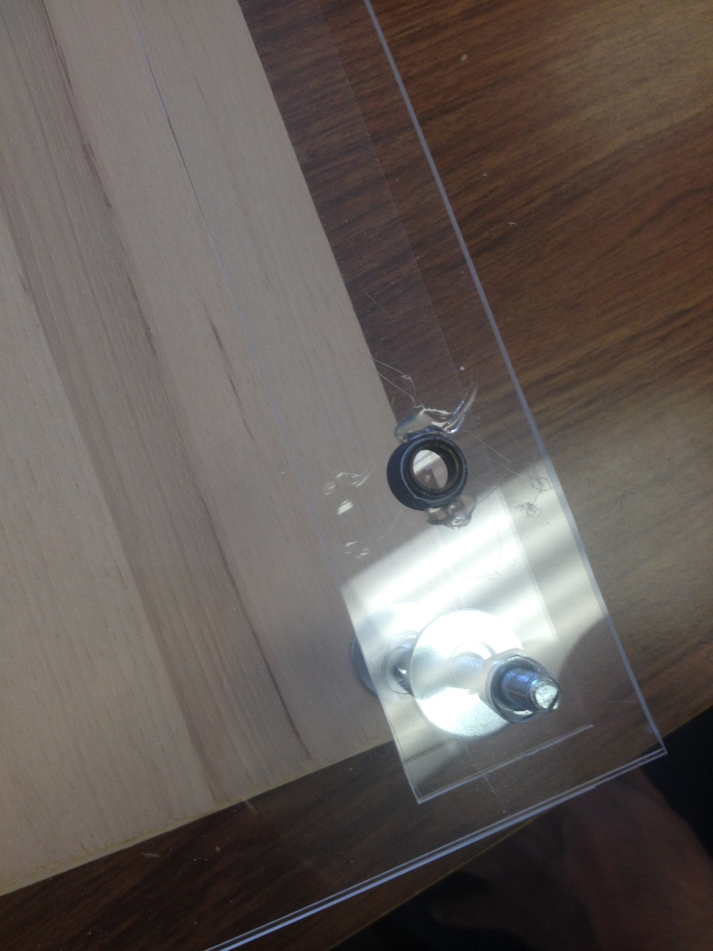

Slide 21
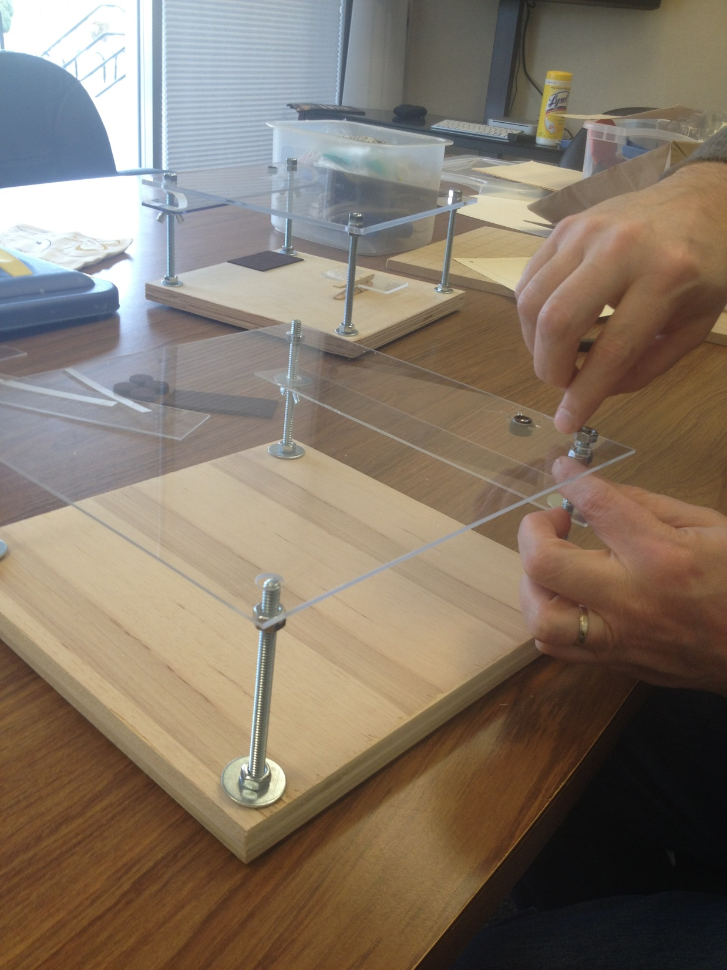

Slide 22
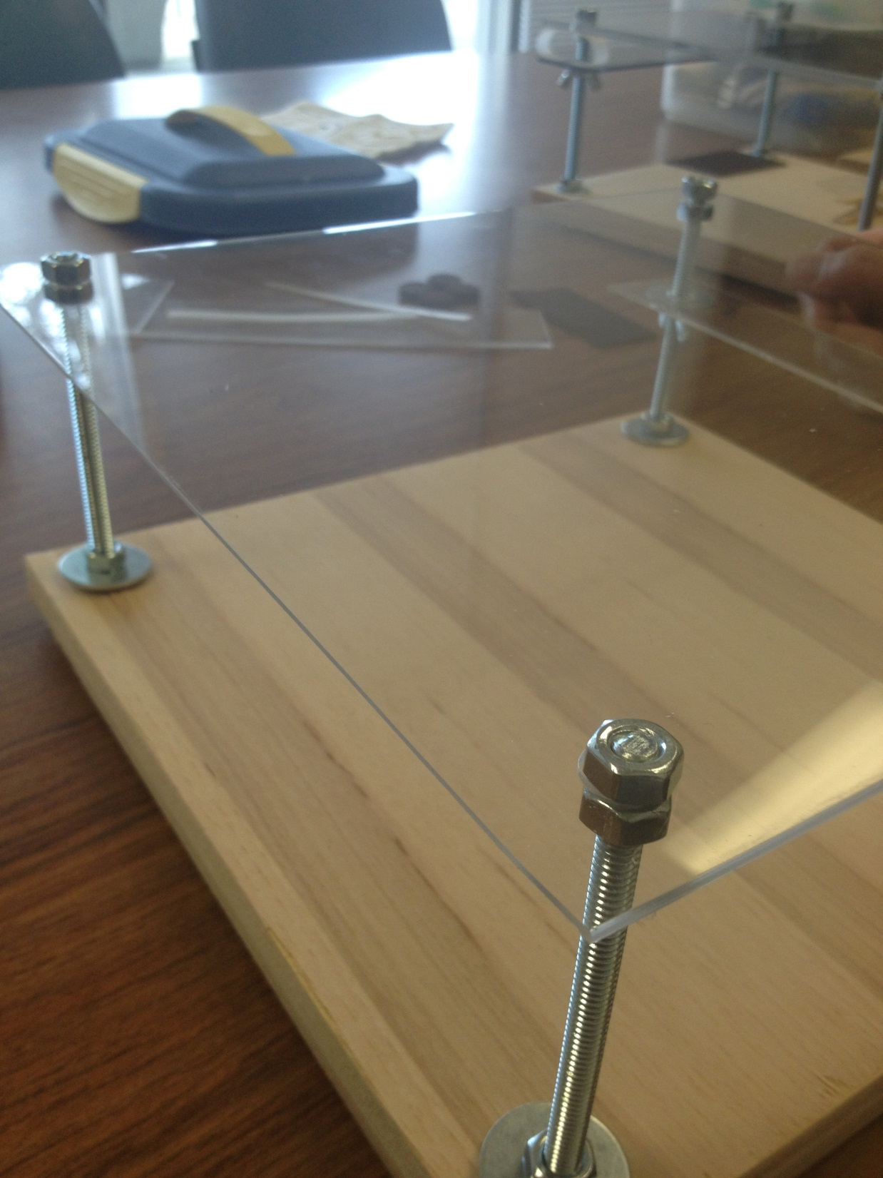

Slide 23
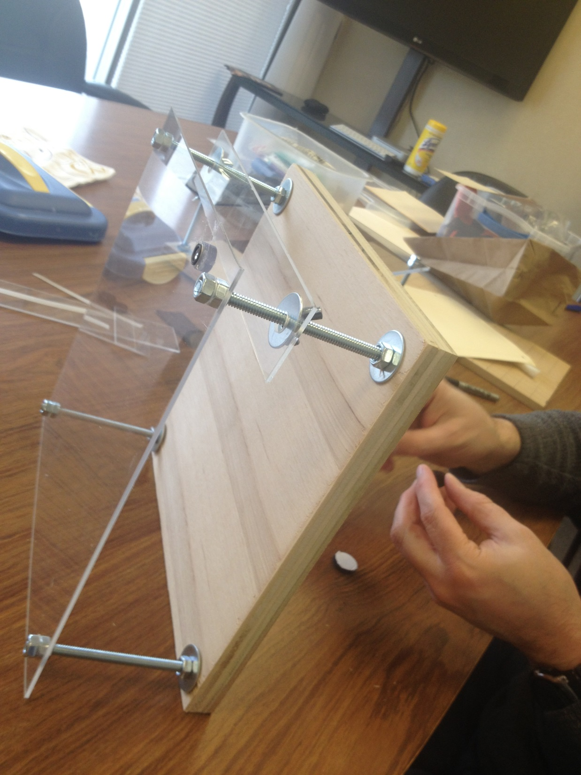

Slide 24
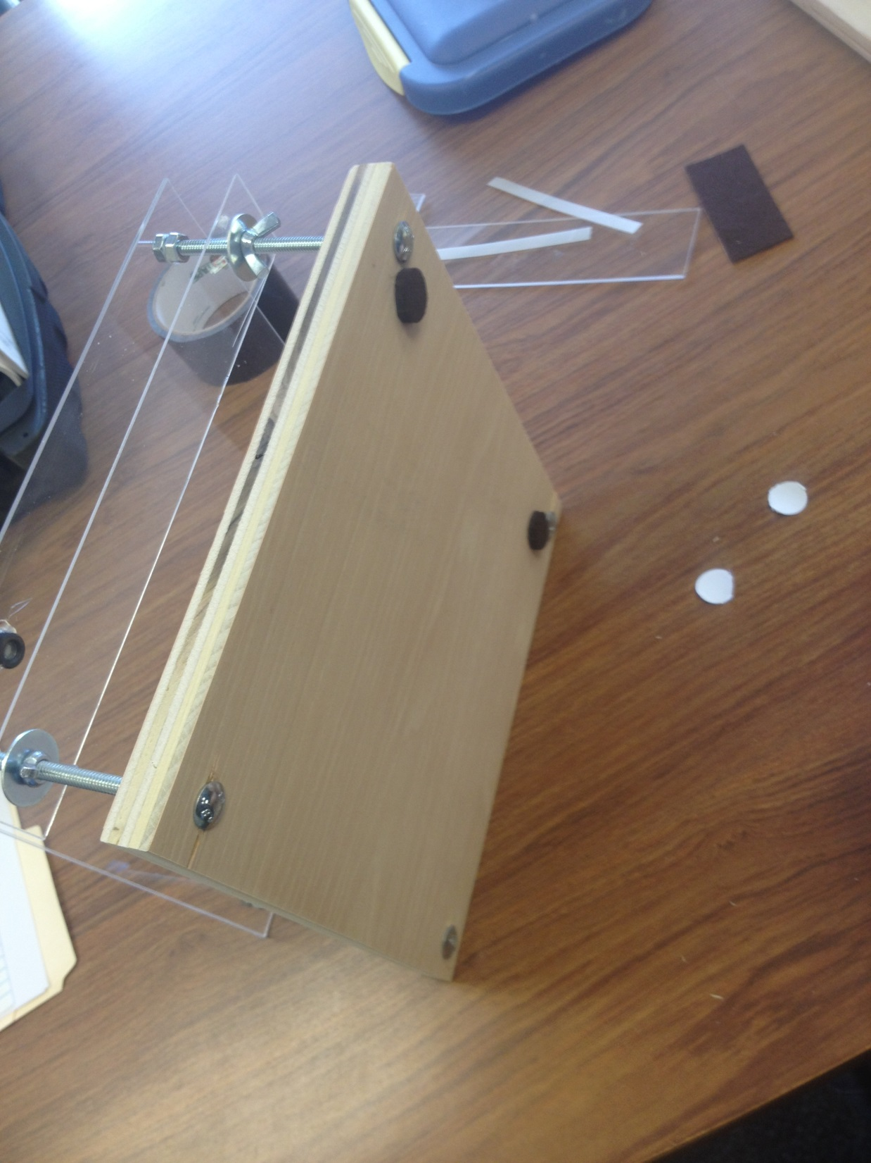

Slide 25
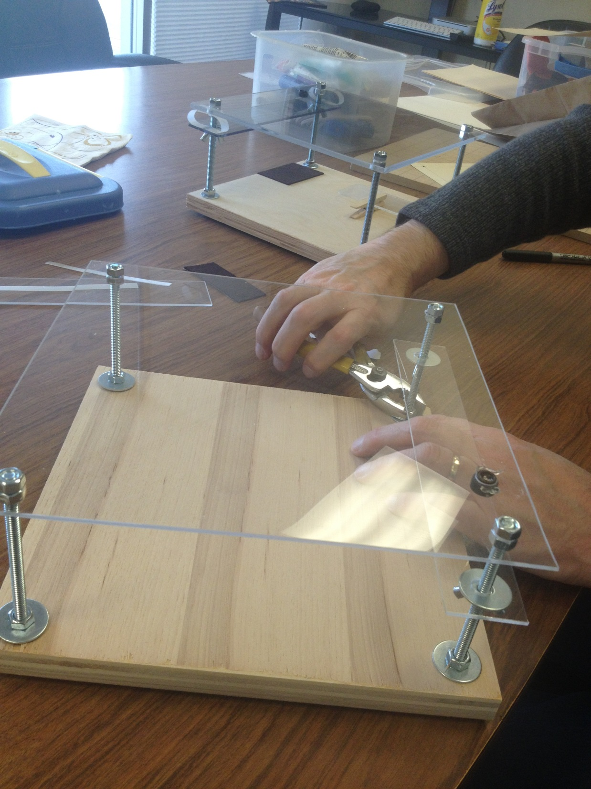

Slide 26
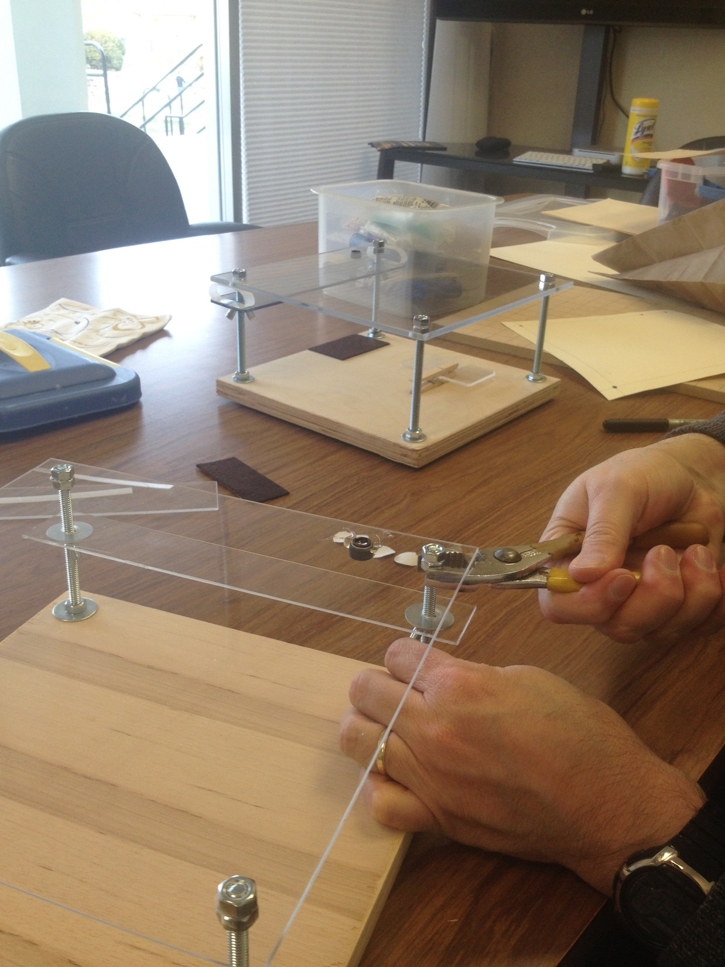

Slide 27
The black tape or dark felt is used to give a dark background behind the image you are magnifying. This will go on the wood directly below the lens.

Slide 28
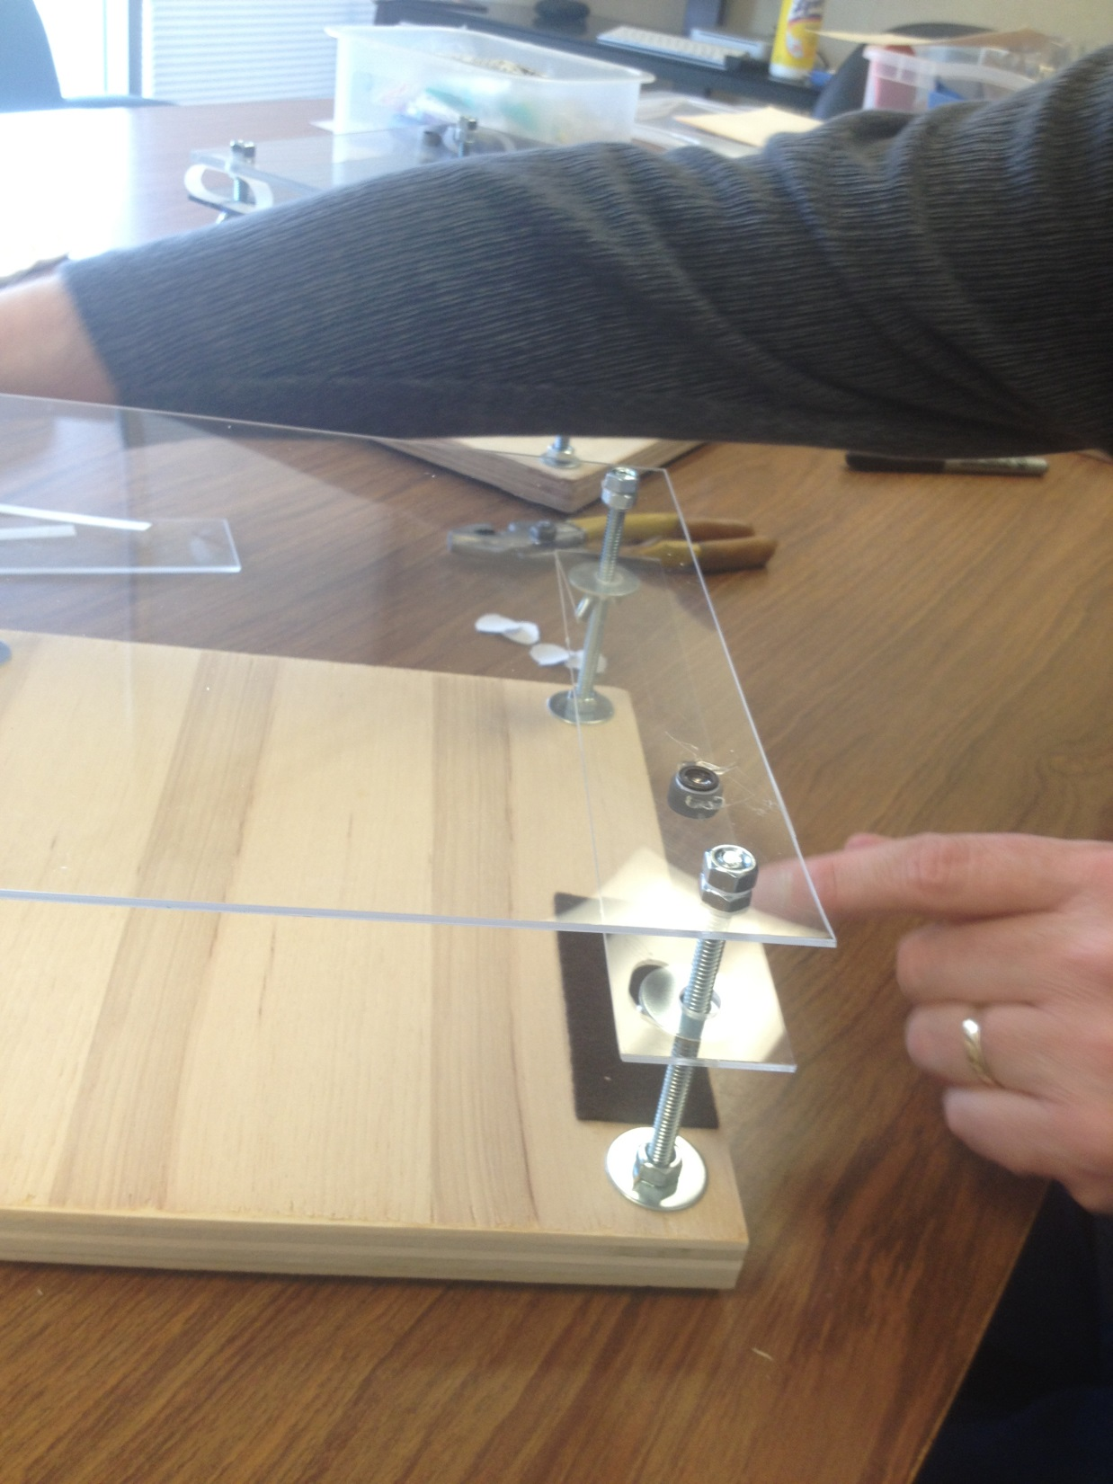

Slide 29
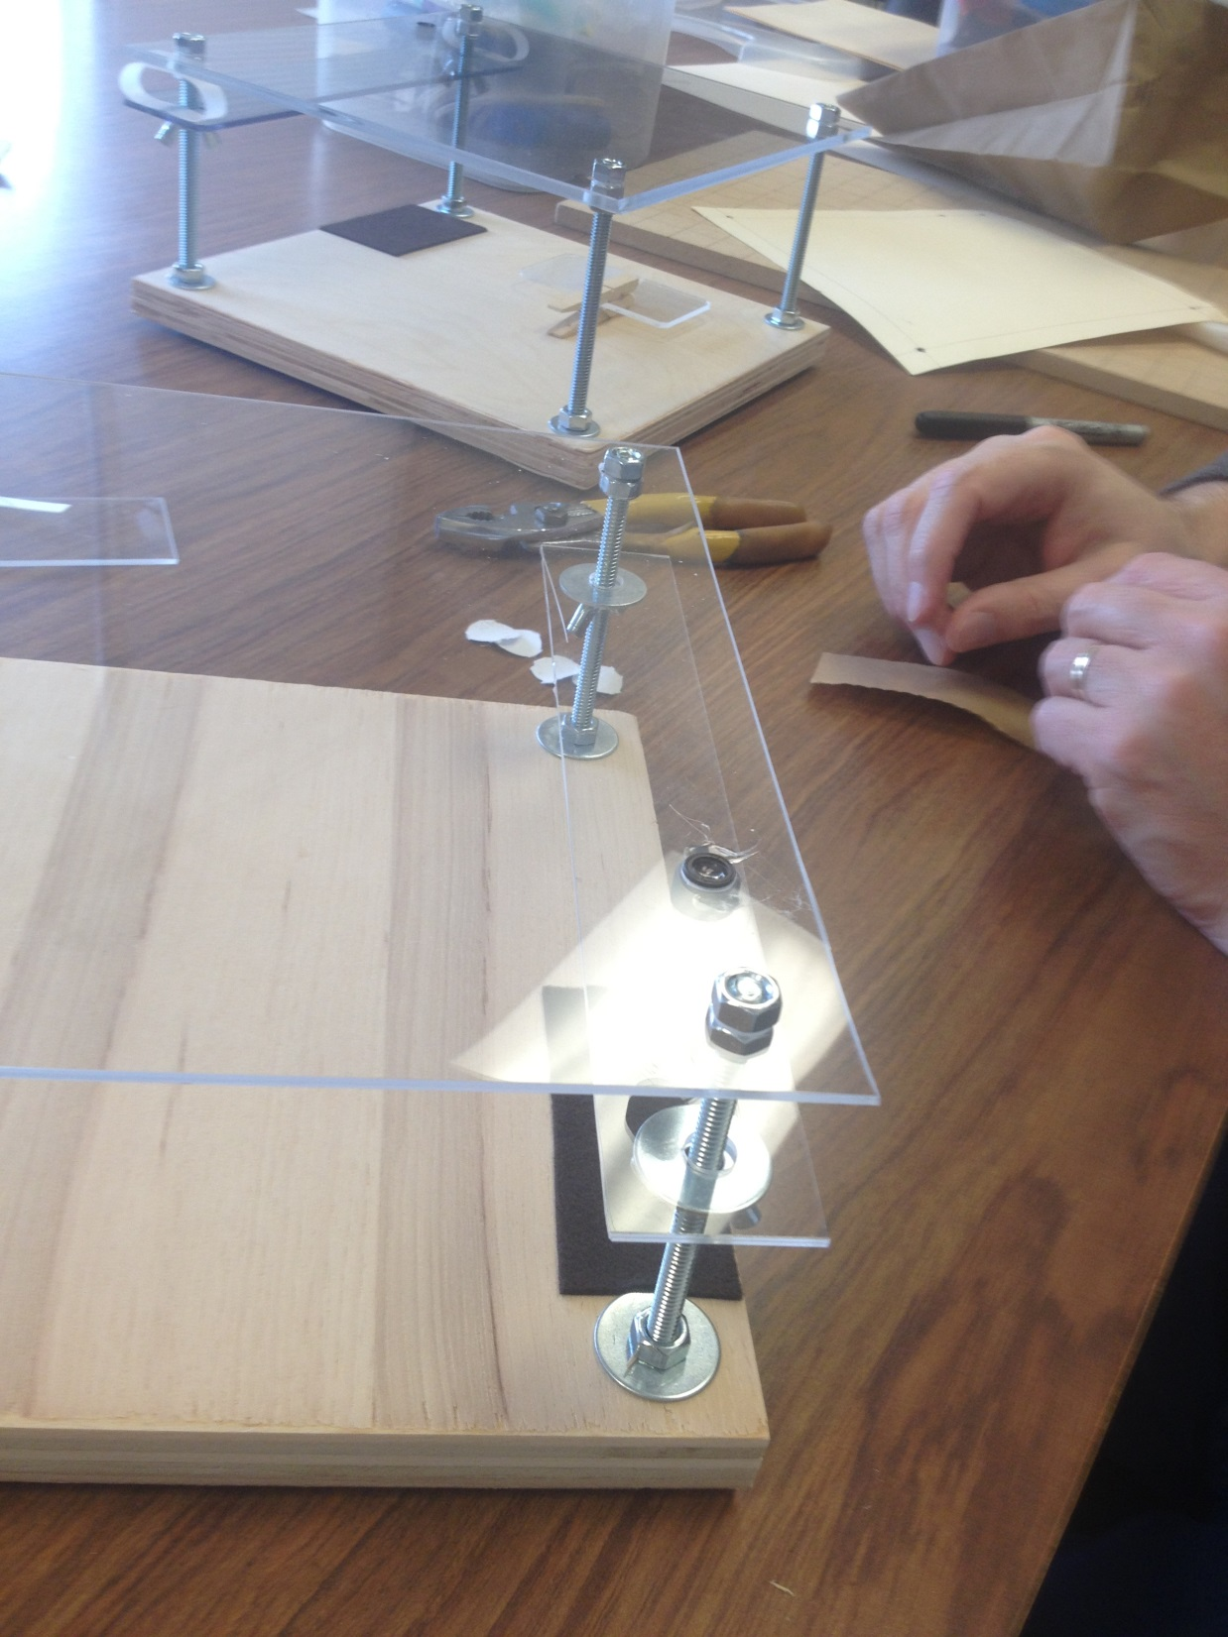

Slide 30
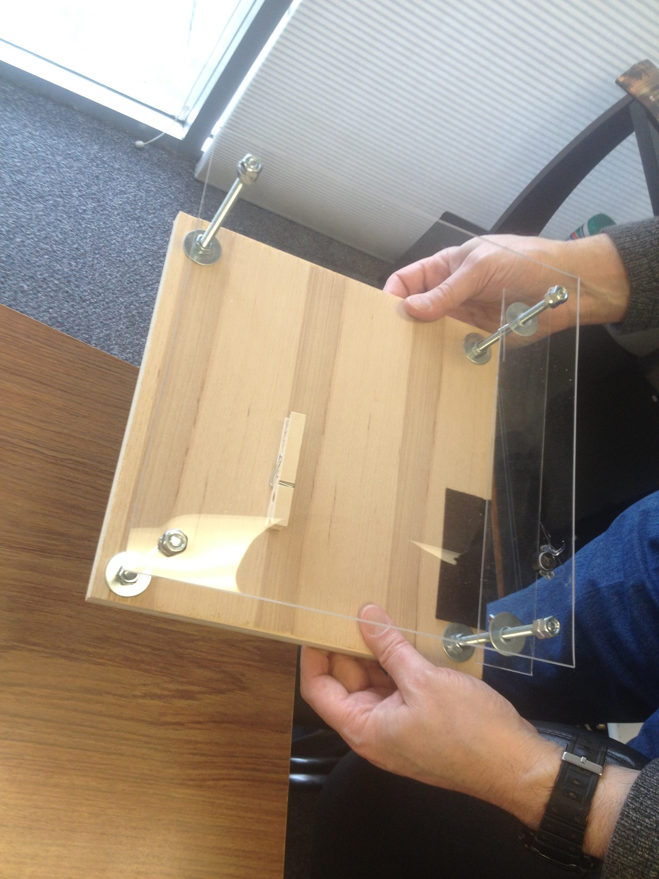

Slide 31
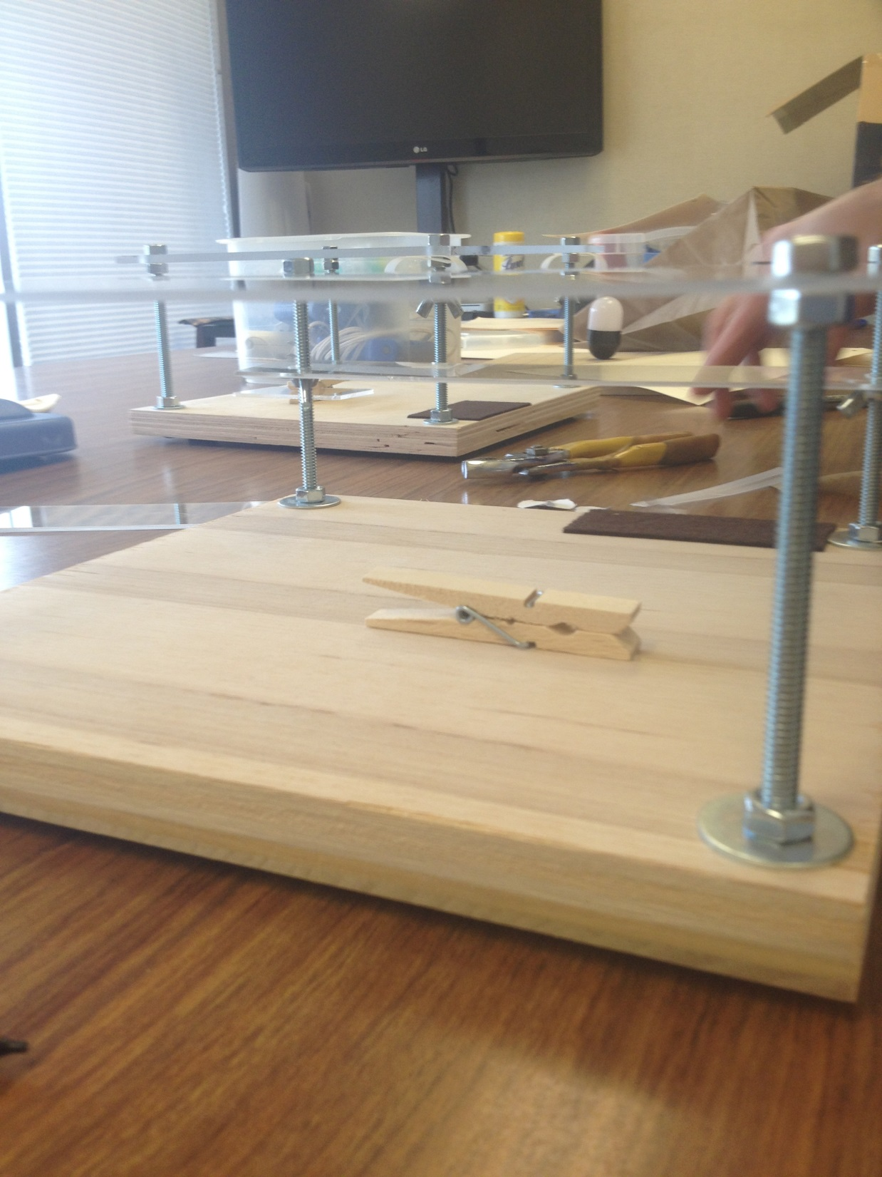

Slide 32
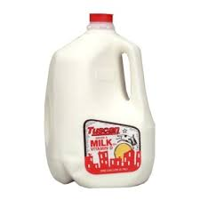
OPTIONAL
You can glue strips of plastic cut from a plastic jug of milk on the deck for stability.

Slide 33
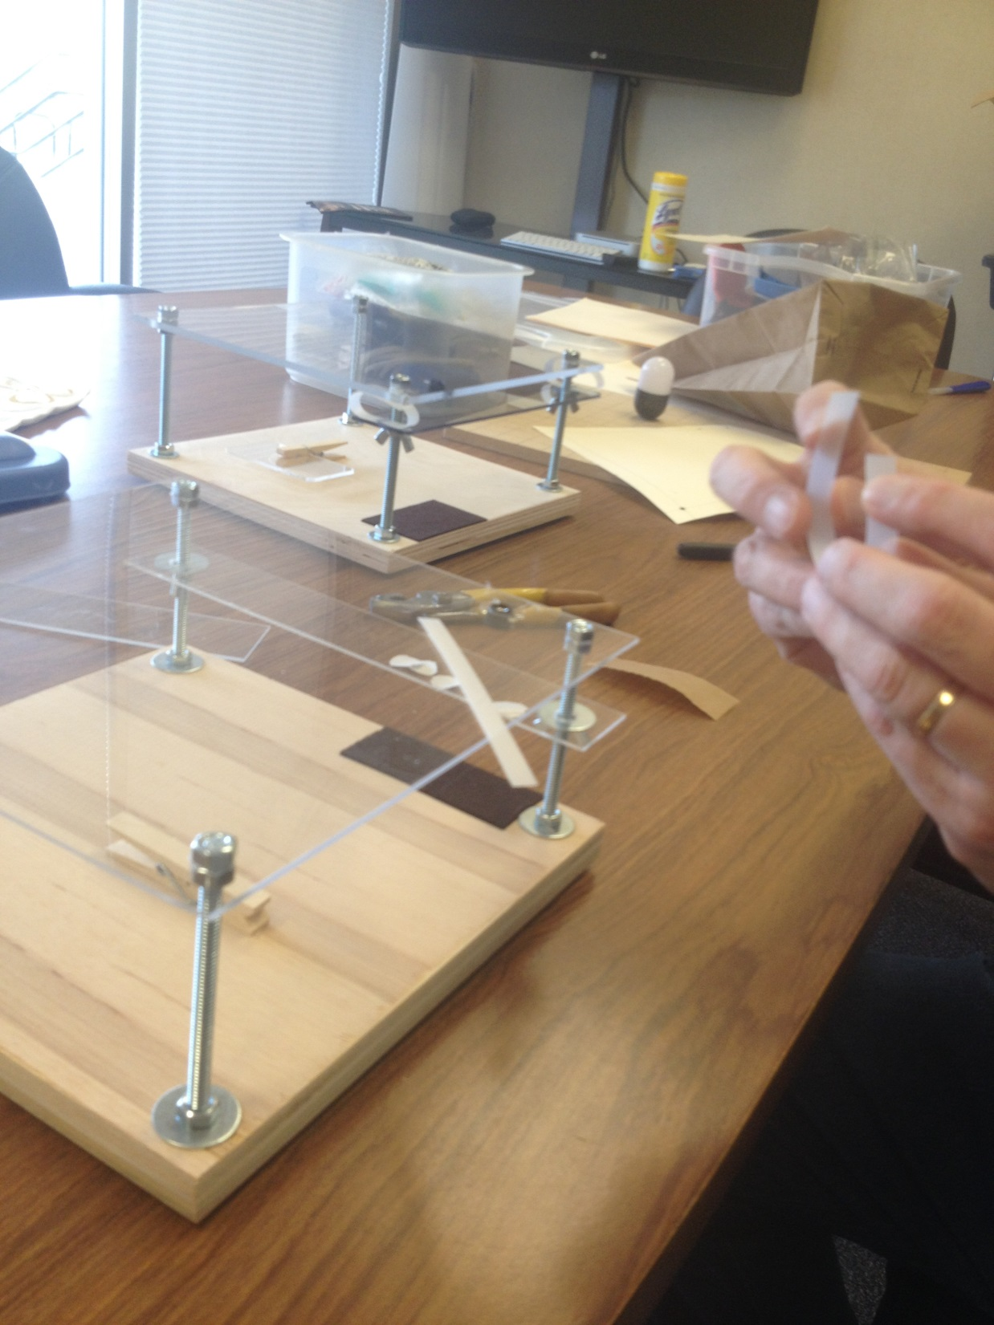

Slide 34
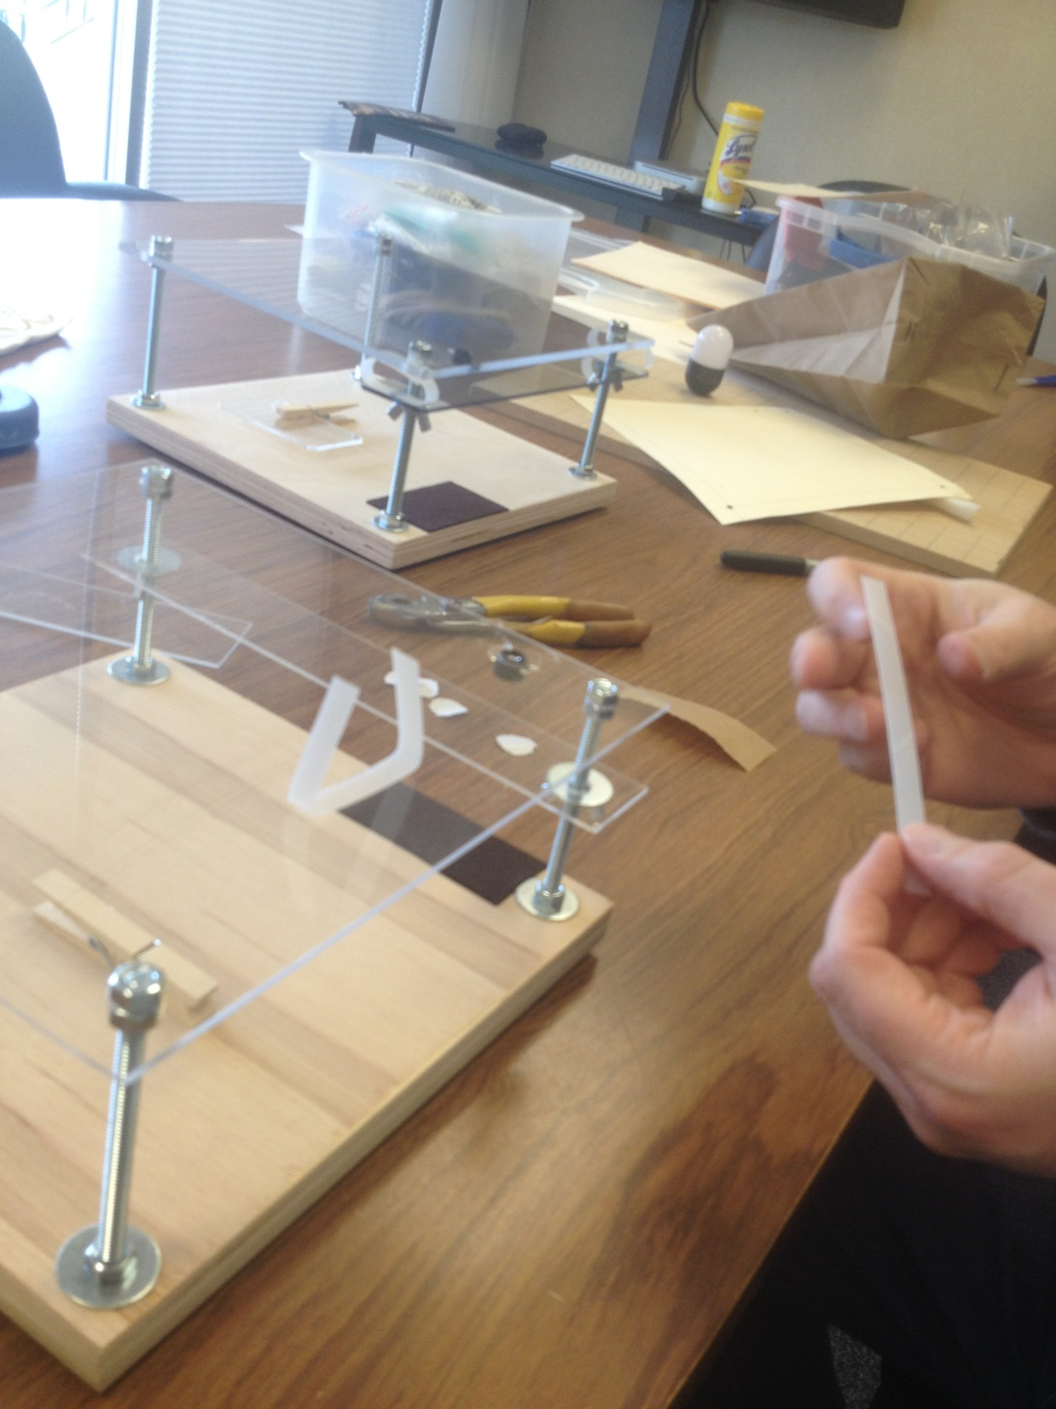

Slide 35
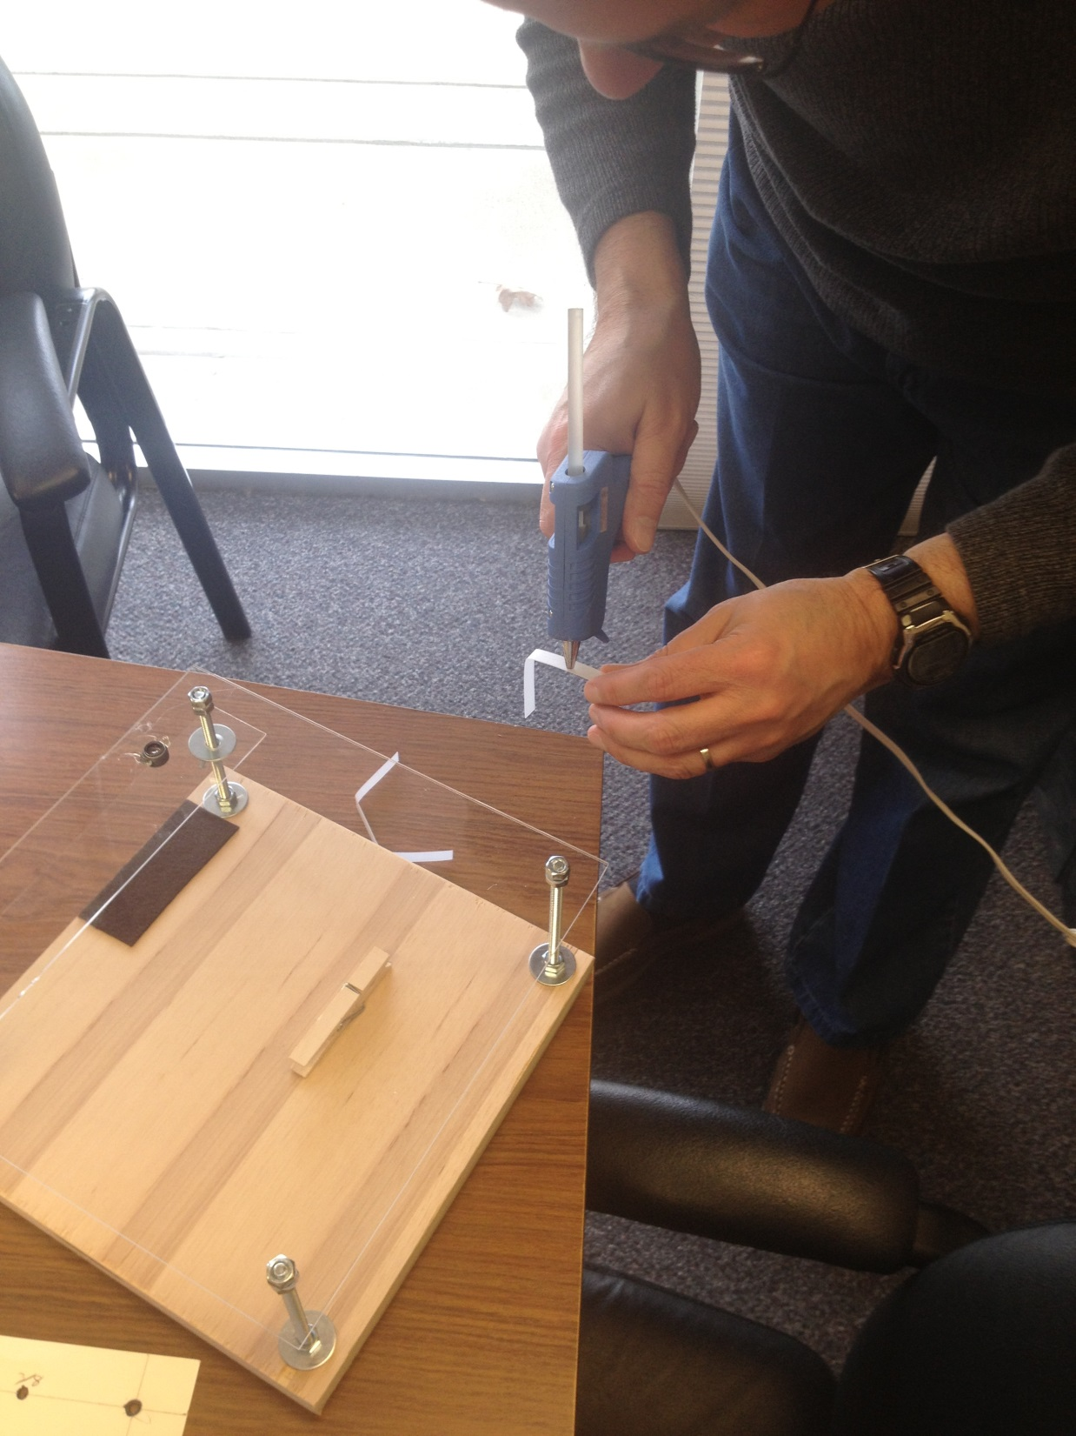

Slide 36
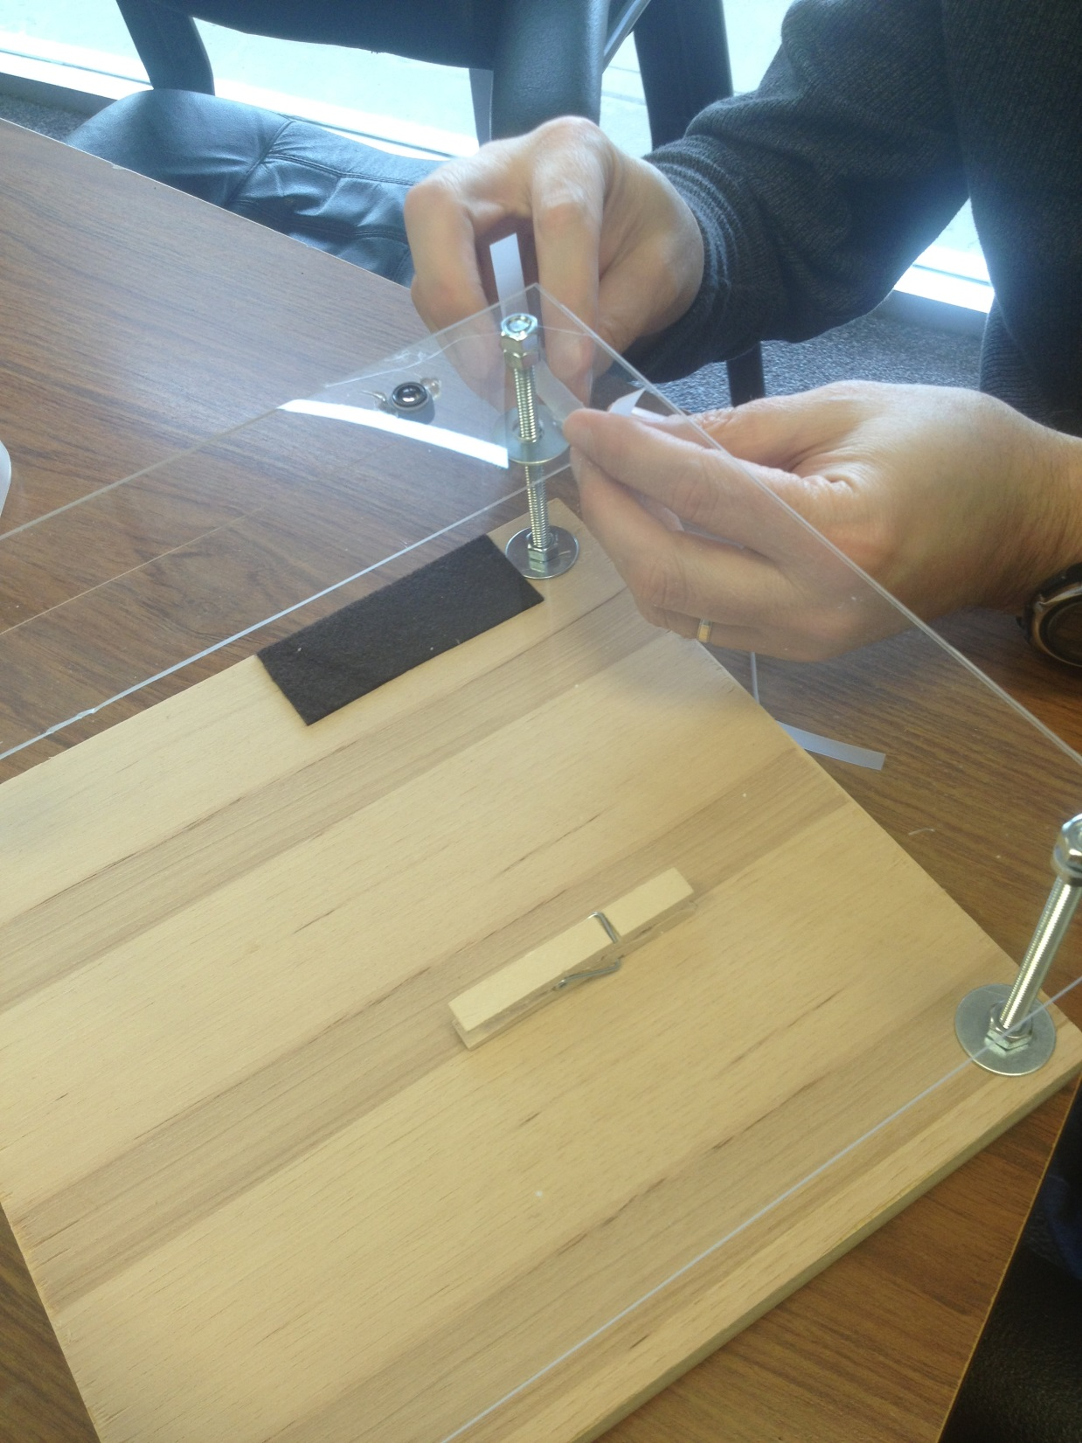

Slide 37
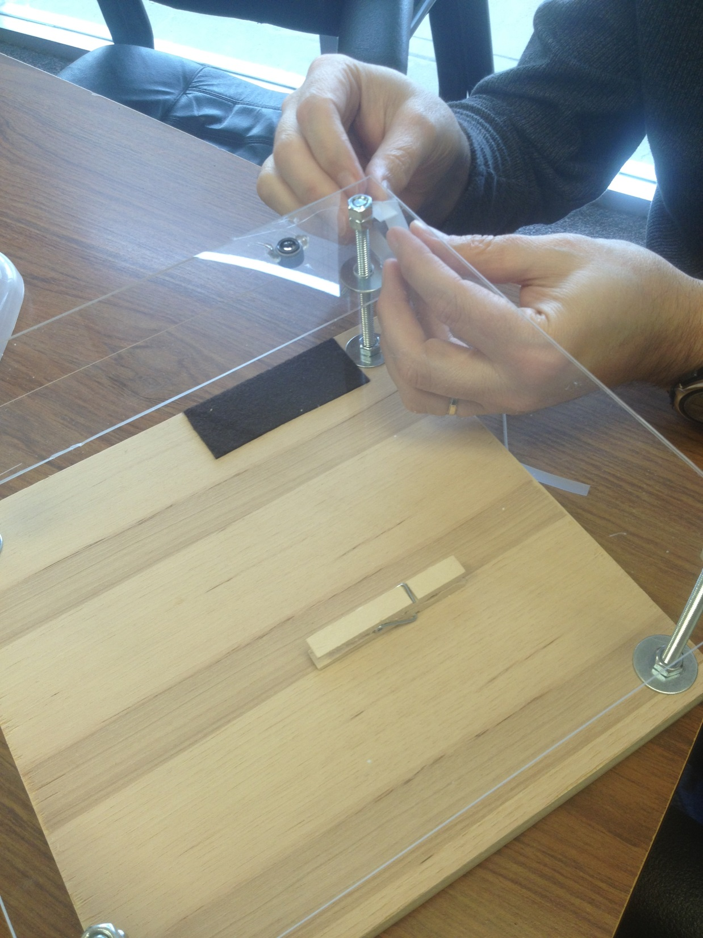

Slide 38
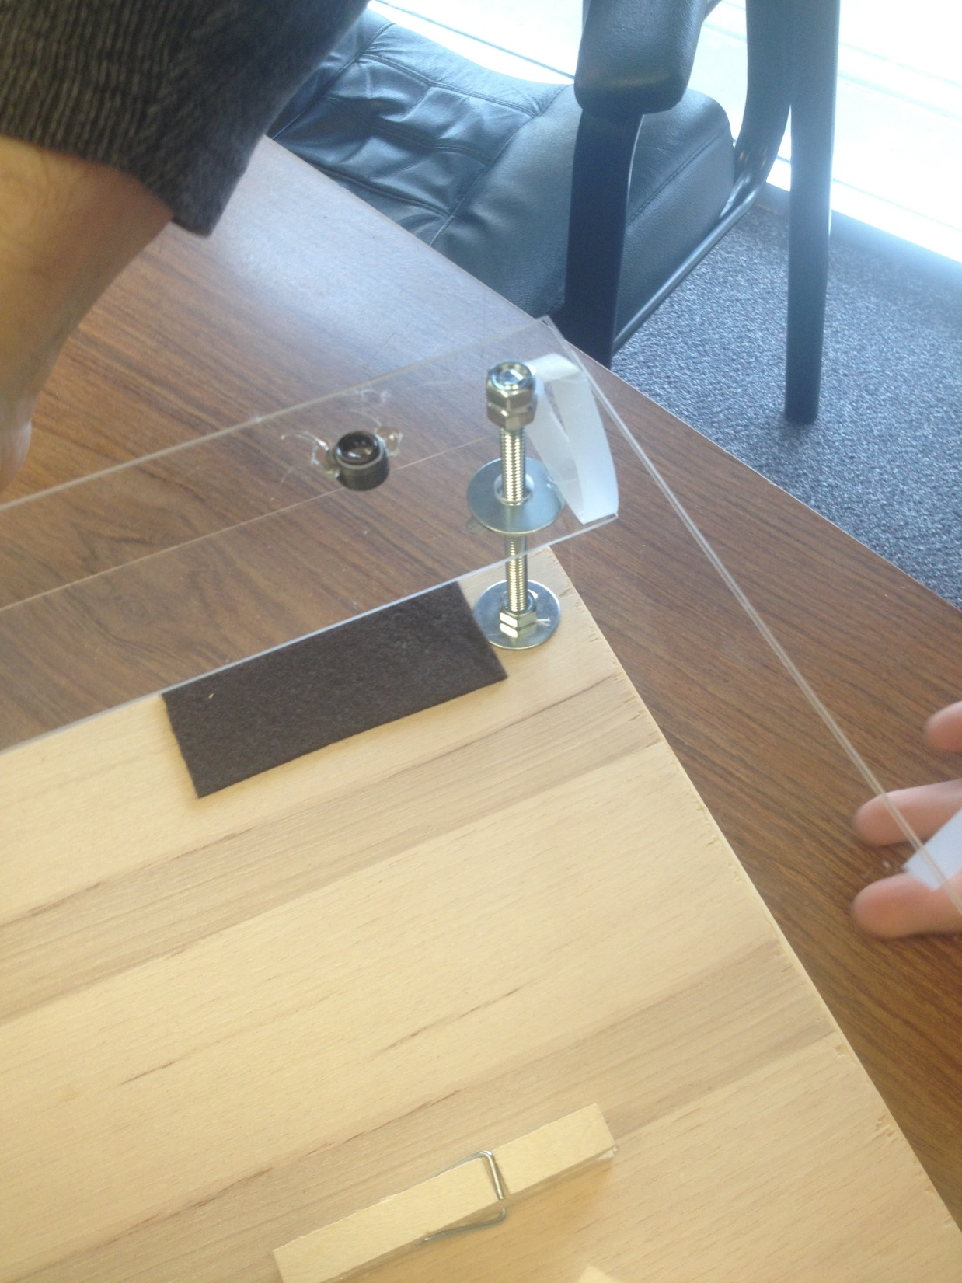

Slide 39
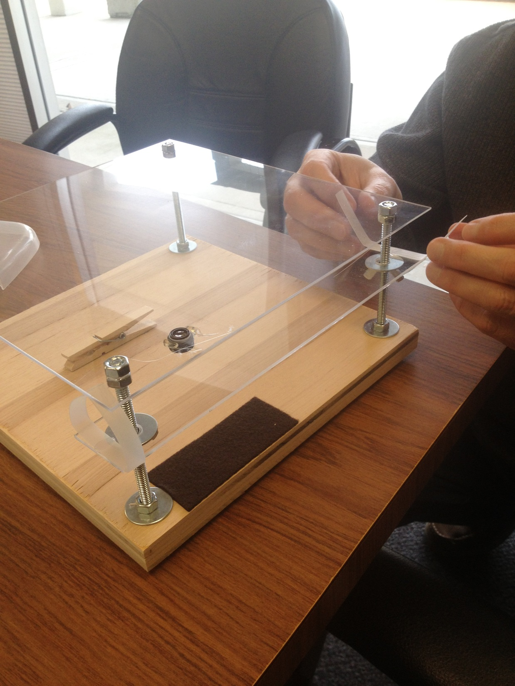

Slide 40
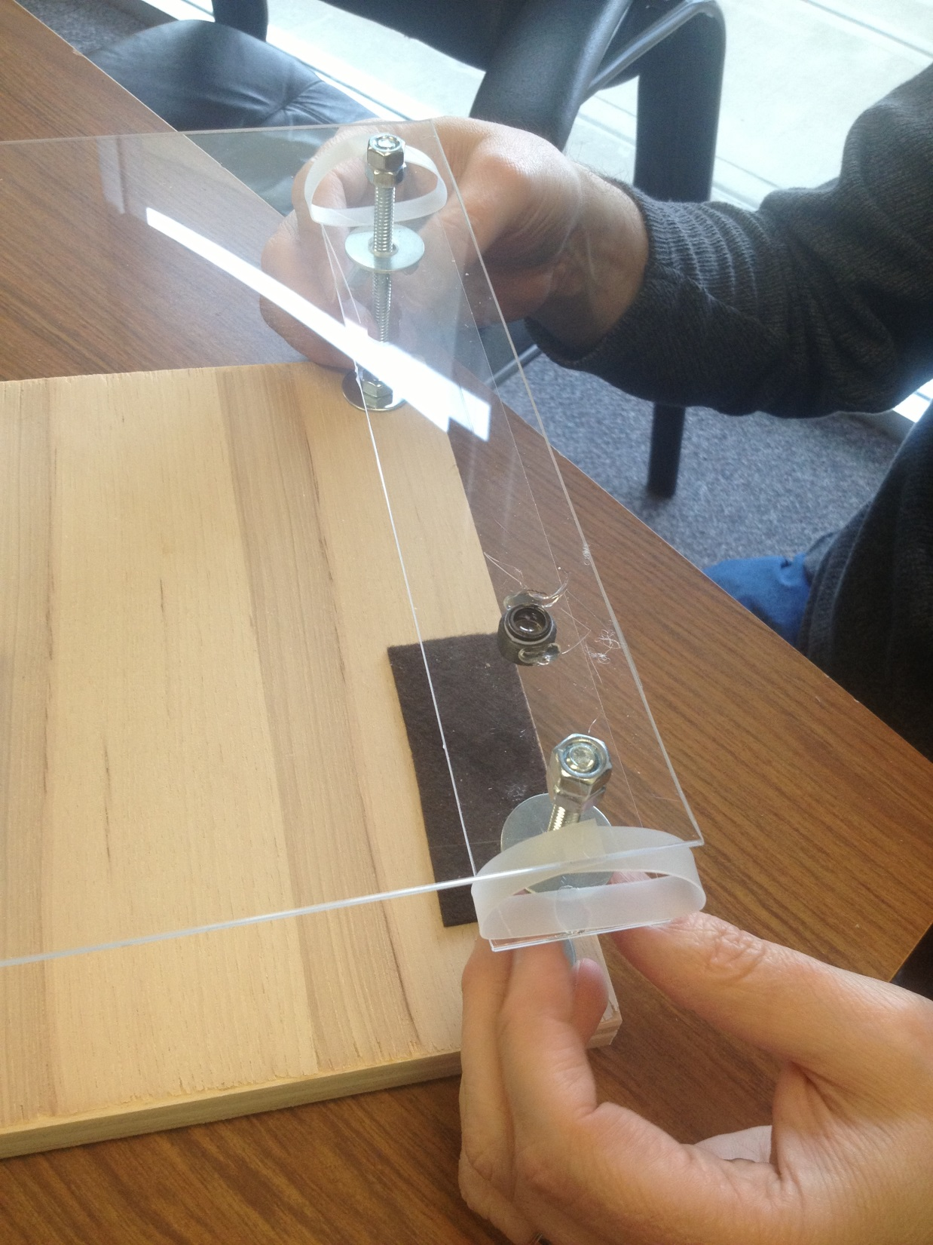

Slide 41
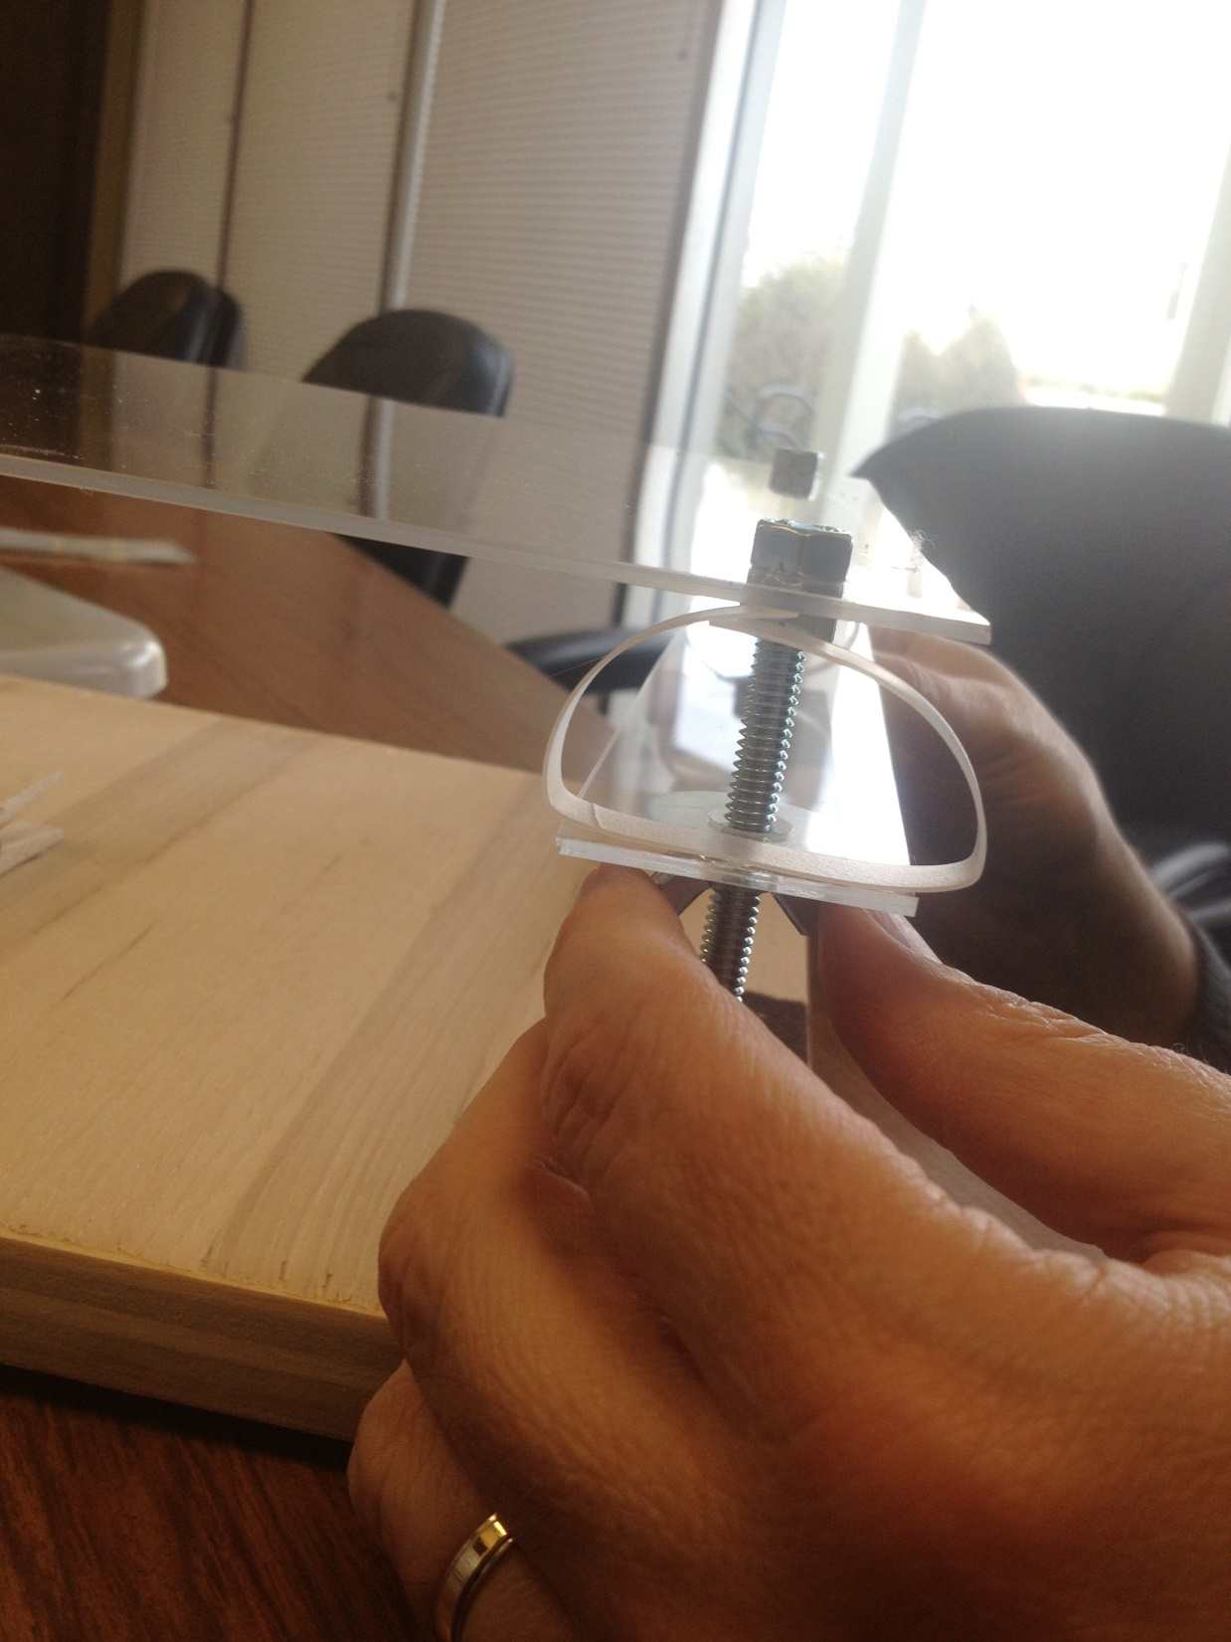

Slide 42
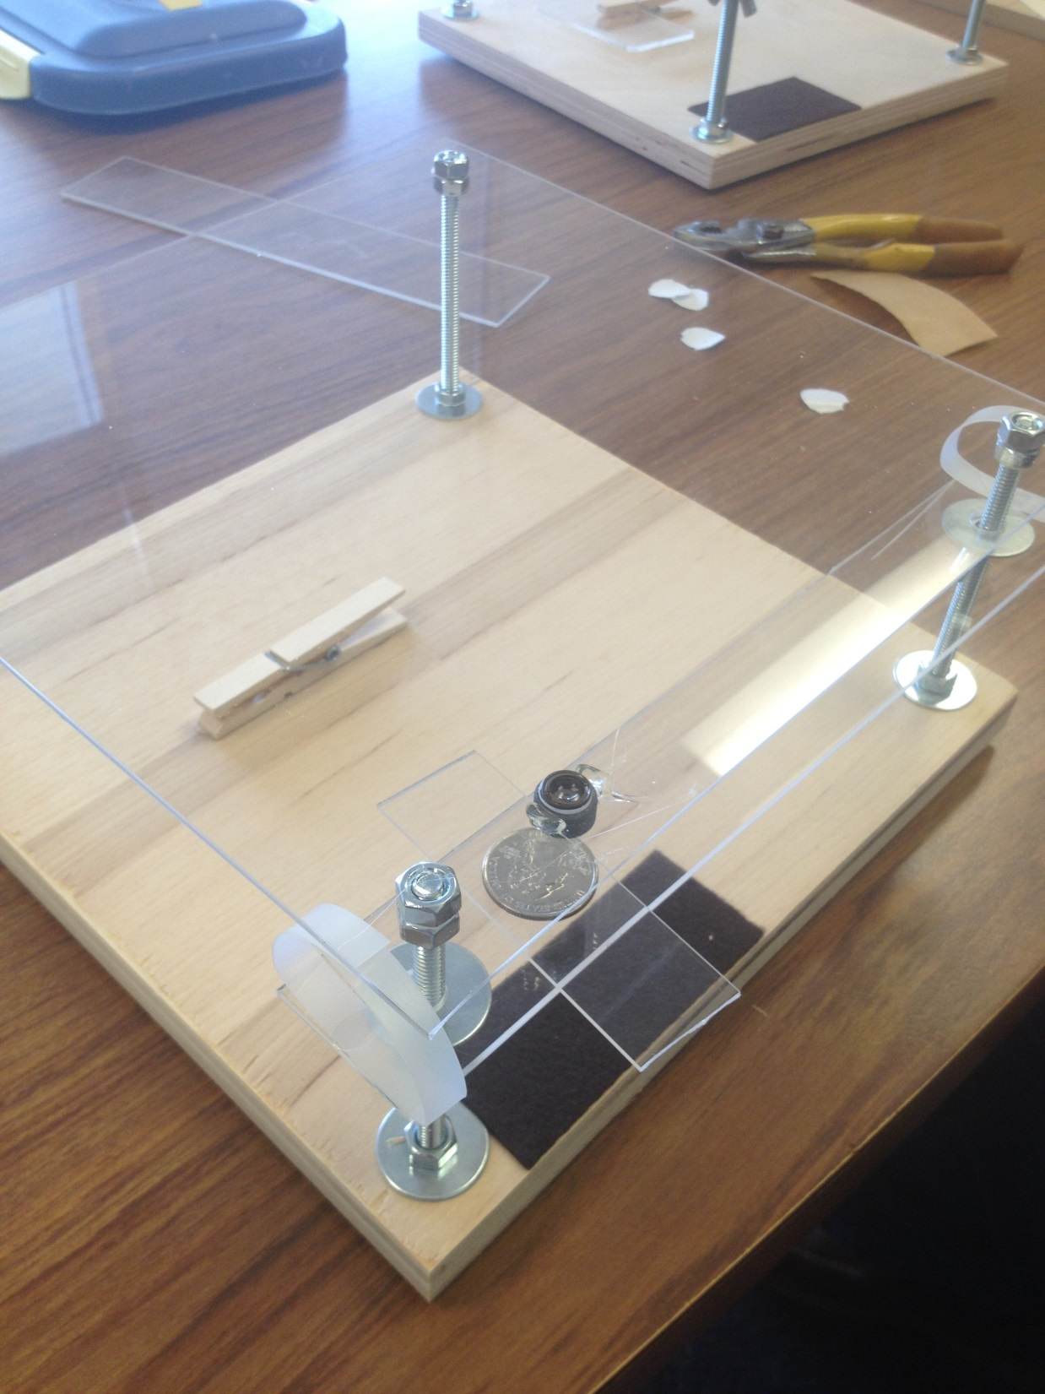

Slide 43
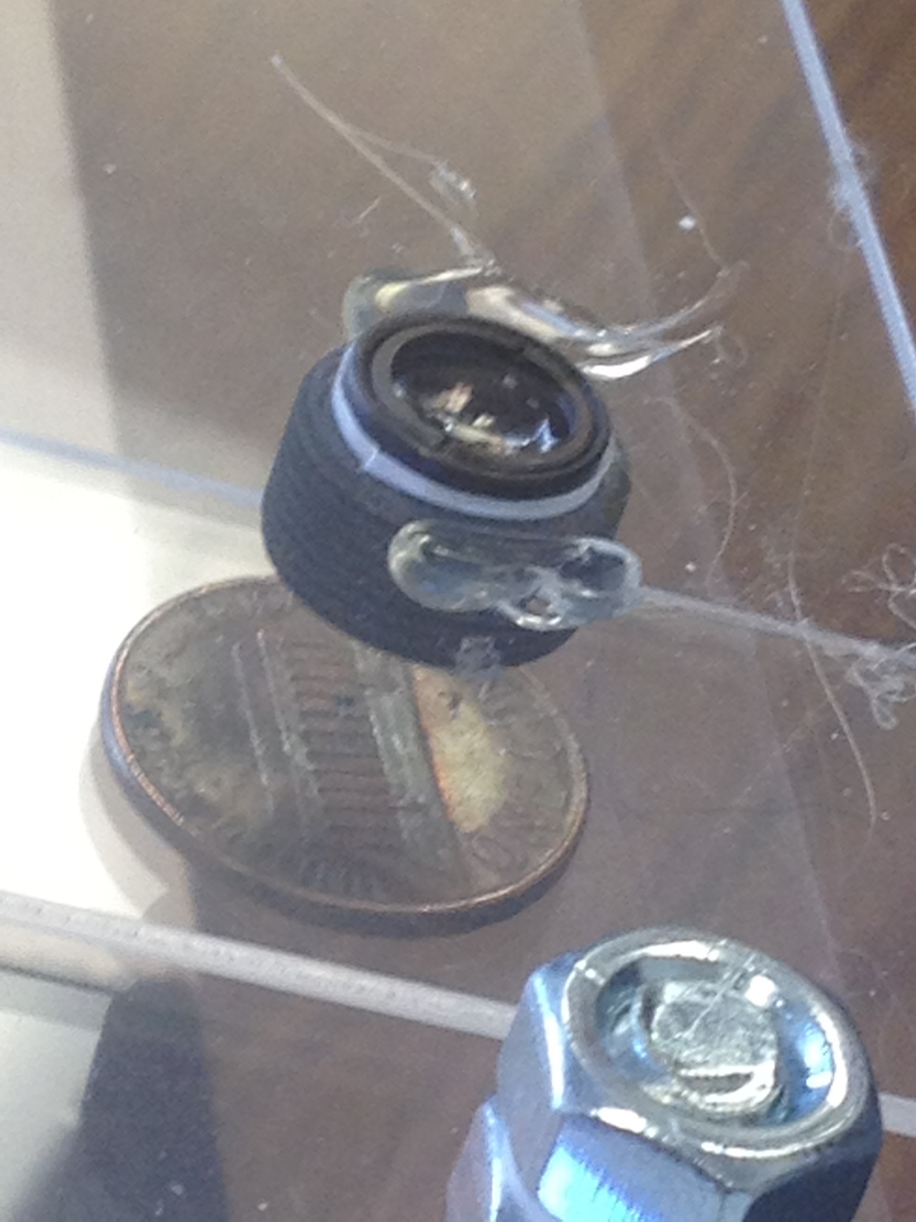

Slide 44
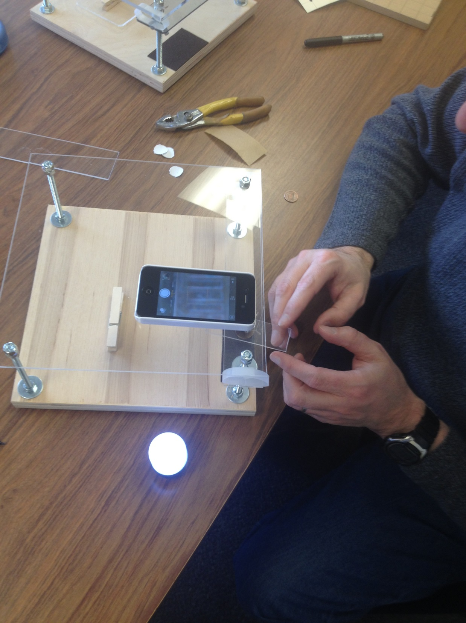

Slide 45
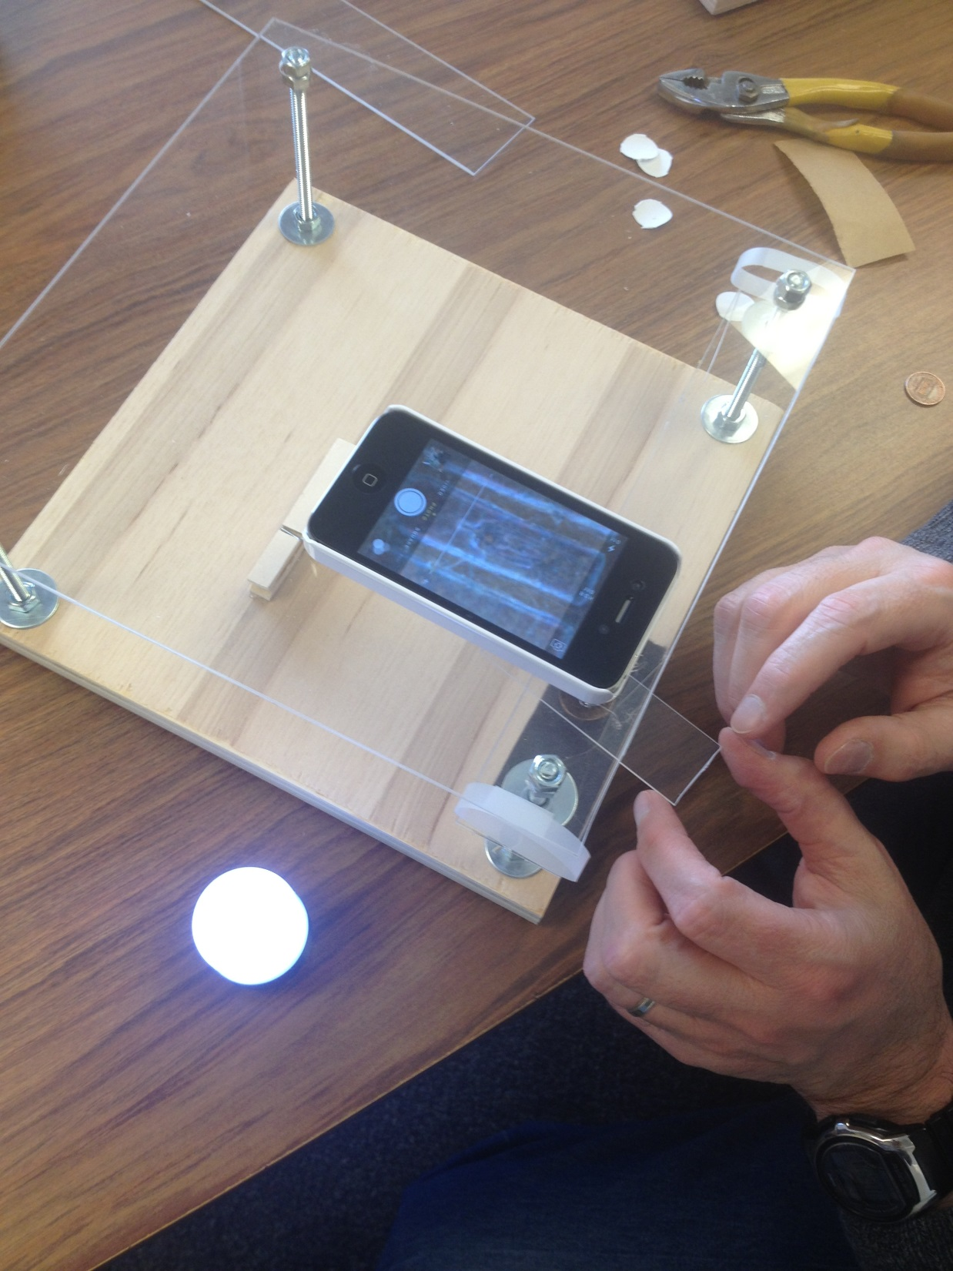

Slide 46
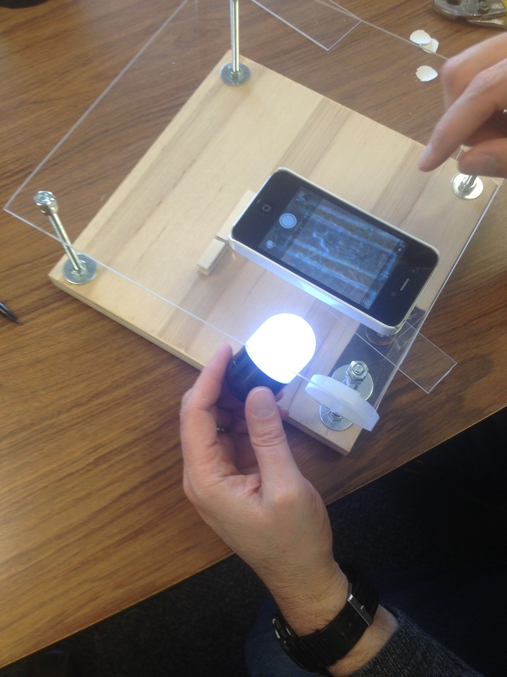
Light is optional and not included

Slide 47
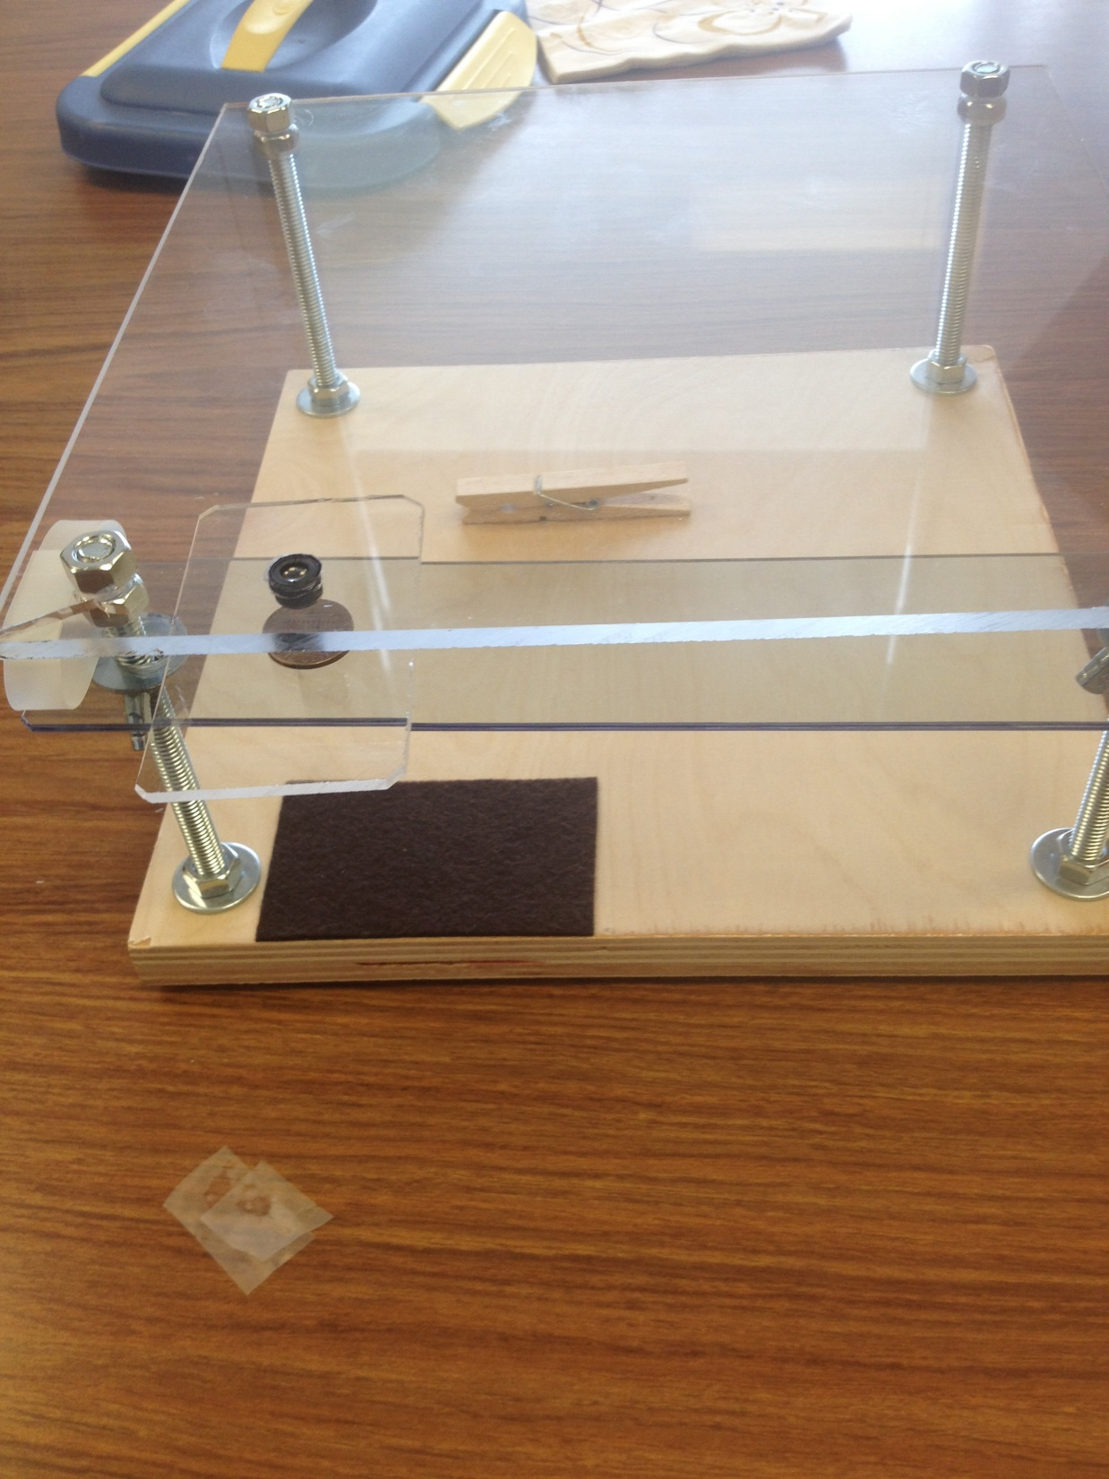

Slide 48
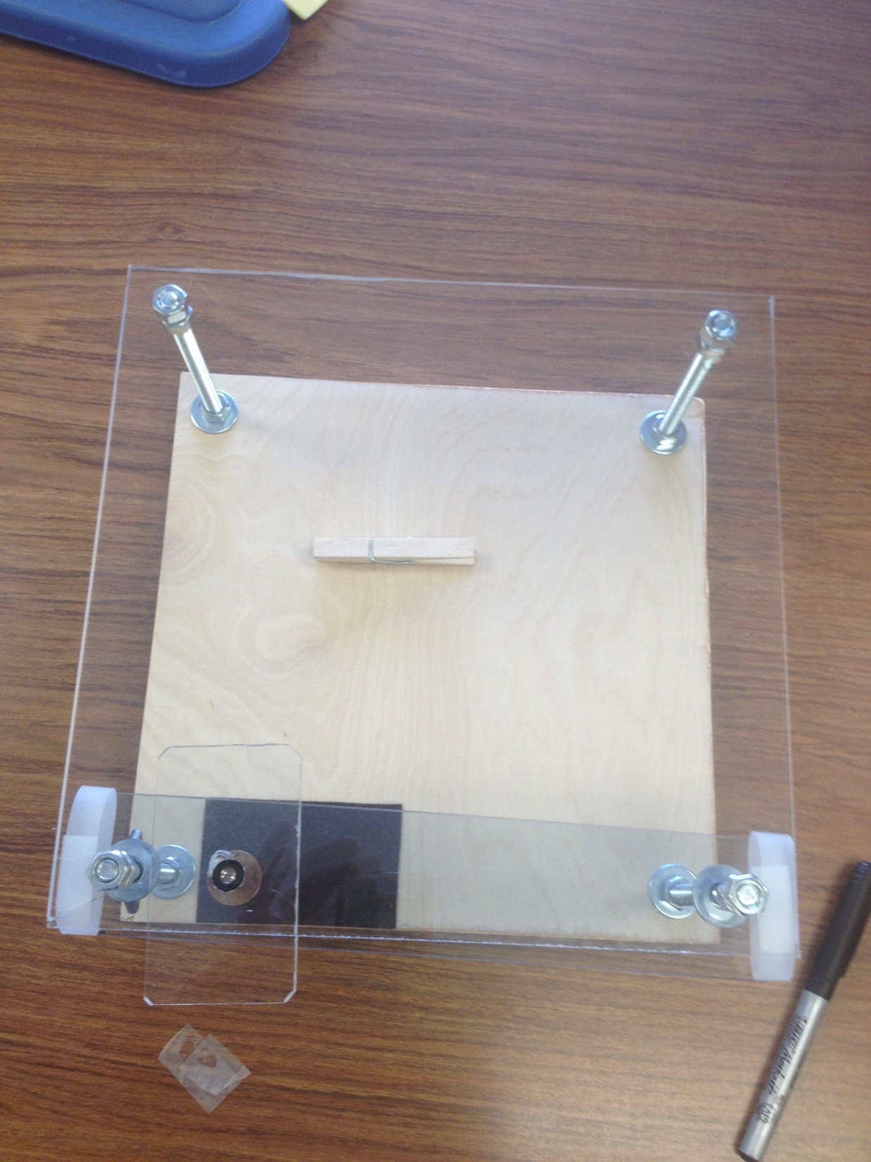

Slide 49
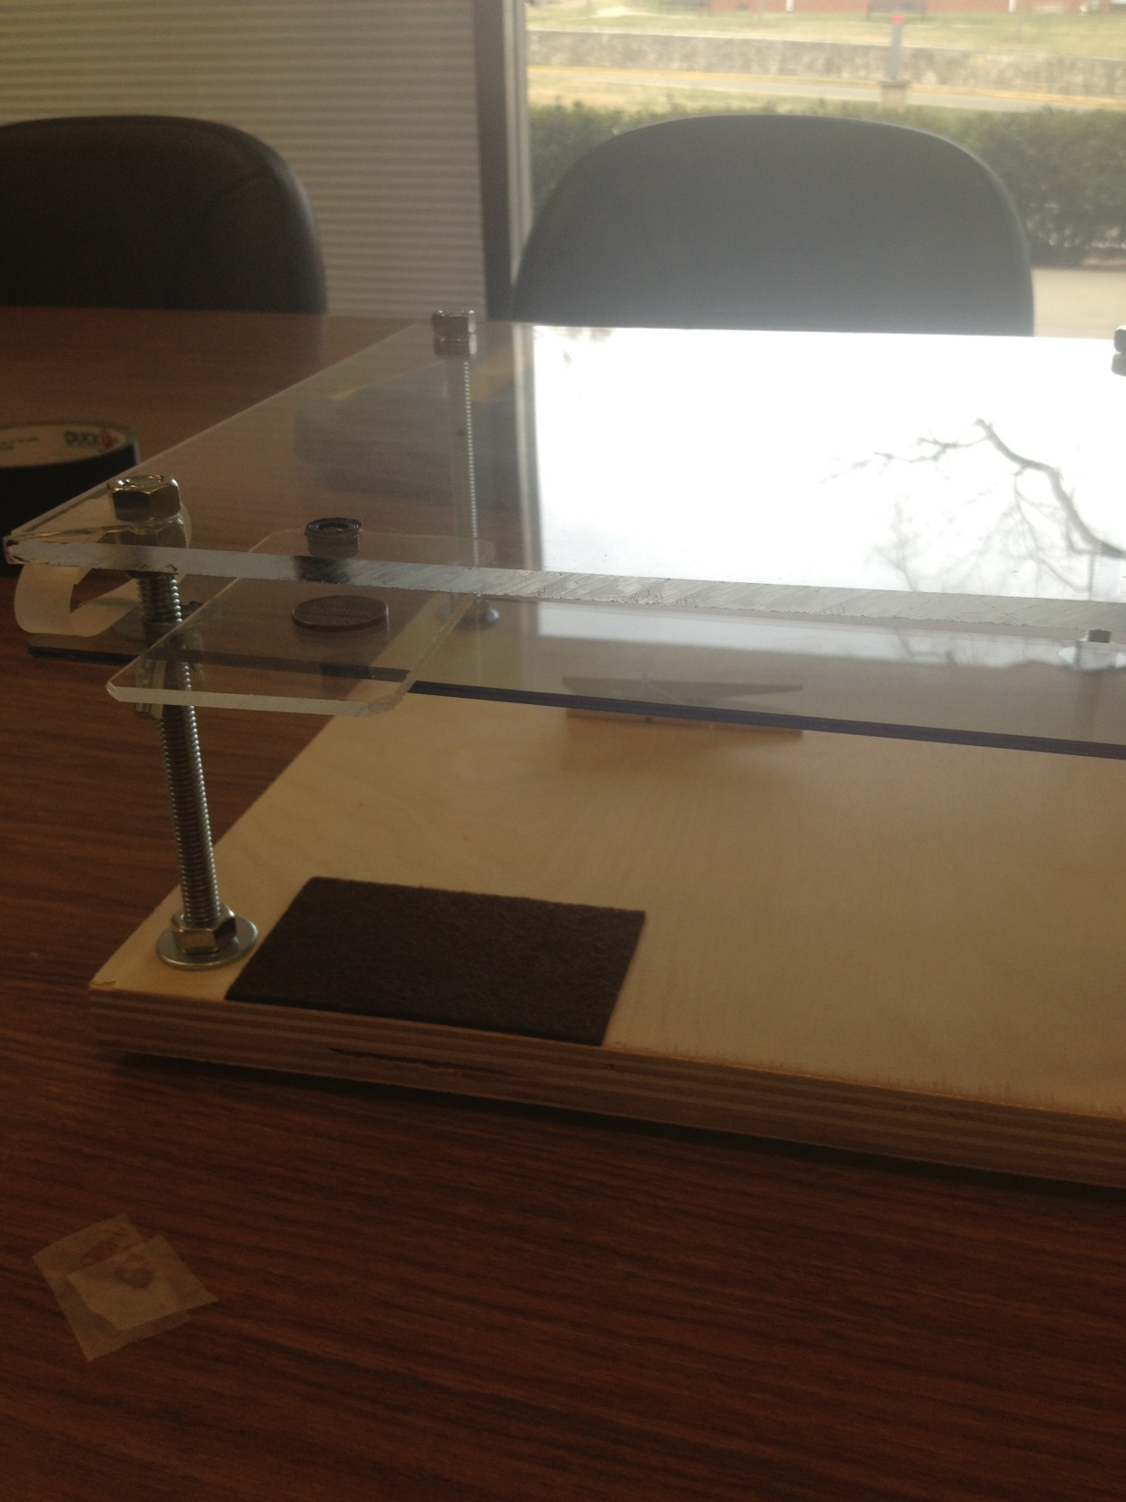

Slide 50
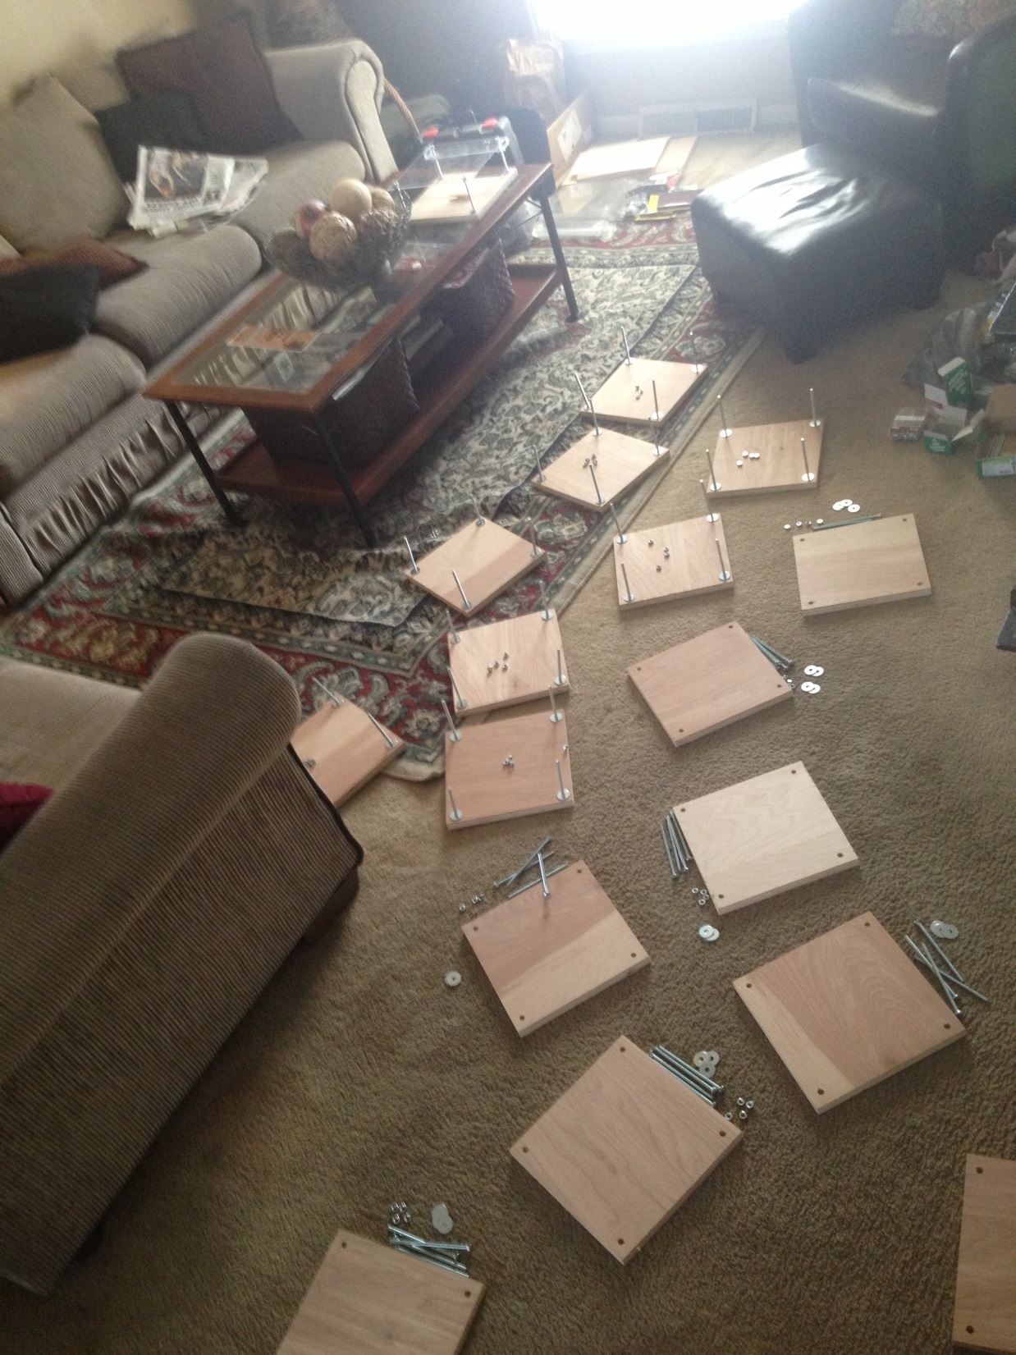

Slide 51
THE END
If you have any problems please contact me any time:
Before June 30th kevin.crump@education.ky.gov
After June 30th kevin.crump@fayette.kyschools.us

