Slide 1
“Device” with a Camera into a Microscope Make and Take Session (1:00-3:30)
Kevin Crump
Science Instructional Specialist, KDE
SE/SC Coop
Kevin.crump@education.ky.gov

Slide 2
Today:
Conduct an investigation
Discuss the three dimensions of NGSS along with some Performance Expectations
Build a microscope
Go outside and find some stuff to magnify

Slide 3
NGSS
Take a look inside your folder
KAS for Science

Slide 4
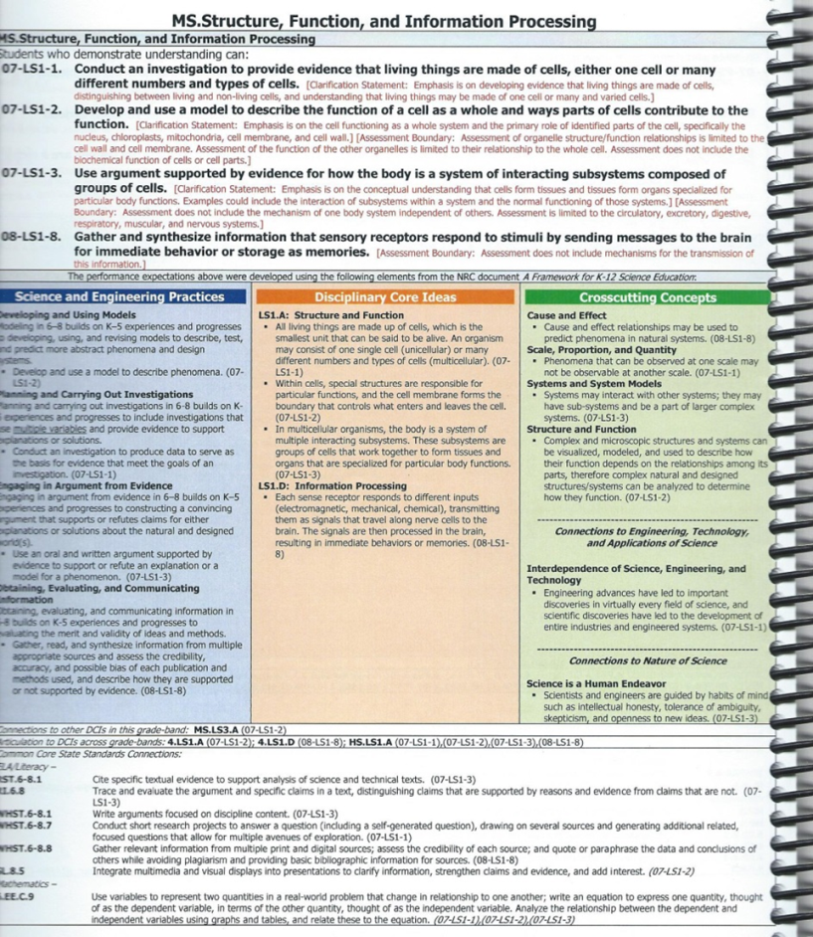
Performance Expectations
(What is assessed)

Slide 5
The THREE DIMENSIONS: LOOK AT SHEET The Foundation Box (in the middle)
Blue Science and Engineering Practices | Orange Disciplinary Core Ideas | Green Crosscutting Concepts

Slide 6
Foundation Box

Slide 7
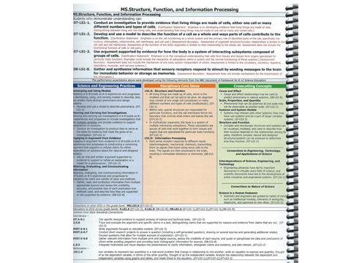

Slide 10
Connection
Box

Slide 11
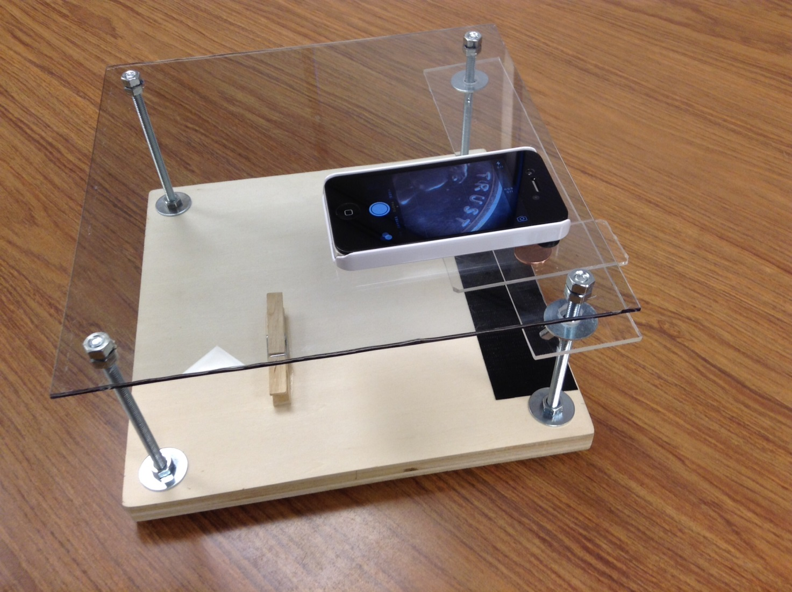
Each table group has an “iPad/iPhone microscope

Slide 12
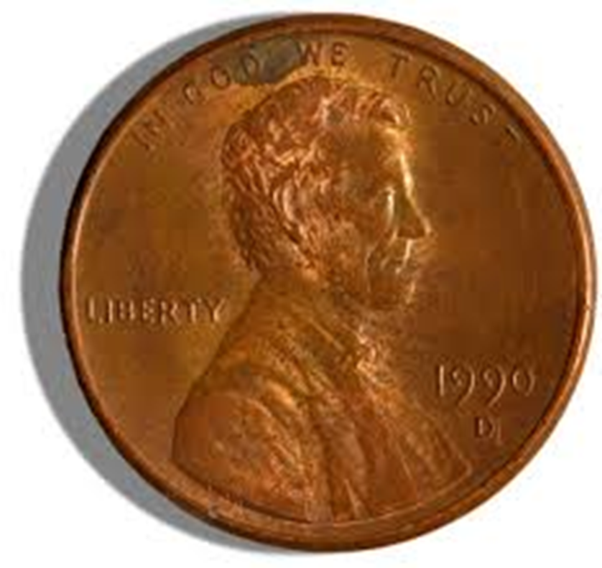
Groups of 4
Each group should have a penny

Slide 13
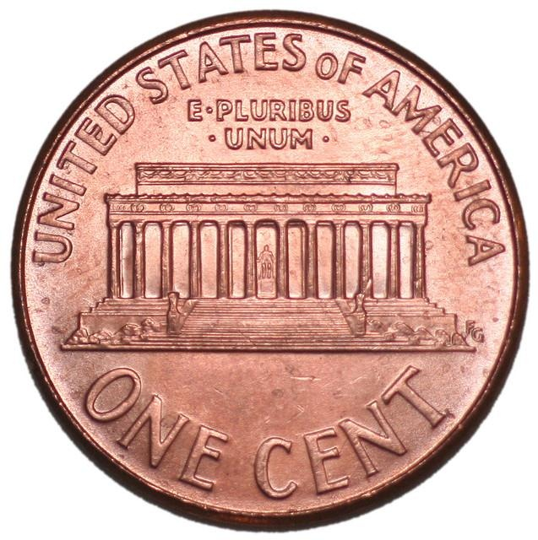
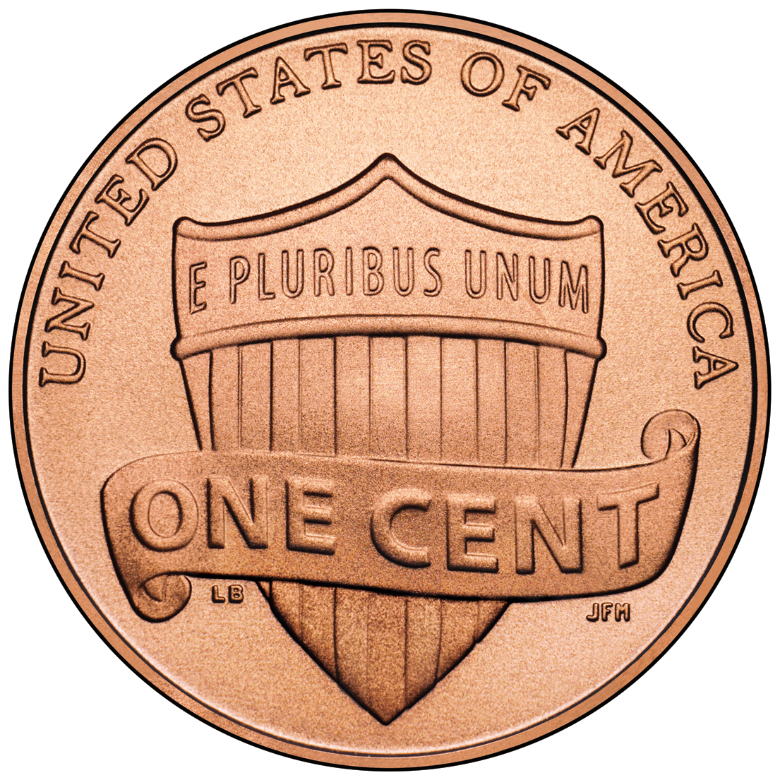
Not just any penny

Slide 14
2009

Slide 15
FINDING ABE LINCOLN

Slide 16
iPad/iPhone Microscope
What are the following pictures?

Slide 17
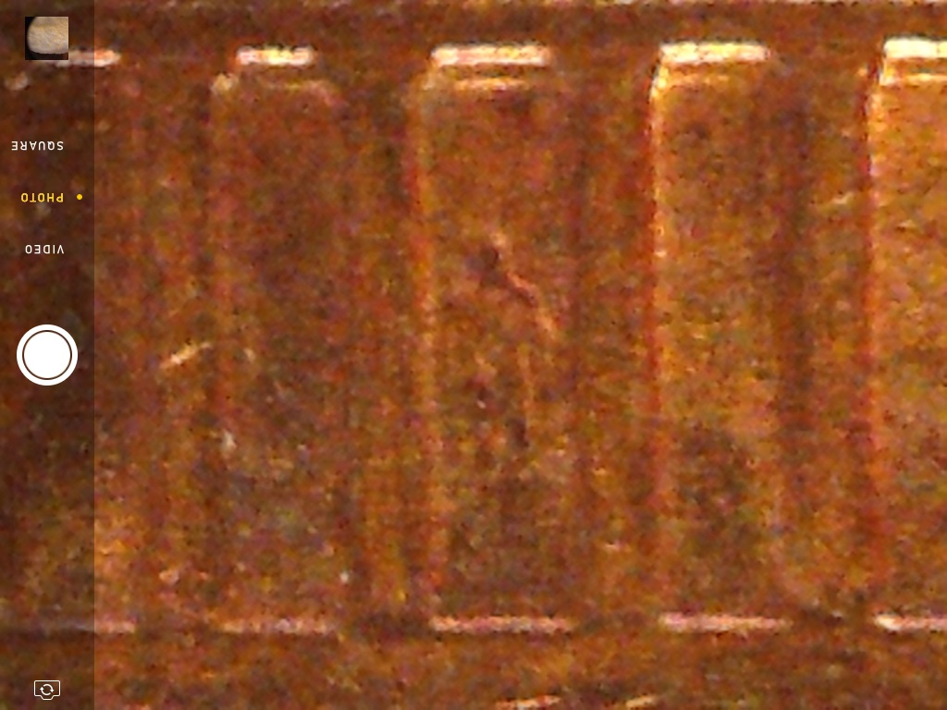

Slide 18
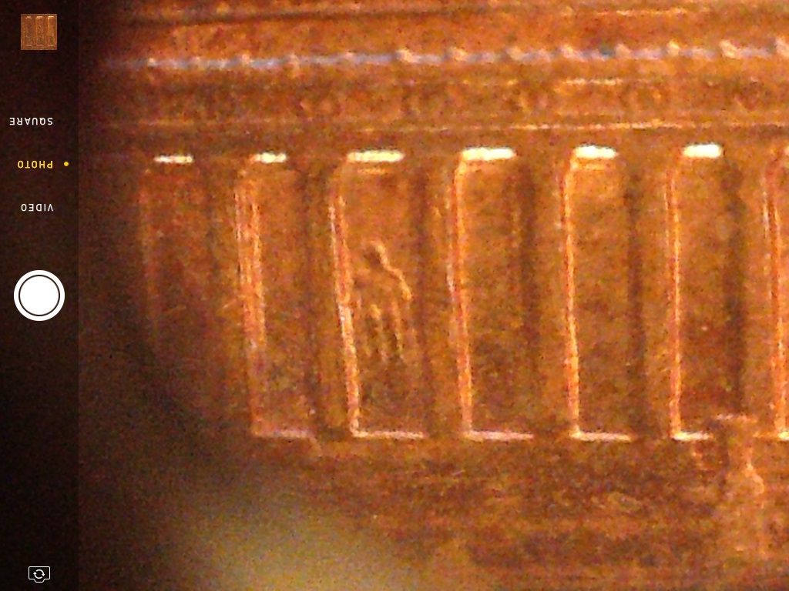

Slide 19
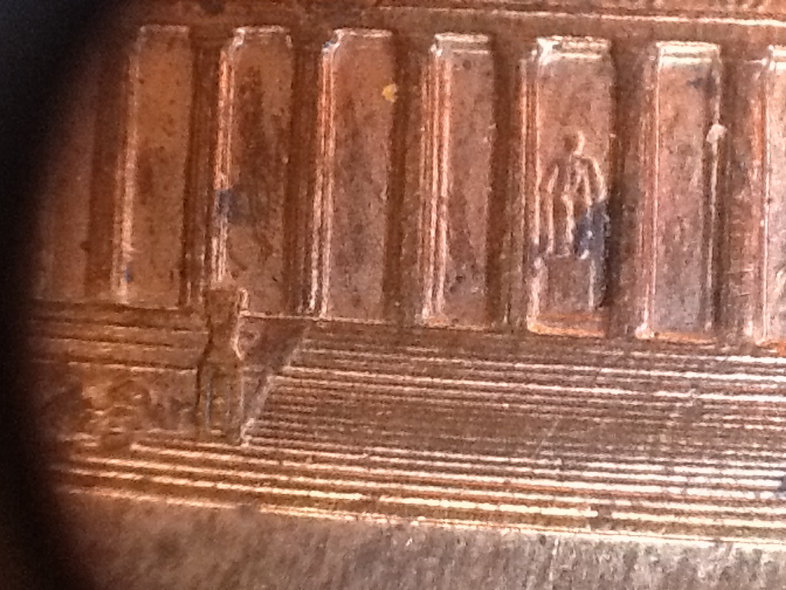

Slide 20
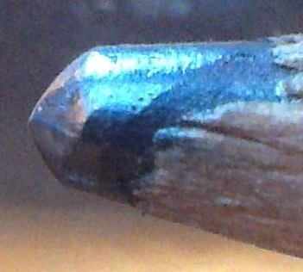

Slide 21
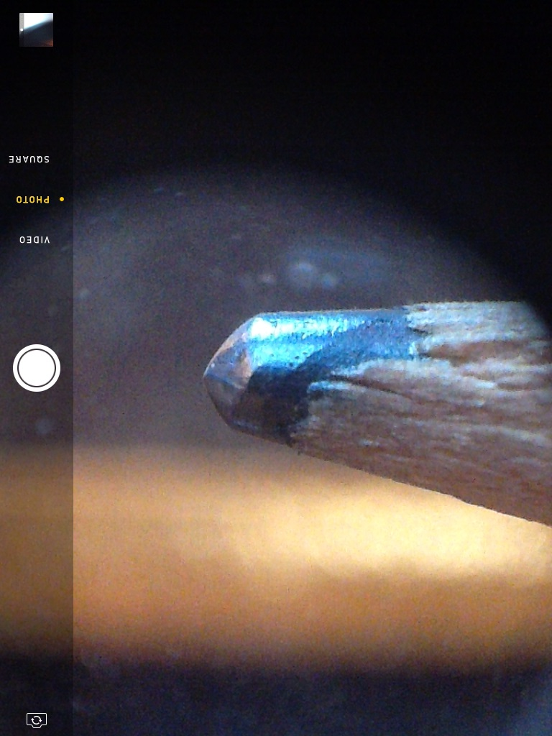

Slide 22
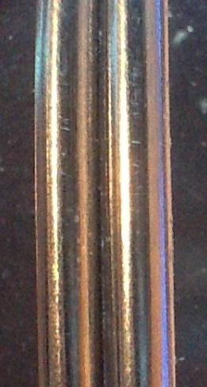

Slide 23
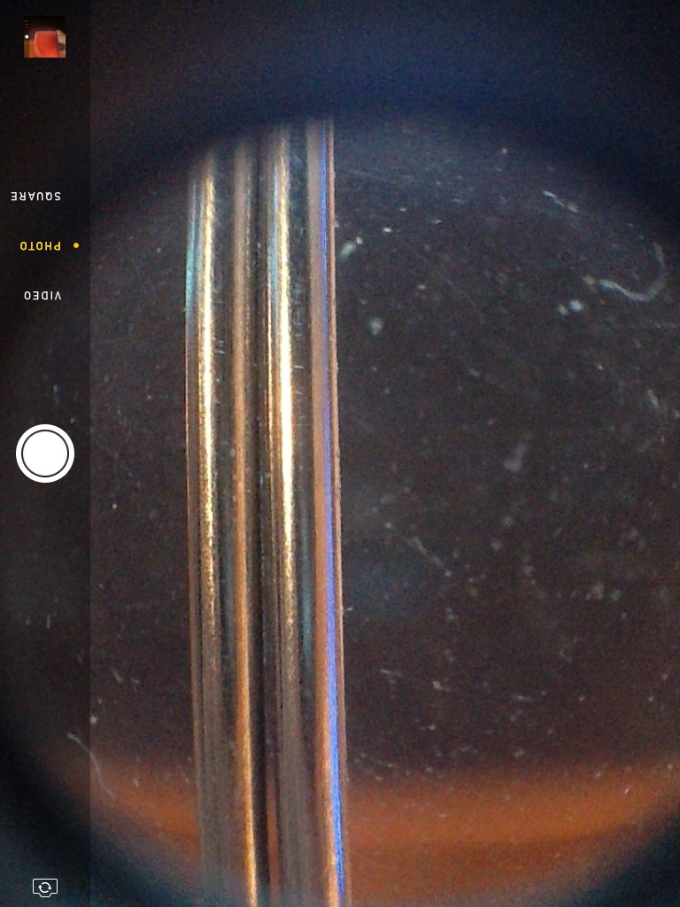

Slide 24
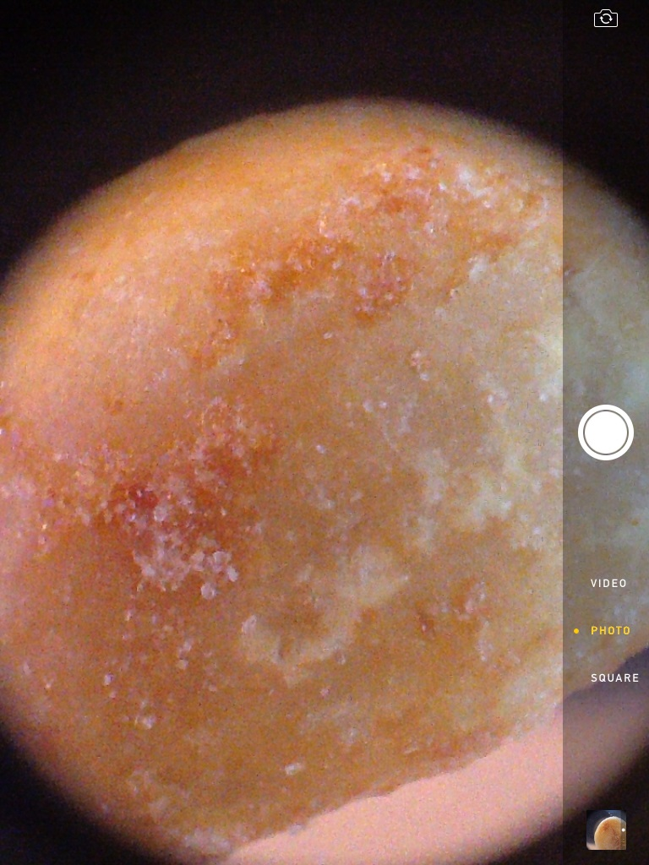

Slide 25
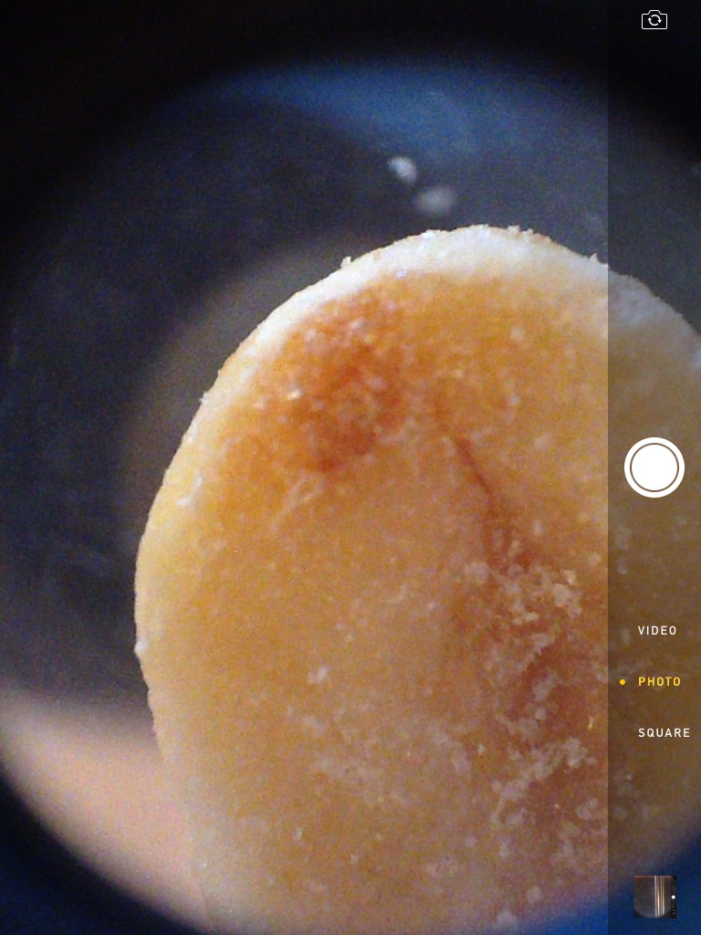

Slide 26
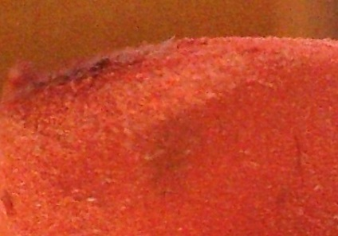

Slide 27
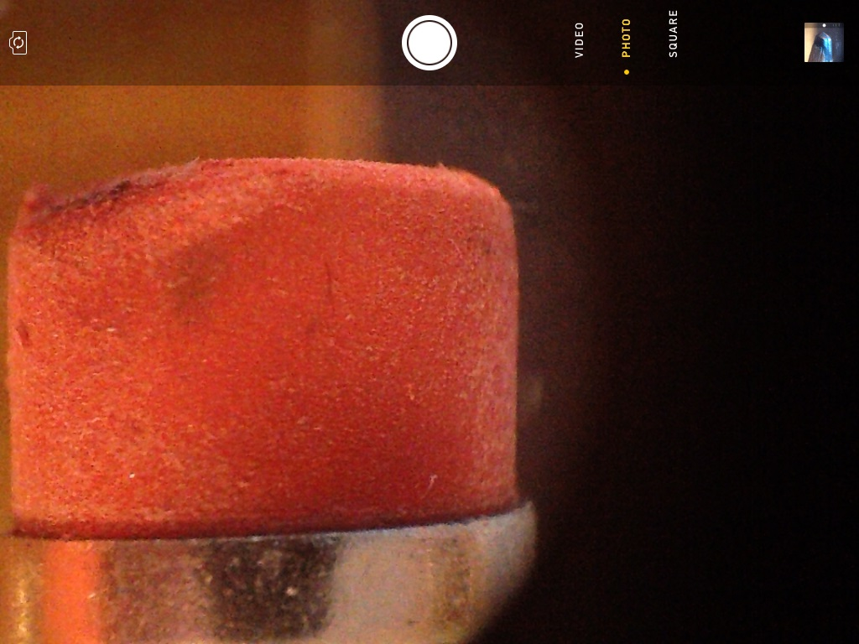

Slide 28
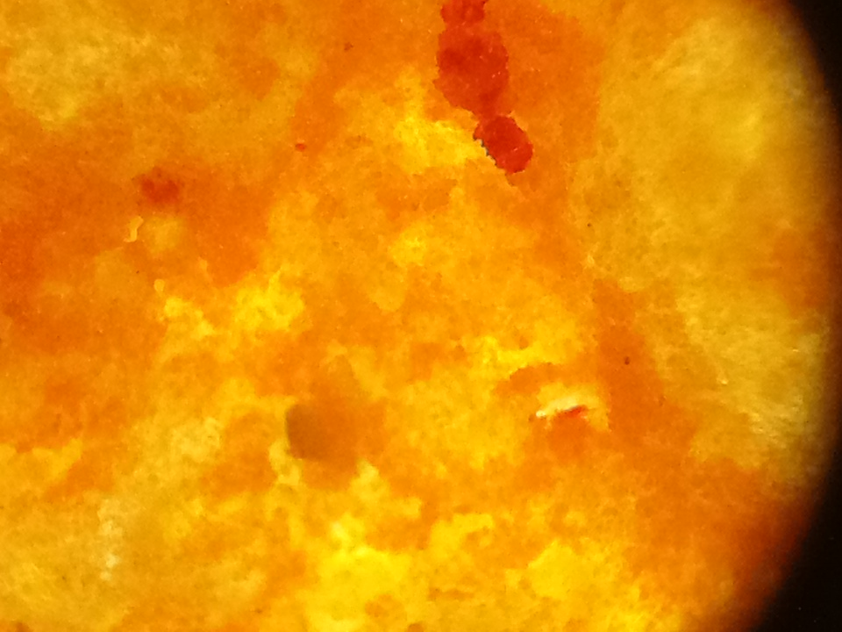

Slide 29
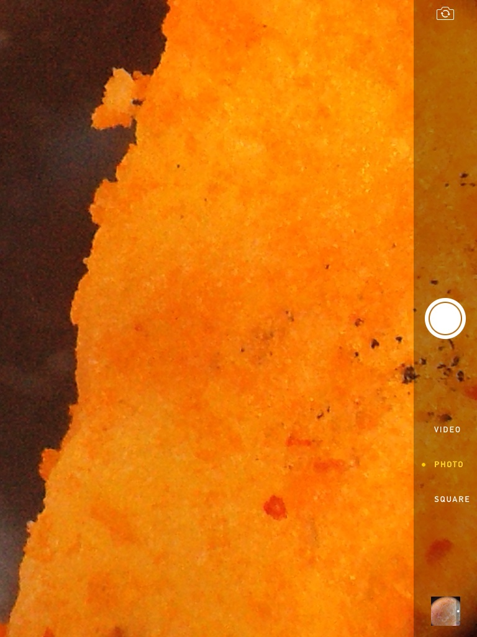

Slide 30
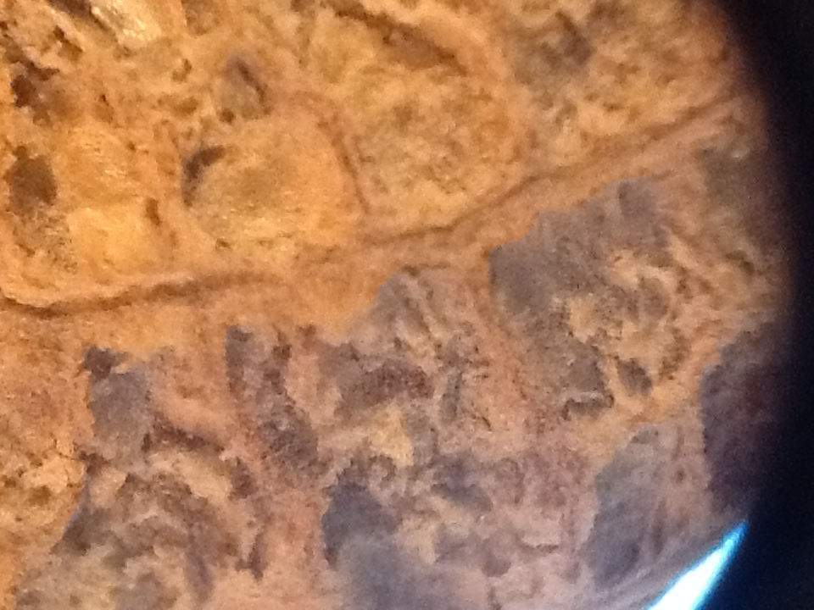

Slide 31
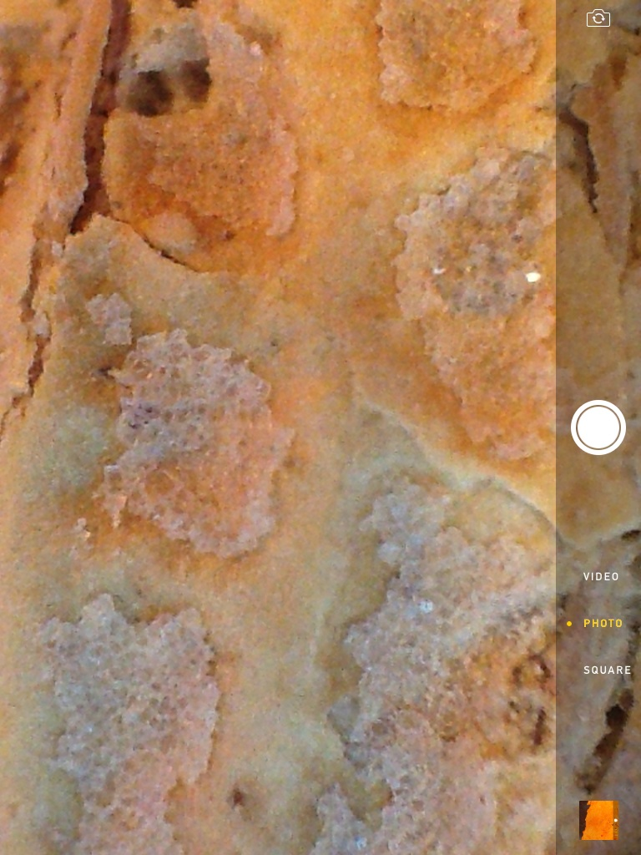

Slide 32
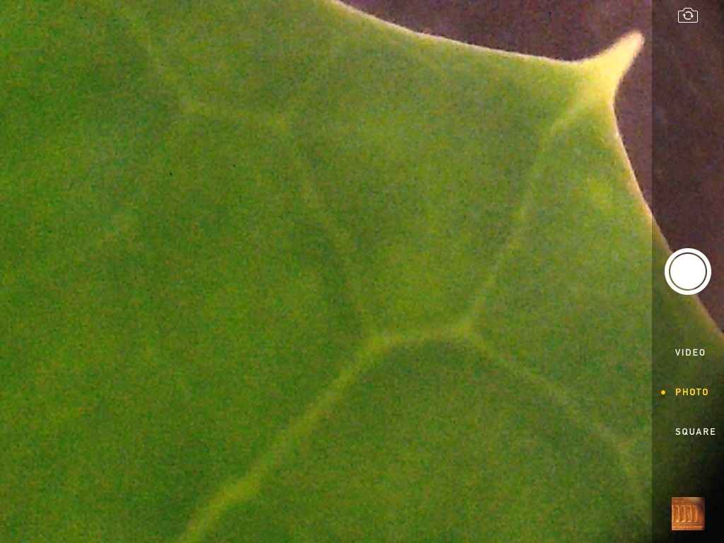

Slide 33
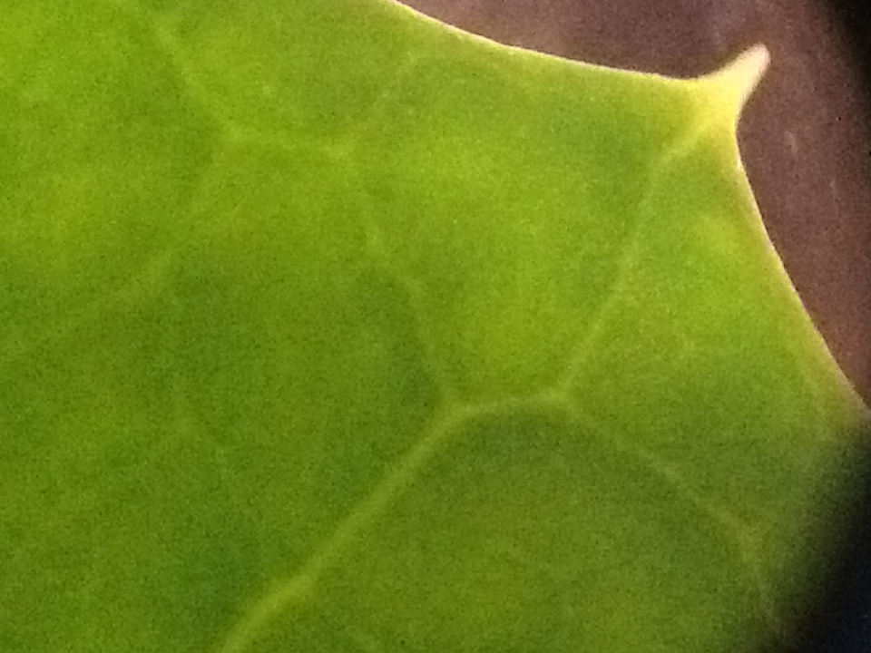

Slide 34
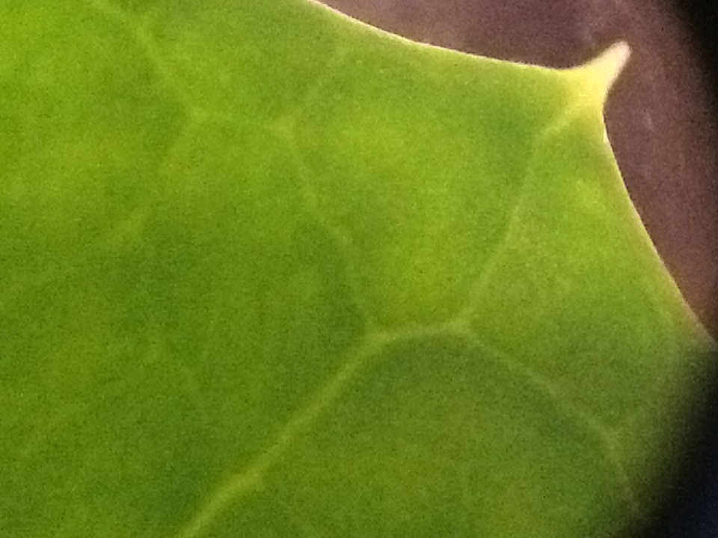

Slide 35
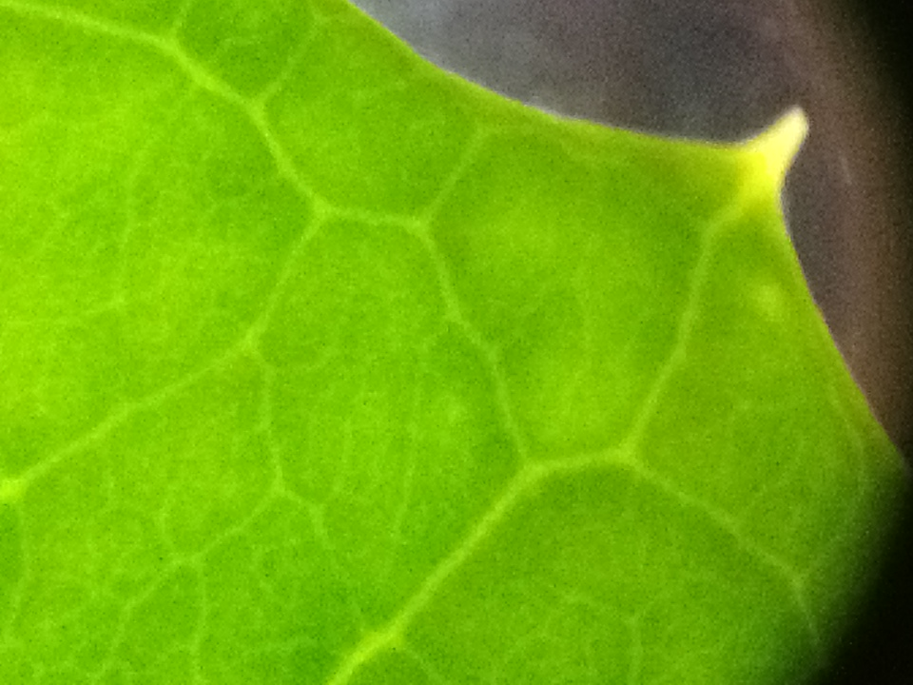

Slide 36
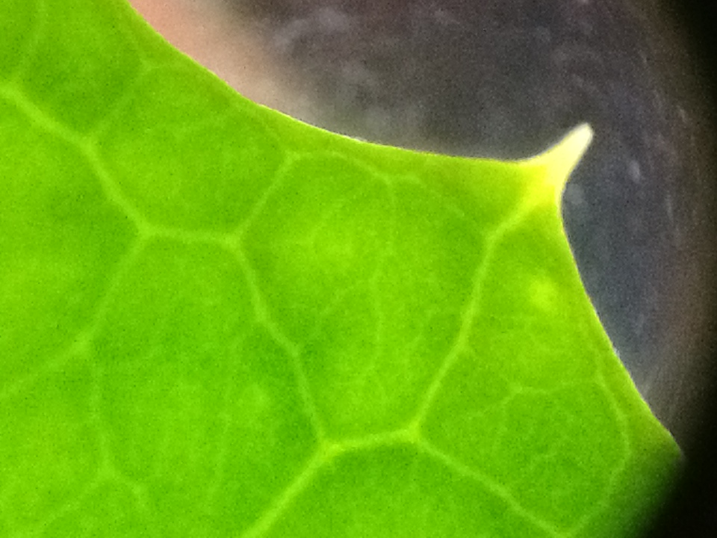

Slide 37
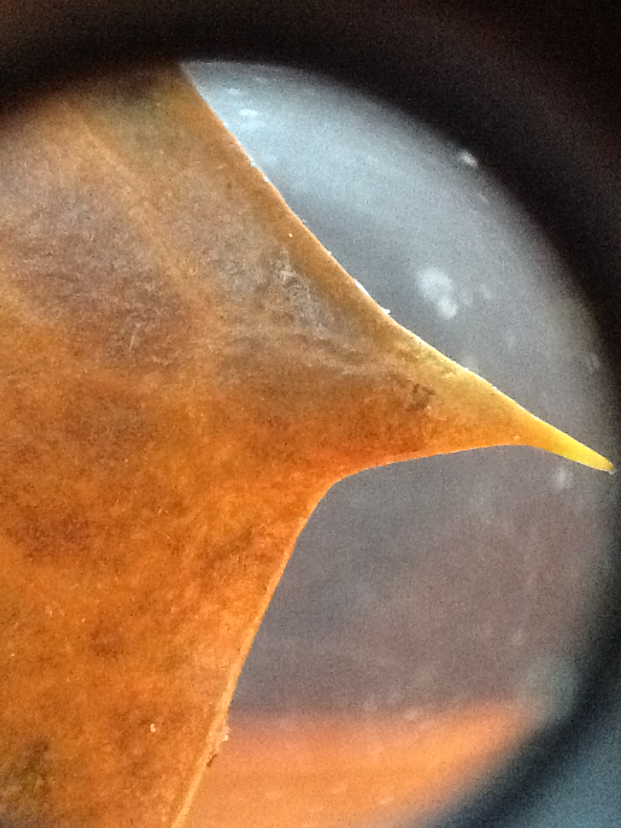

Slide 38
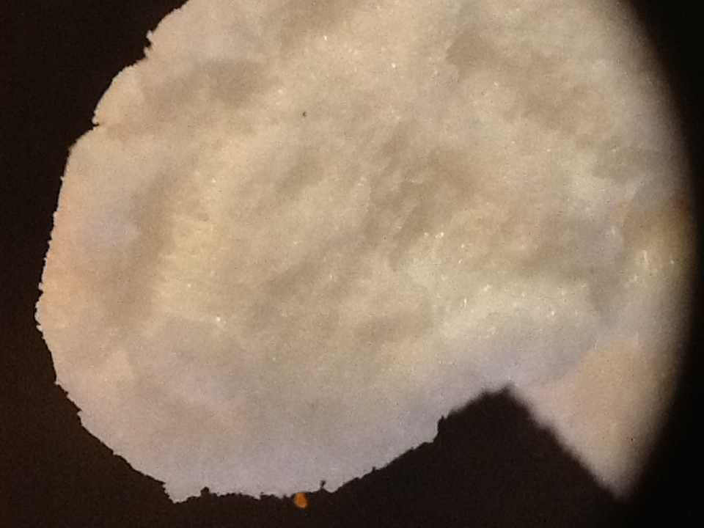

Slide 39
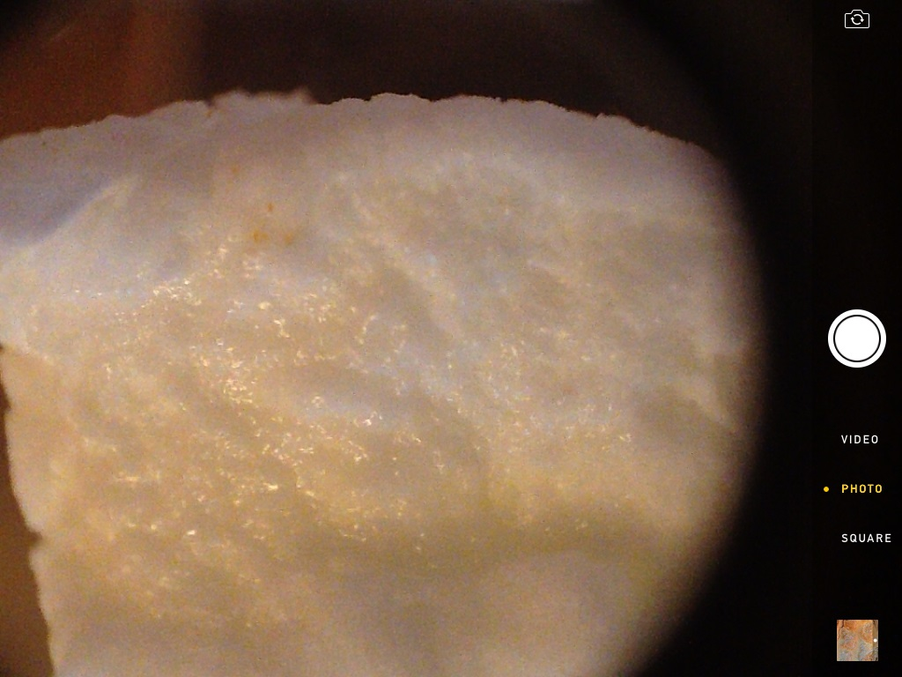

Slide 40
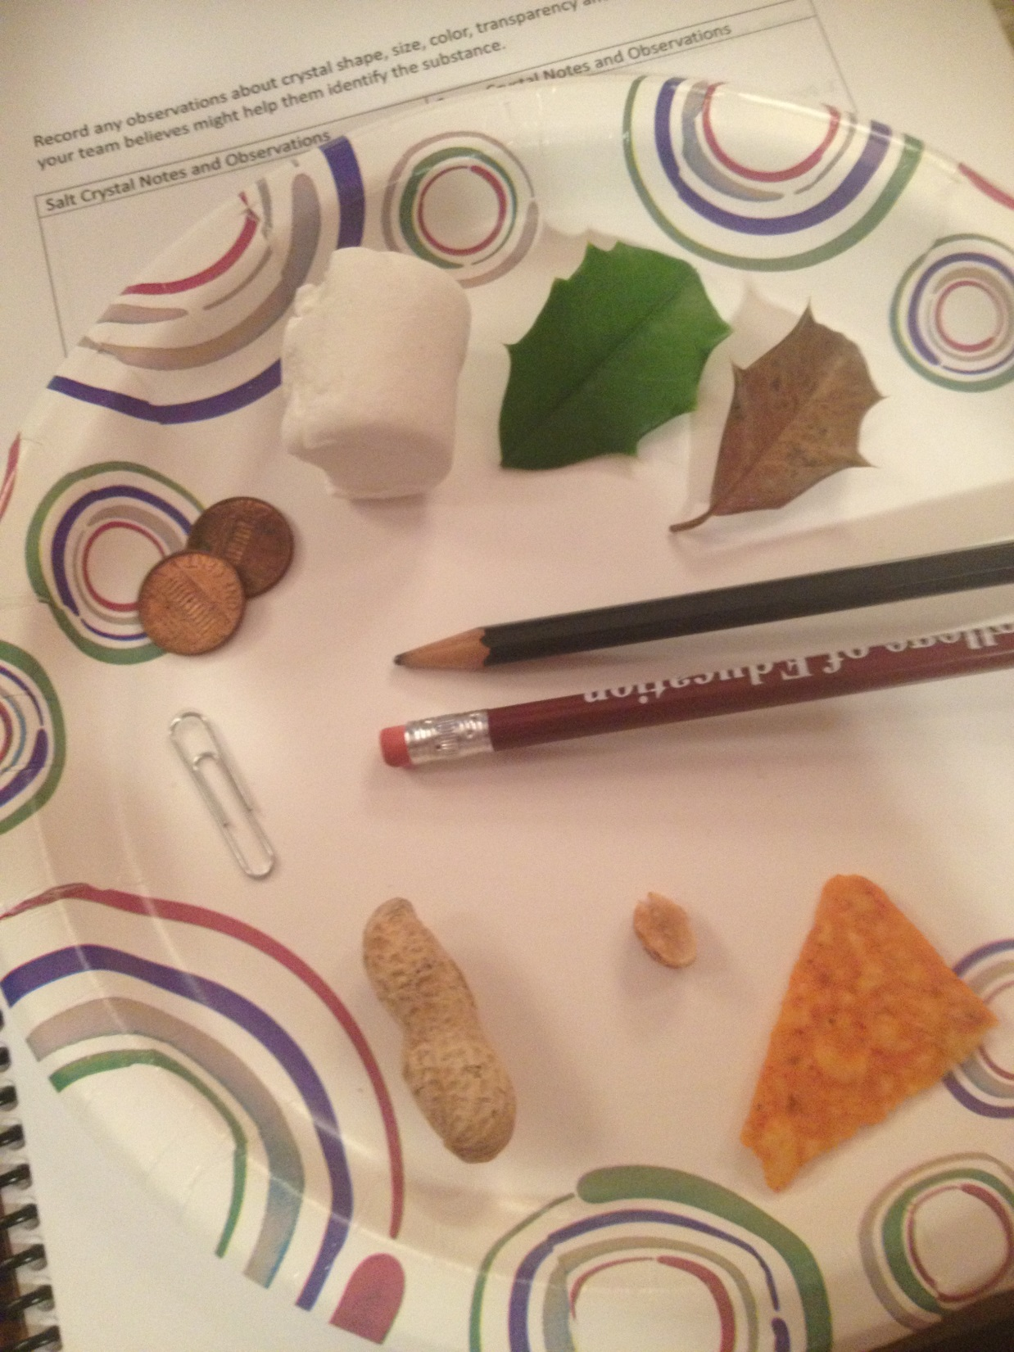

Slide 41
Each table group has an “iPad/iPhone microscope.
Find objects to practice and learn to focus and zoom in and out using your iPad or iPhone.

Slide 42
Once your group understands how to use the microscope get a small sample of both salt and sugar crystals from the materials table.
Observe each sample under the microscope at low and high power. Record any observations about crystal shape, size, color, transparency and any other properties your team believes might help them identify the substance if you were given an unknown sample.
You can also take pictures to use later.

Slide 43
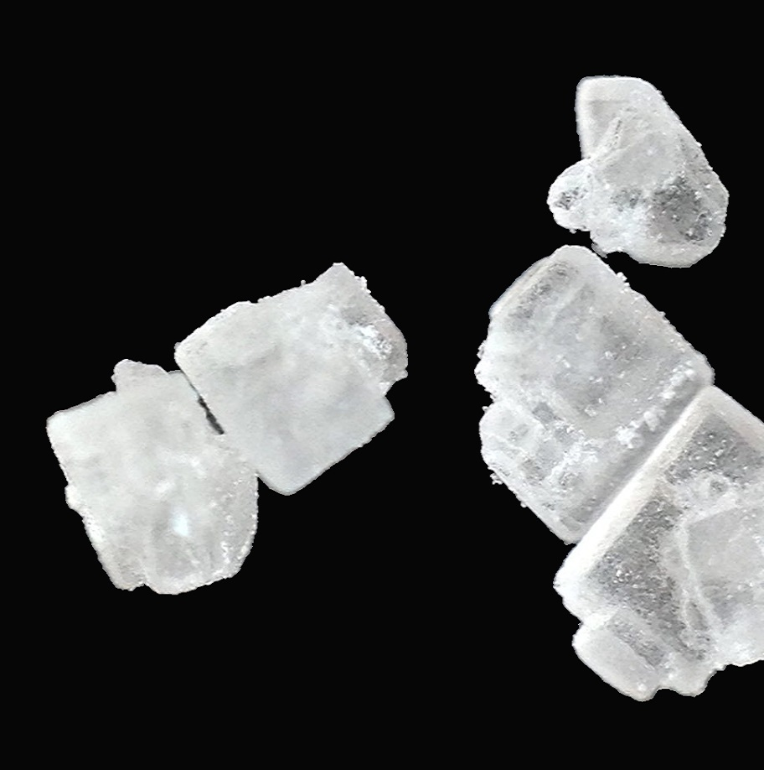
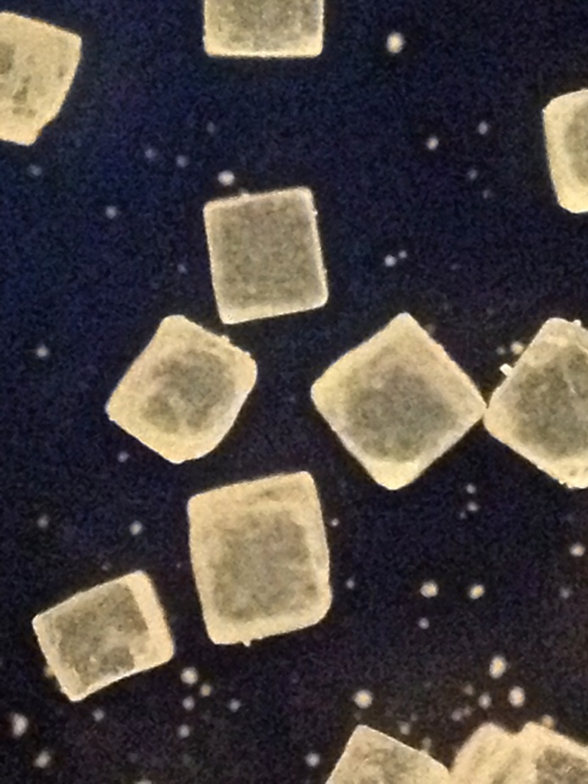

Slide 44
After your team has made all the observations they need of the known salt and sugar samples they should return to the materials table to collect a Test Sample. Observe under the microscope. Then select what is in the Test Sample from the choices below.
The Test Sample is…
A. salt mixed with an unknown substance.
B. salt with sugar and an unknown substance
C. salt only
D. sugar only
E. sugar mixed with an unknown substance
F. salt and sugar only (no unknown substance)
Identify

Slide 45
PS1.A Structure and Properties of Matter
5-PS1-3
Make Observations and measurements to identify materials based on their properties

Slide 46
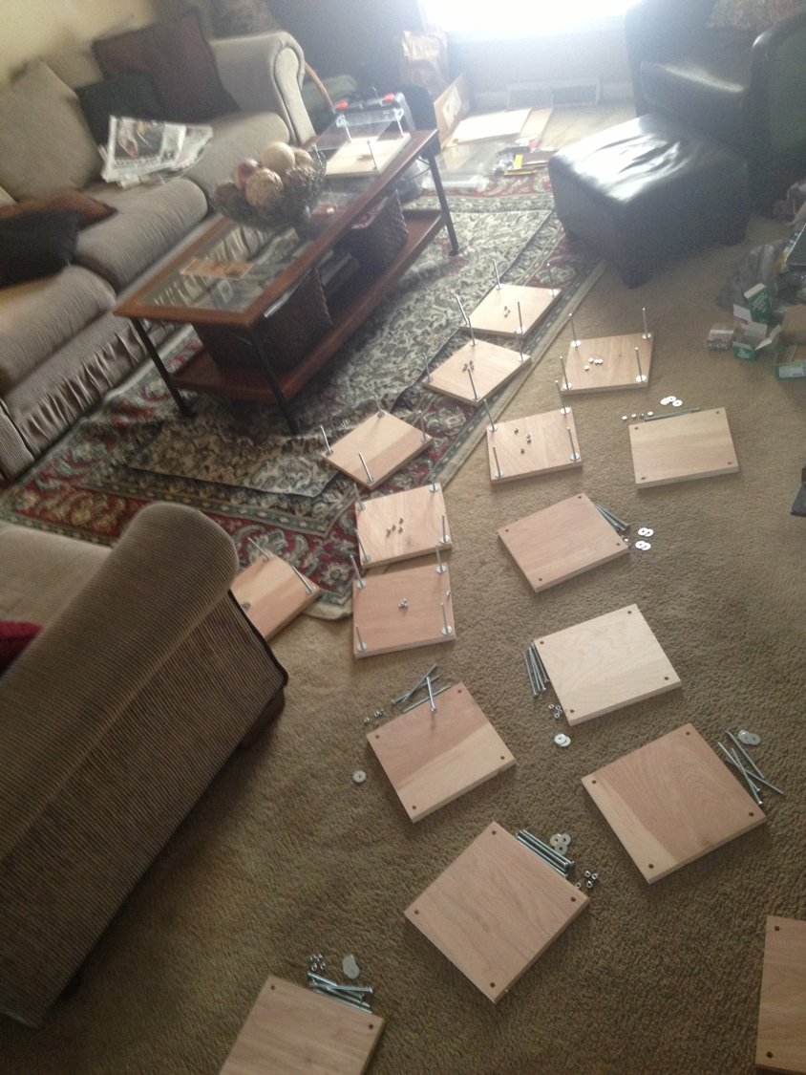
Time to build your own

Slide 48
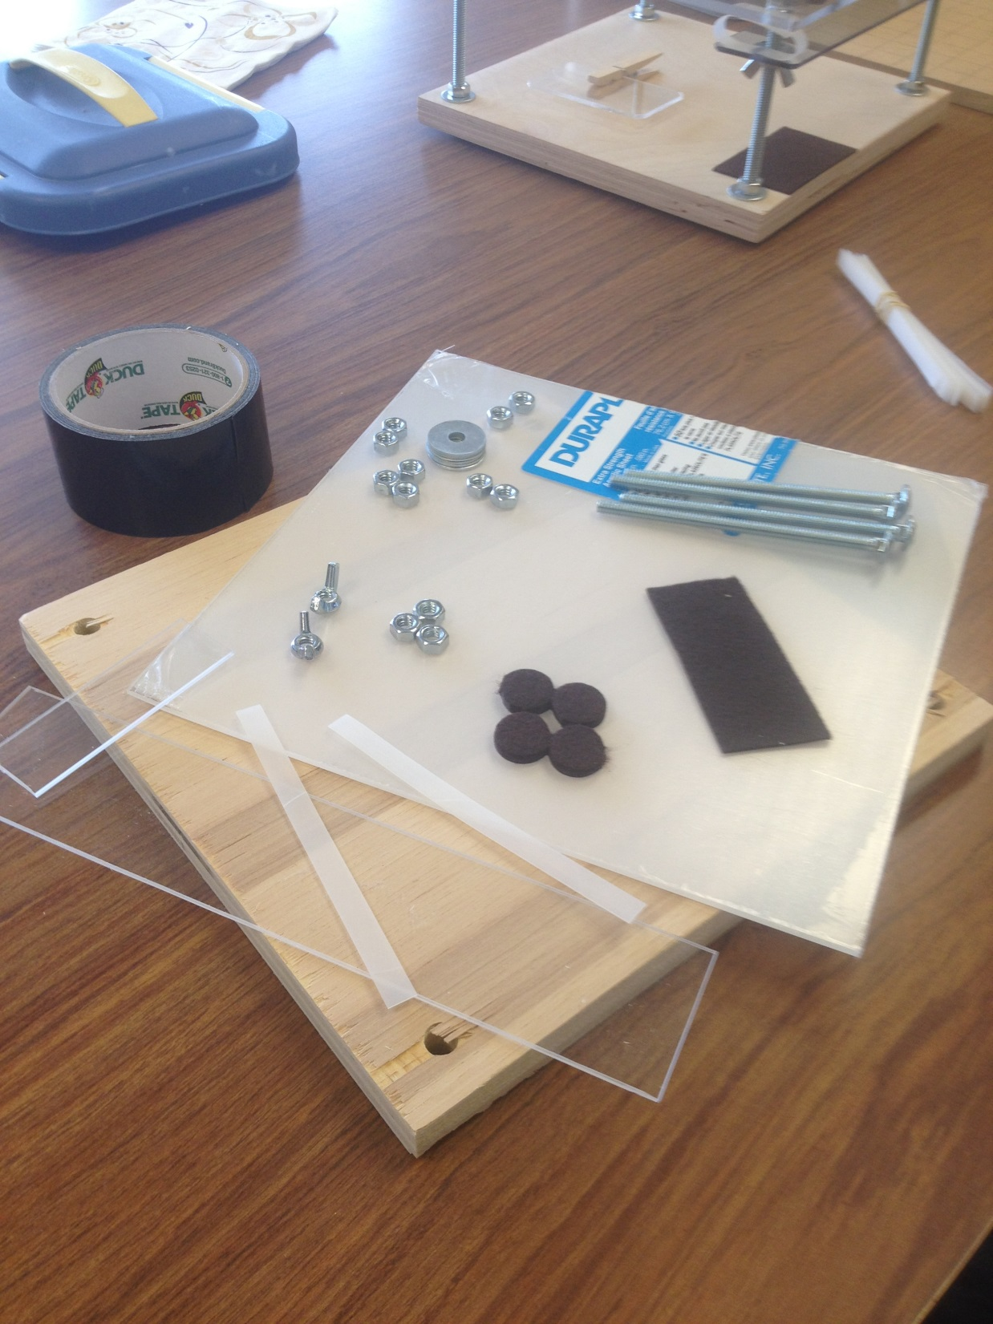

Slide 49
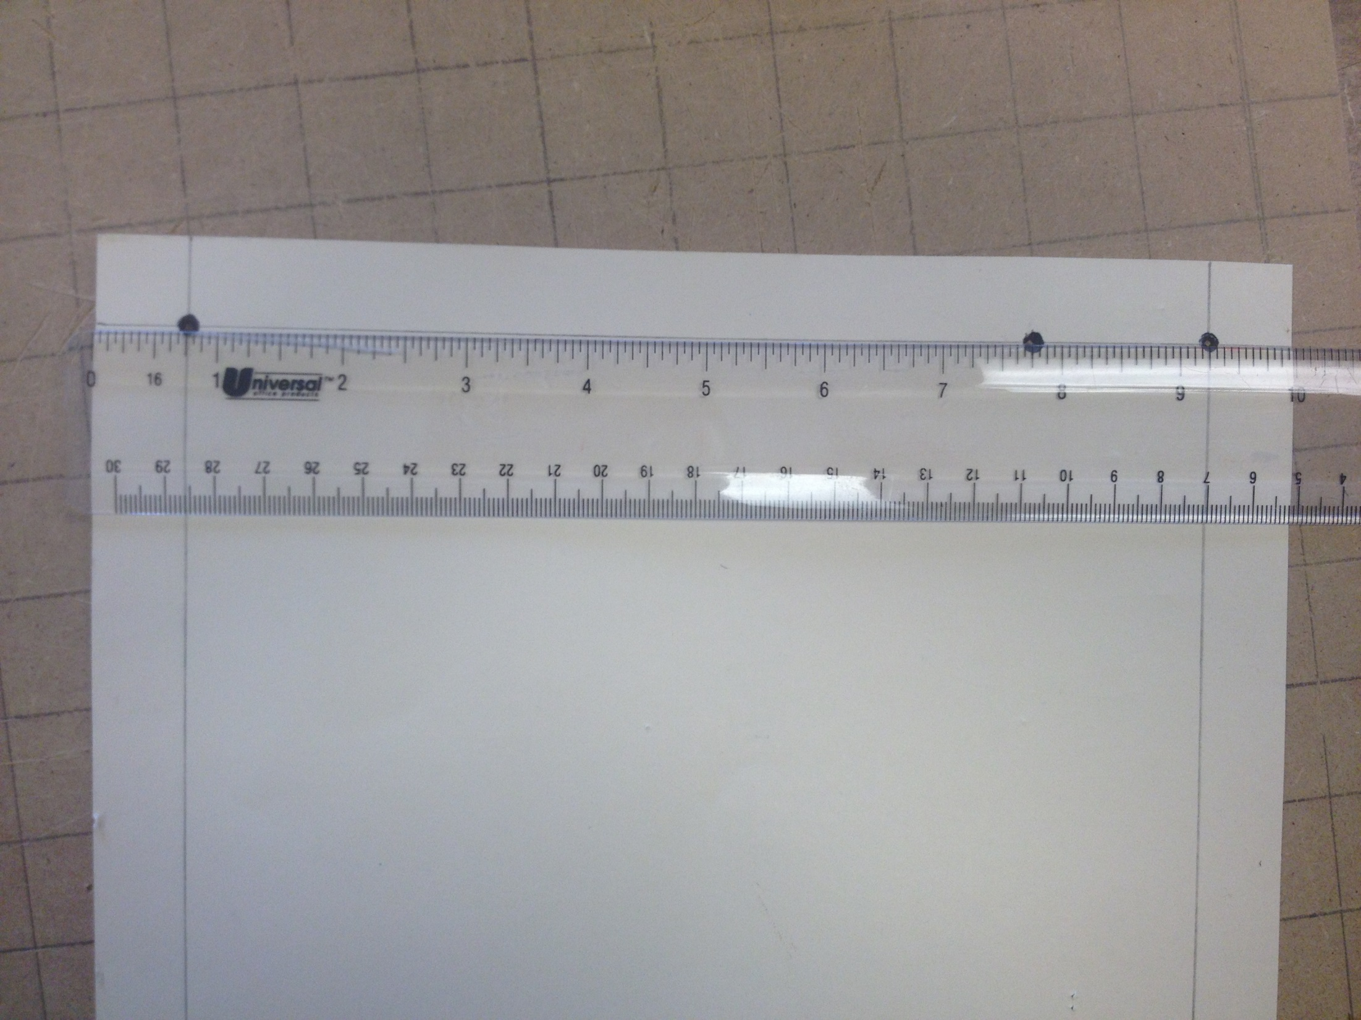

Slide 50
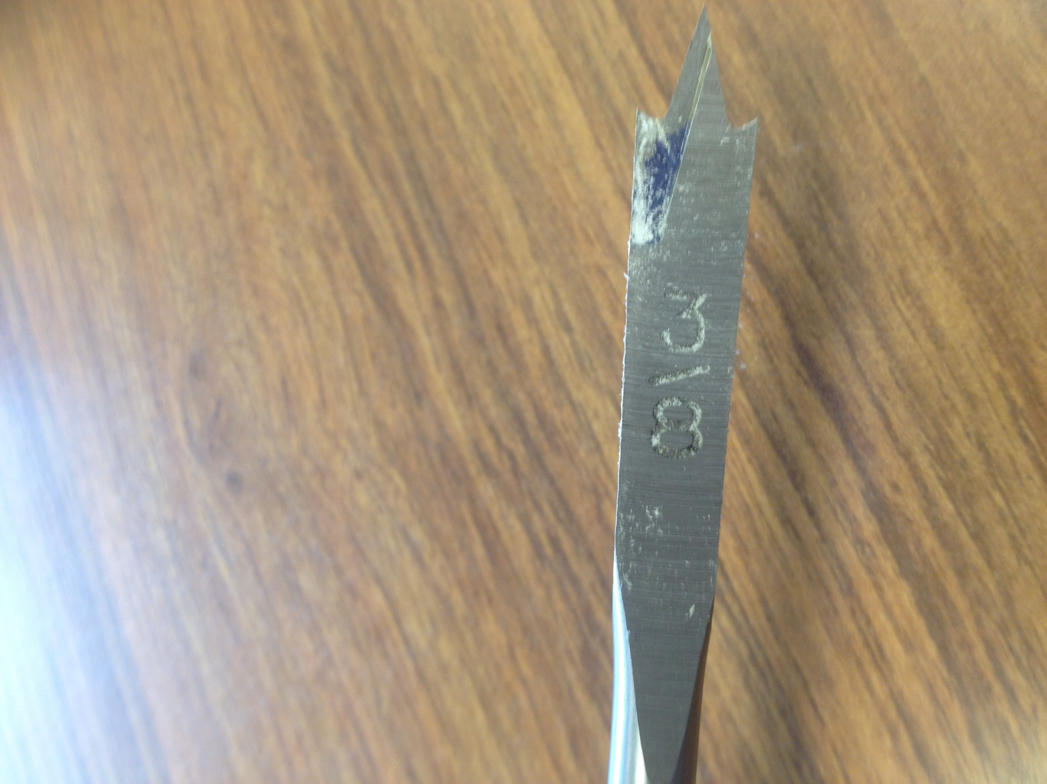

Slide 51
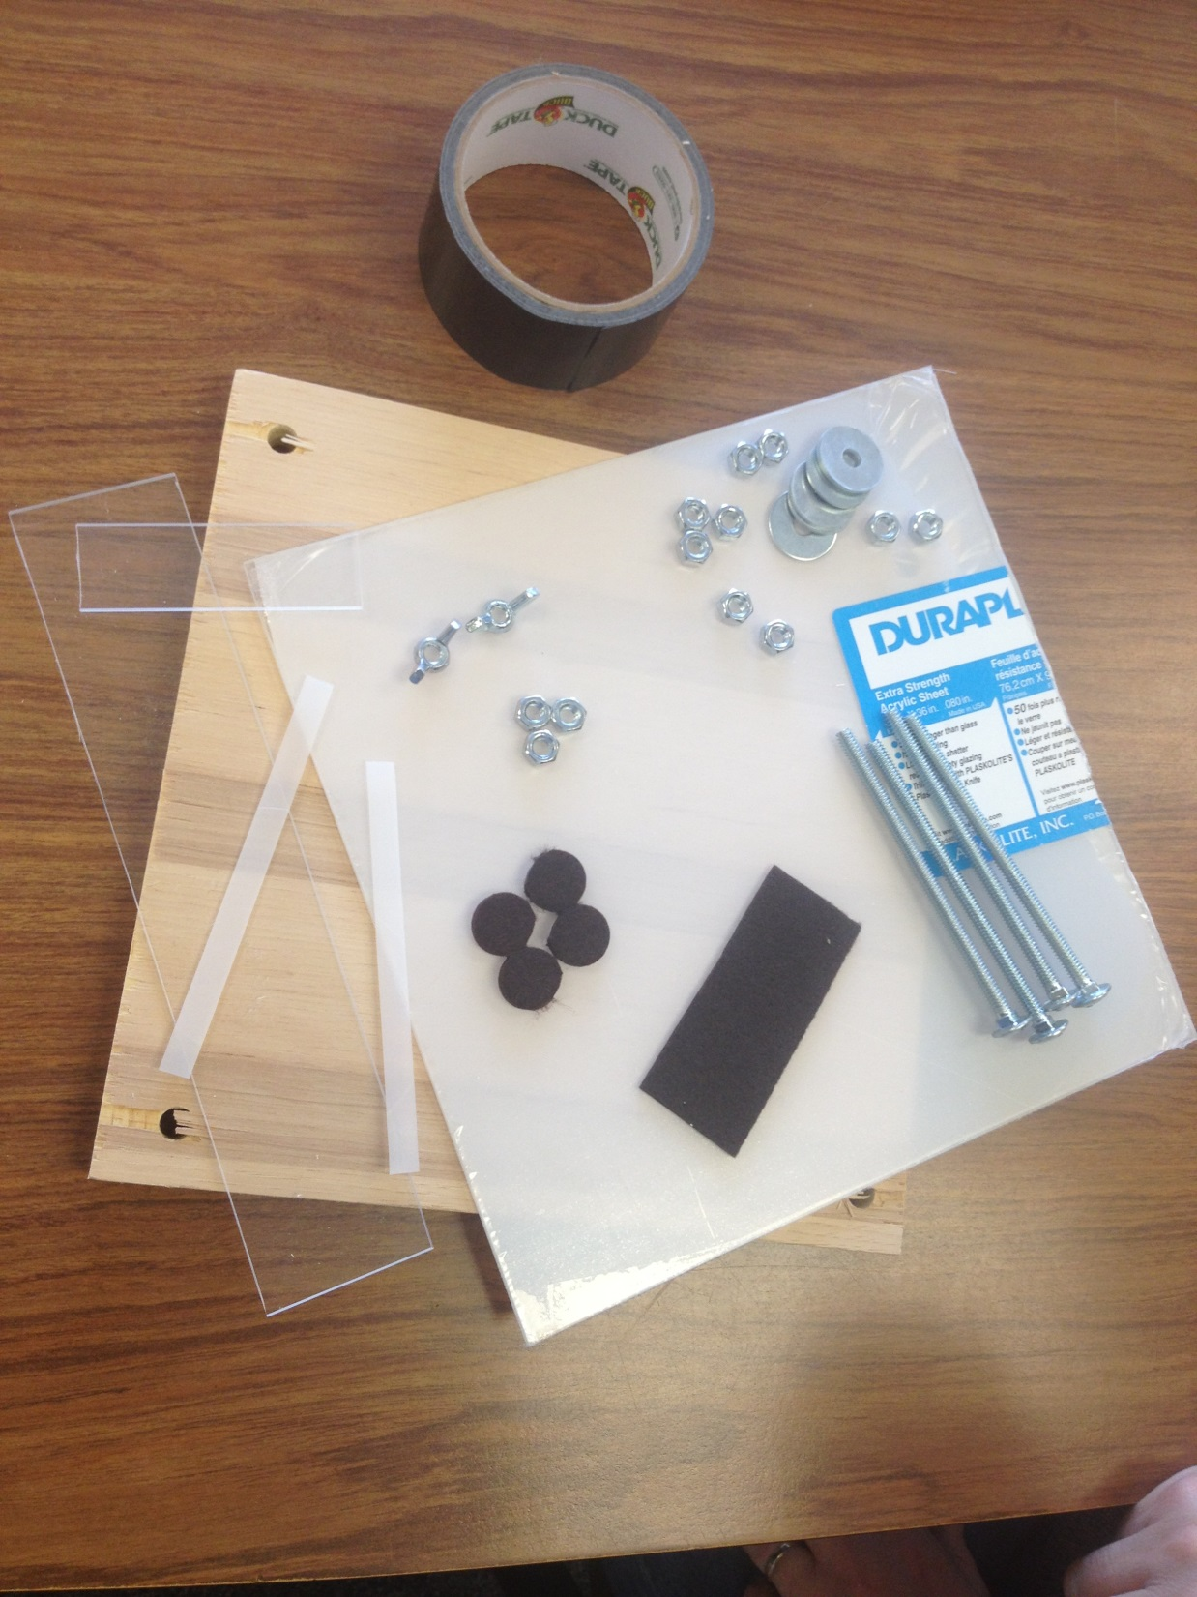

Slide 52
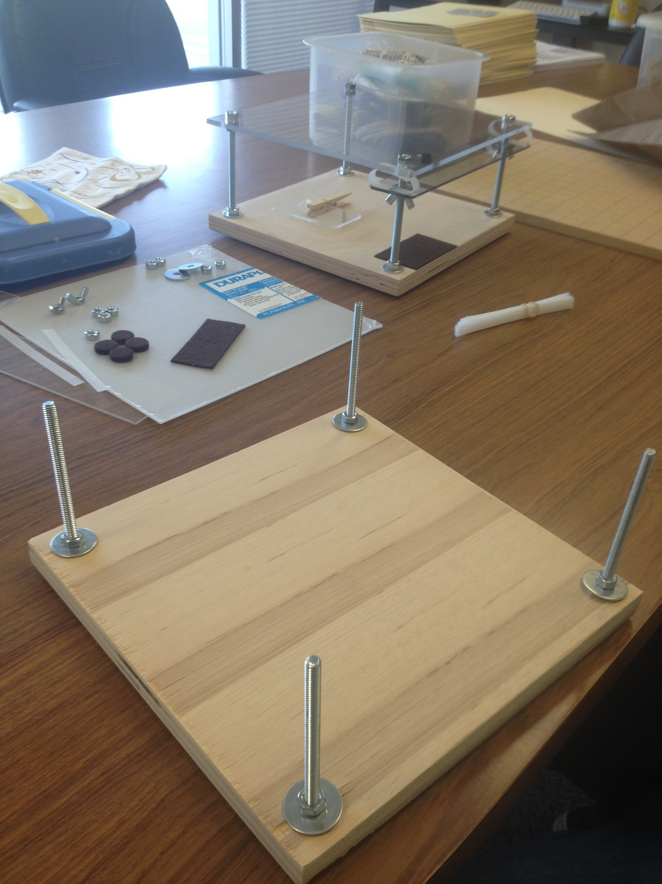

Slide 53
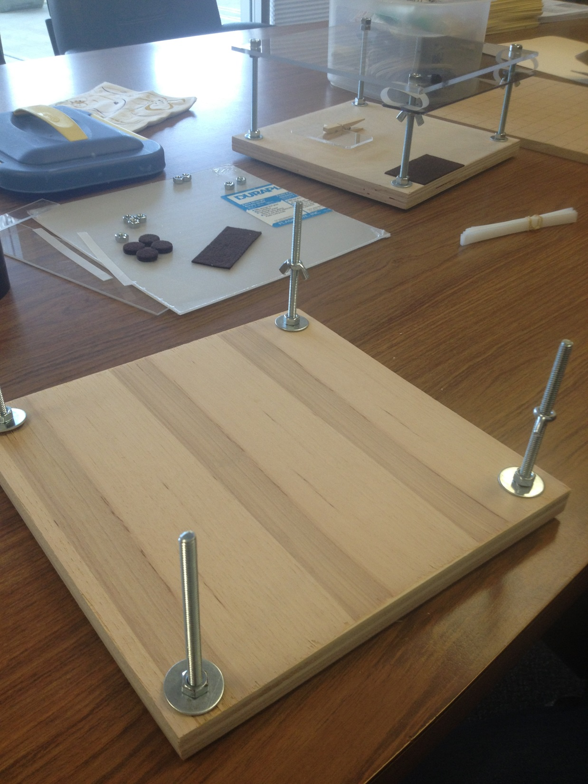

Slide 54
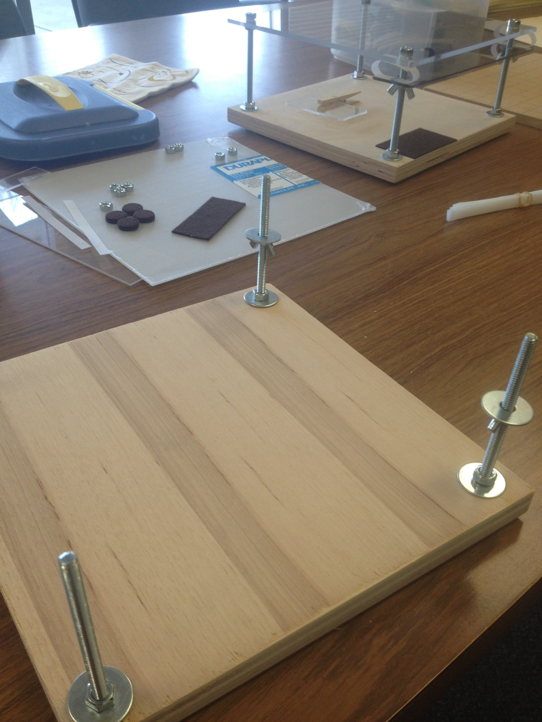

Slide 55
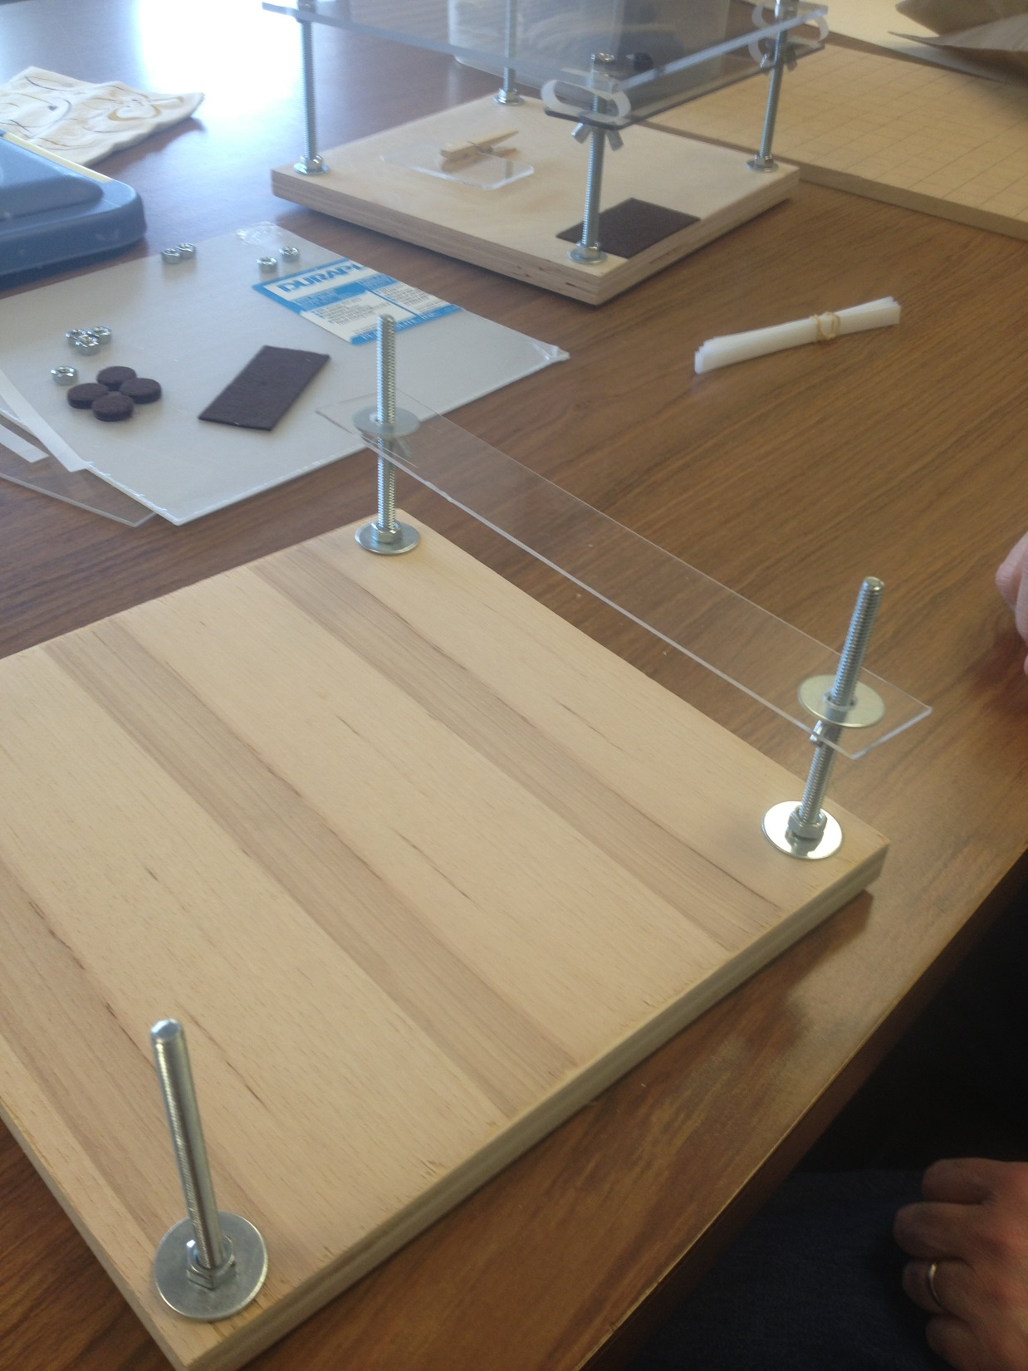

Slide 56
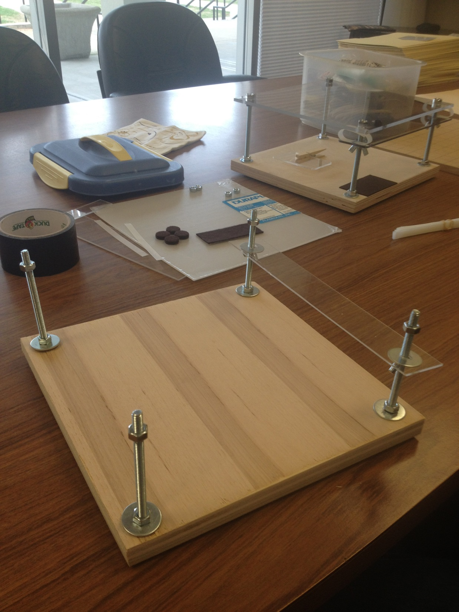

Slide 57
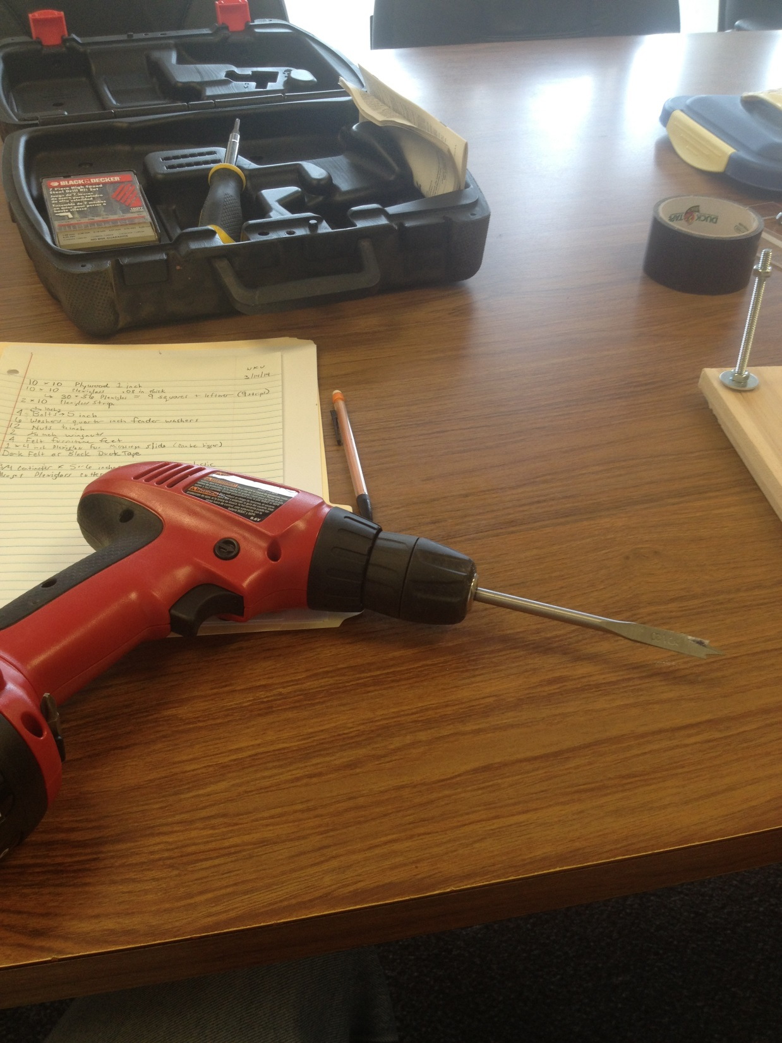

Slide 58
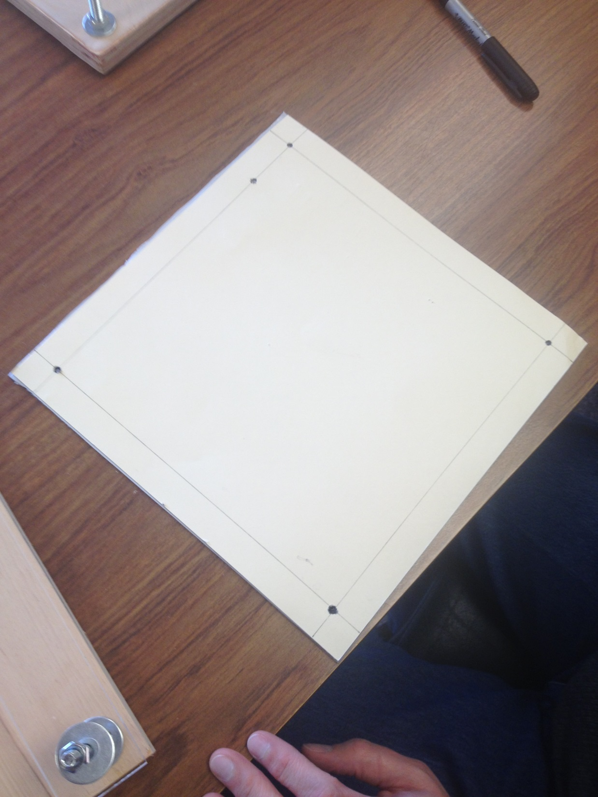

Slide 59
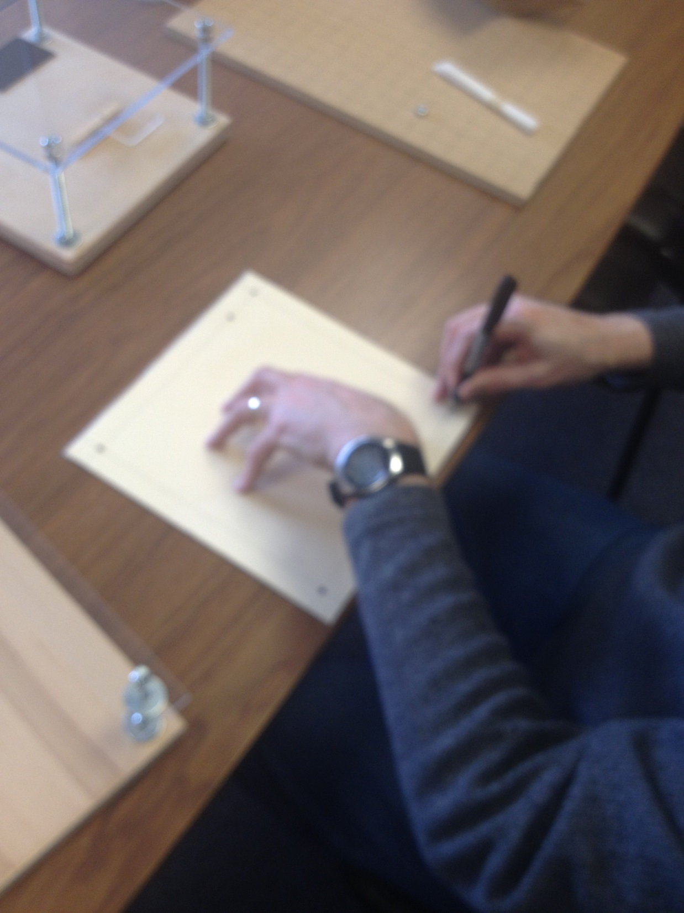

Slide 60
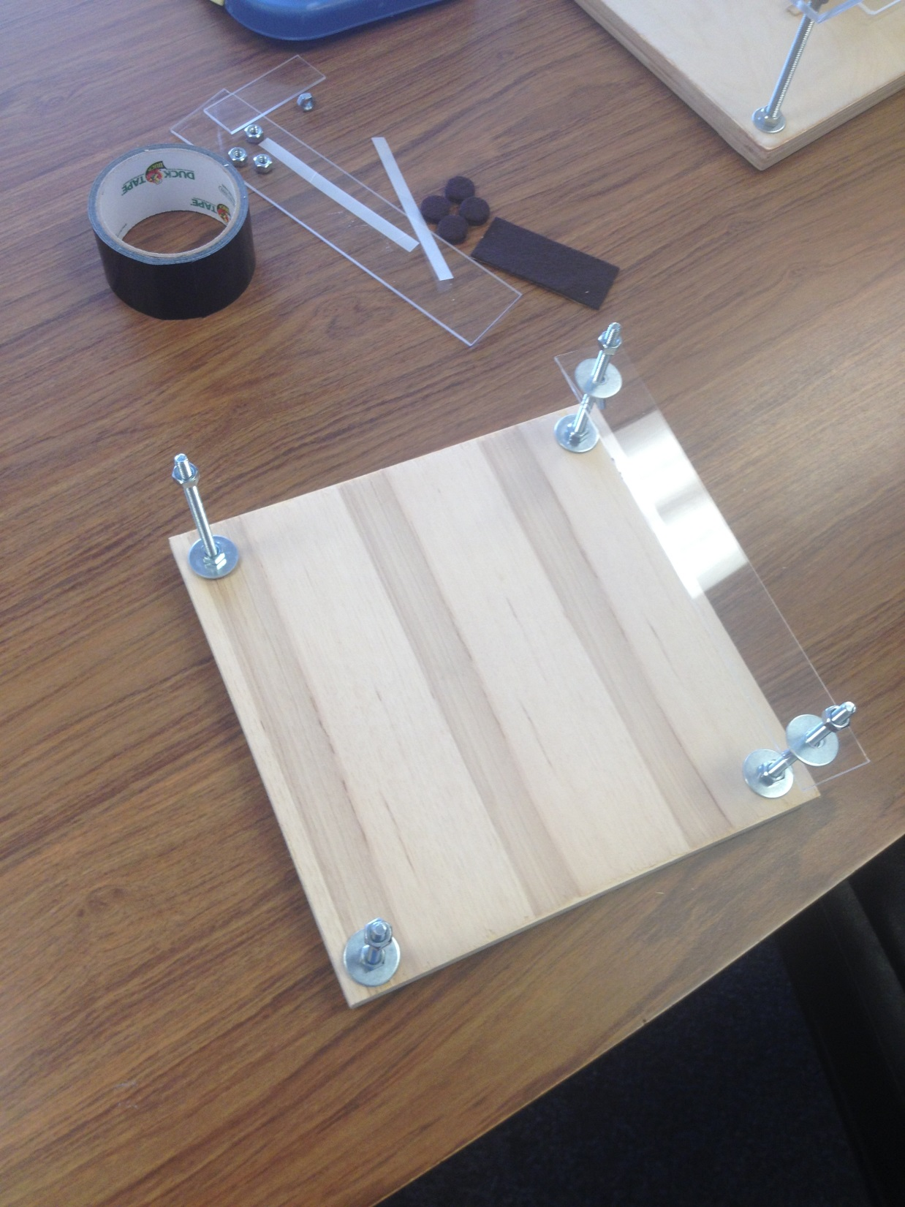

Slide 61
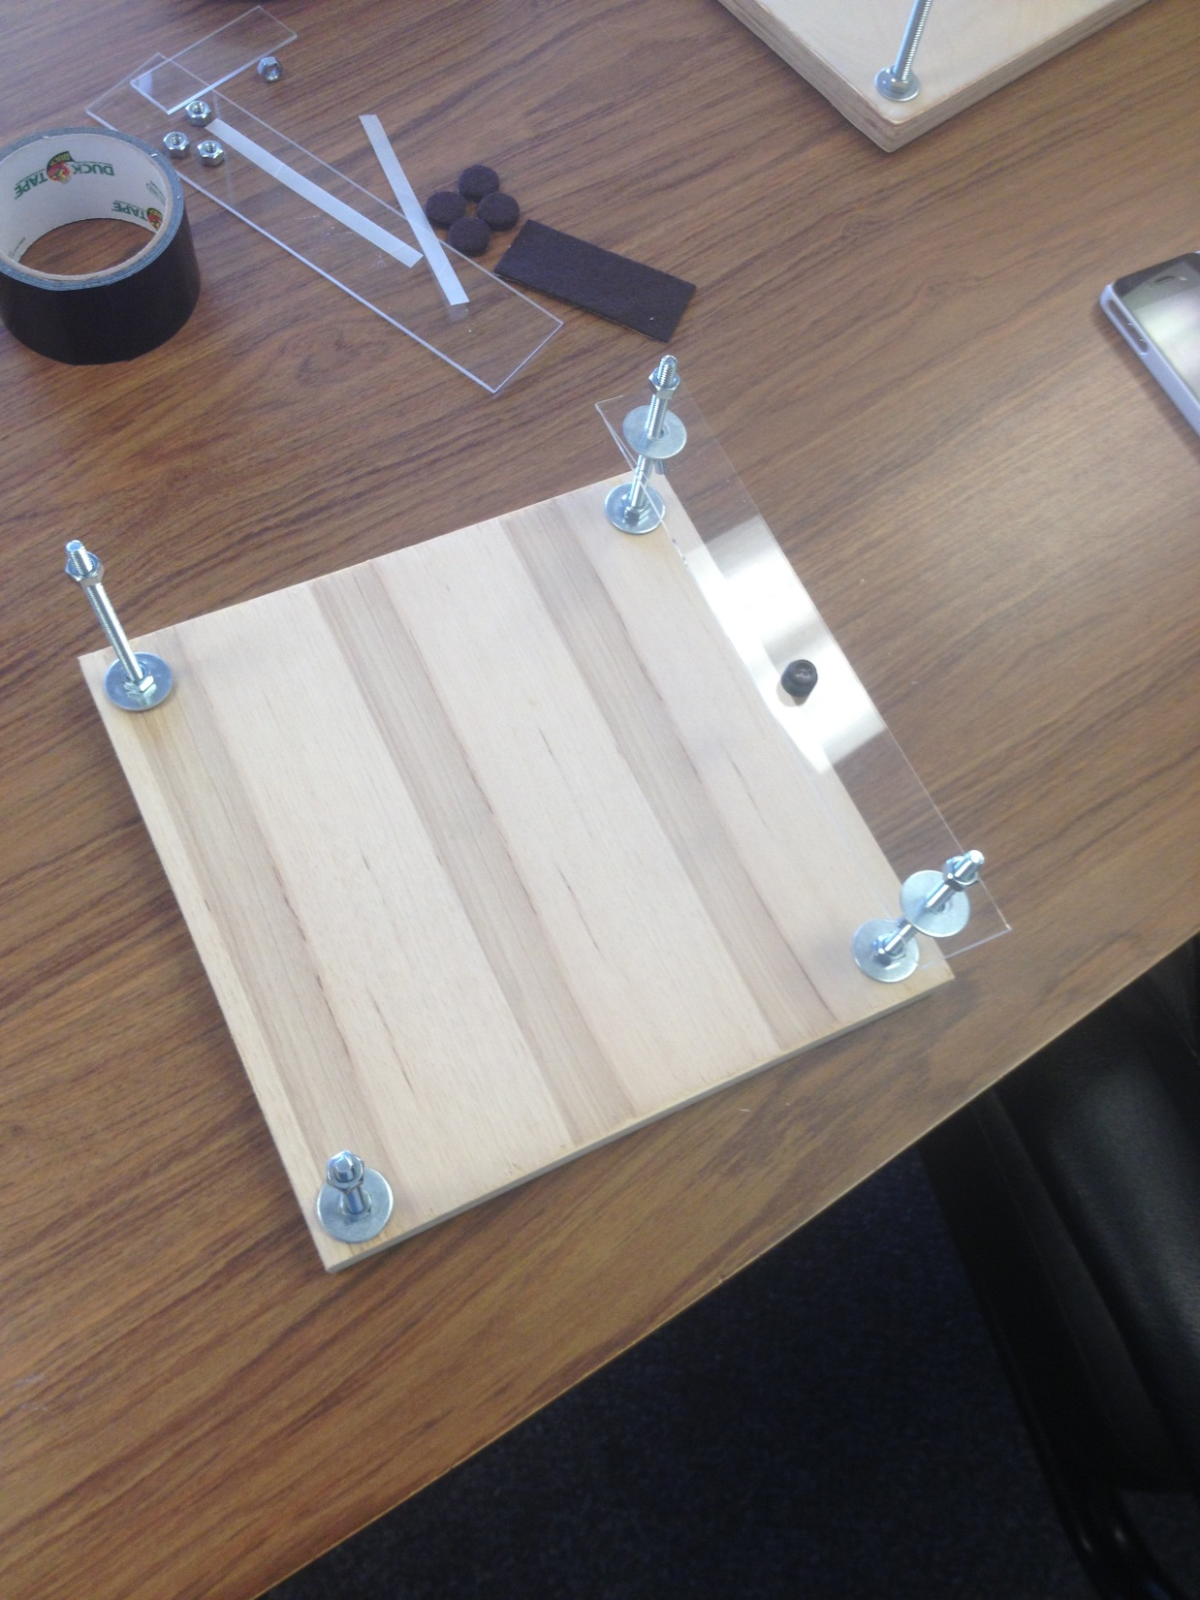

Slide 62
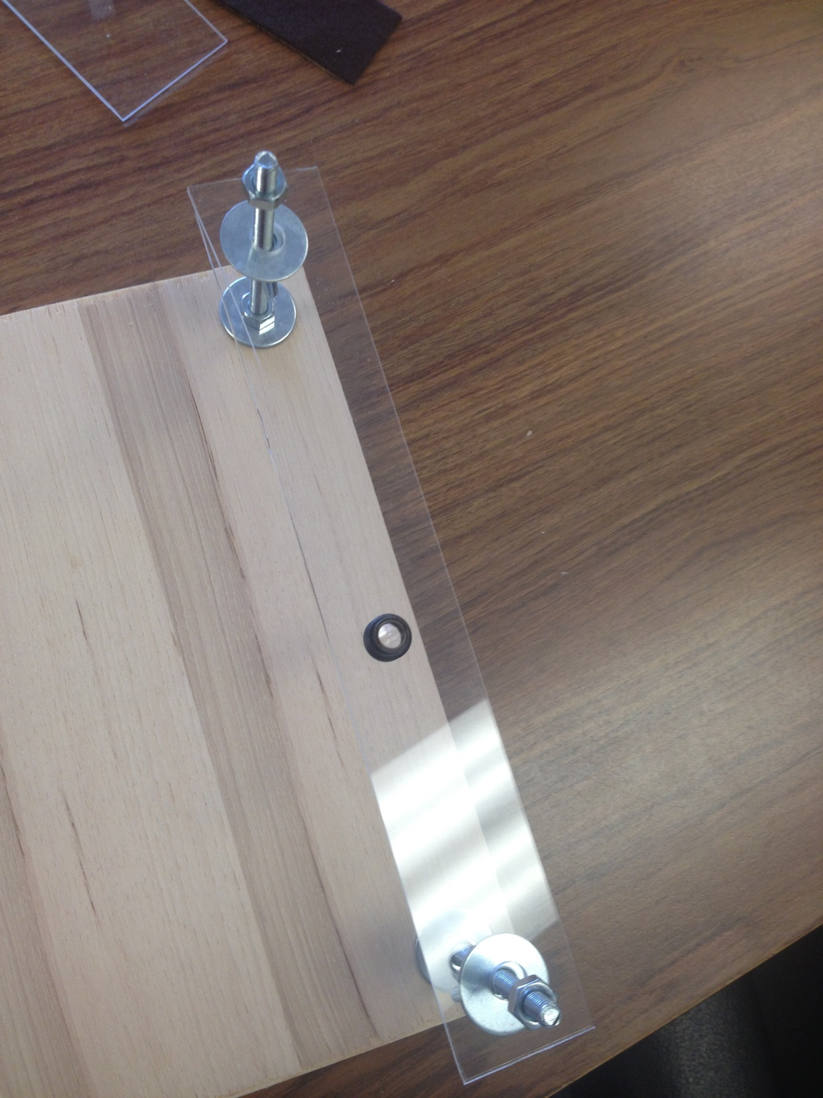

Slide 63
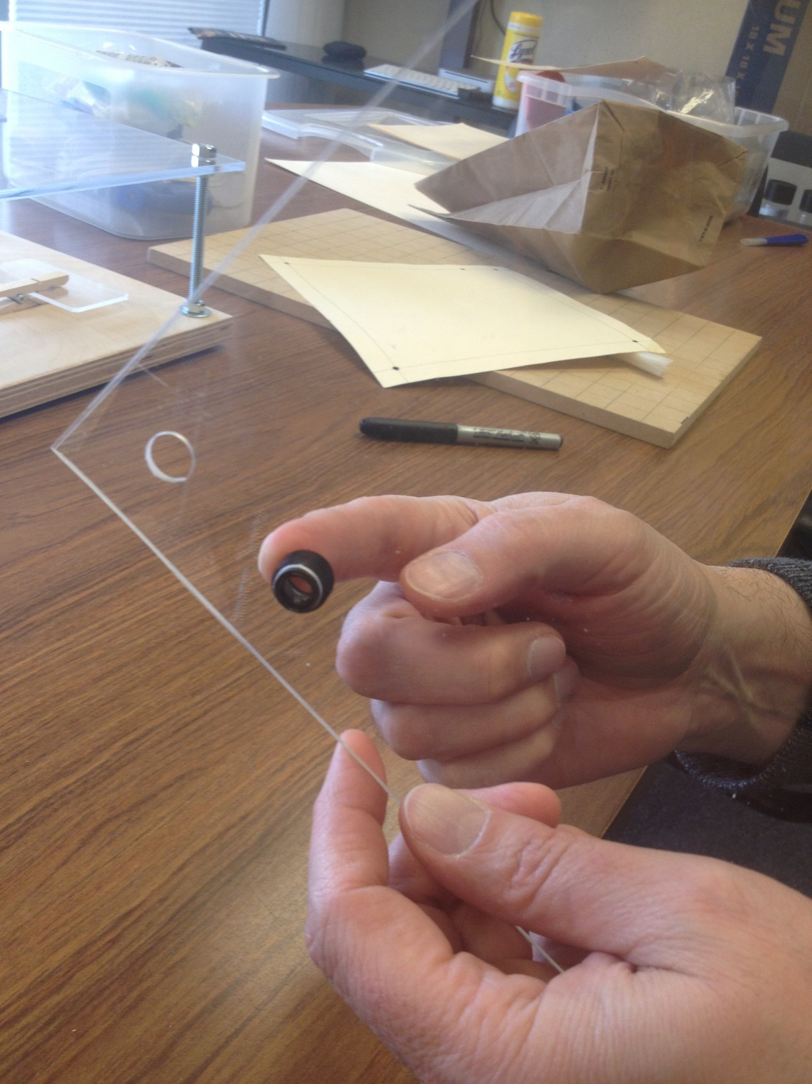

Slide 64
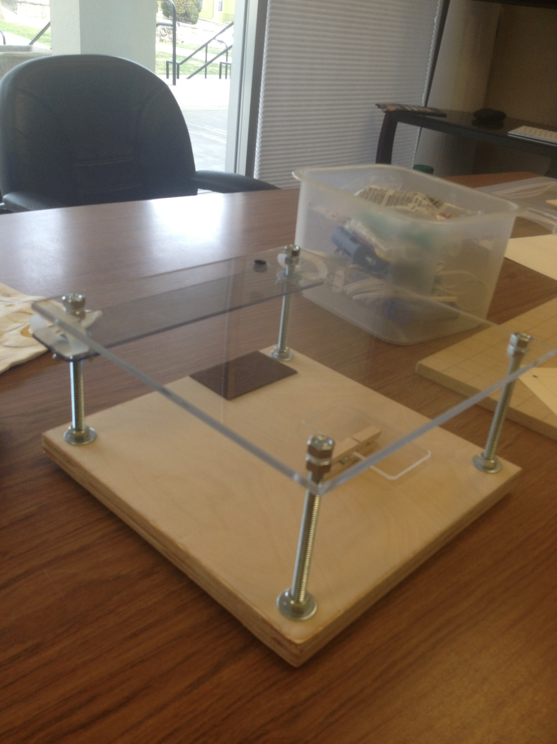

Slide 97
The Lens

Slide 98
The Lens
Here is a video that shows how to get the lens out of a laser pointer. Make sure the hole you cut in the plastic platform for the lens matches the size of the lens.
https://www.youtube.com/watch?v=Sb_xrEXIhHE
http://www.ebay.com/itm/10-Pack-of-AixiZ-standard-acrylic-lenses-for-12X30mm-laser-modules-and-cases-/381117572159?hash=item58bc60a43f

